Slide 2
Plan a, Plan b, & serendipity for life’s unpredictable journey
Presenter – Hon. Susan S. Barnes

Slide 3
LIFE’S UNPREDITABLE JOURNEY …
LIFE IS AN UNPREDICTABLE JOURNEY.
Each of us have hopes, hunches, paths of direction, routines for work, school, home, and so on … Yet, none of us truly knows what lies ahead in all aspects of our lives.
In one way, it is positively incredible and exhilarating that each day reveals itself with newness and possibilities.
Conversely, it is stressful to have the uncertainty of each new day.
To illustrate this point, think how your day went yesterday. Some things likely went as planned and expected, while other things did not.
To really illustrate this point, think back to when you were 20 years old, which may be a few years or many years ago, and ask yourself what you envisioned and where you expected your life to be at age 25, 40, and beyond.
How has that worked out so far?

Slide 4
On-Line Poll Question #1 …
QUESTION 1 – Aside from the impacts of COVID-19, I have experienced the following life event(s) in the last five (5) years: (please check all that apply)
Marriage of self or child
Birth of child or grandchild
Major career change or promotion
Divorce of self, child, or parent
Death of a loved one
Job loss or reduction
Returned to or graduated from formal education/training
Lifestyle change, such as children entered or went away to school, became empty-nester, and/or retired
Moved locally or relocated to new area
Serious or chronic health concern of self and/or loved one

Slide 5
Stuff happens … Who would have thought …
My bet is that the more years that have passed, since you were 20, the more your life has changed than earlier thought and envisioned.
STUFF HAPPENS.
Who would have thought that an unexpected occurrence, even a small one, veers into your path and your life’s journey adjusts or, worse yet, it derails.
If you have a Plan A, it needs a retread, despite the best laid plans
This is when Plan B, your alternative guidepost, springs into action.
Wait a minute --- WHOA! - you don’t have a Plan A or a Plan B ?!?

Slide 6
0n-Line Poll Question #2 …
QUESTION 2 - I have written a Plan A & have assembled data to map a Plan B, as needed.
(please check one)
Yes. I have a Plan A that is referred to regularly and can morph to Plan B, as needed.
Maybe. My Plan A has not seen the light of day for a long time.
No. I have thought about a Plan A and it is on my to-do list, after cleaning-out the junk drawer.
Not needed. Life is full of surprises, so I like to wing it.

Slide 7
Planning ahead and forward thinking avoids disasters and life going awry. Just ask these women who didn’t get it!

Slide 8
YIKES - THEY SHIPWRECKED & WERE STUCK ON AN UNINHABITATED ISLAND FOR YEARS.

Slide 9
Building plan a & plan b
Mapping your future

Slide 10
Know thyself … Take inventory …
Regardless, if you are developing or updating your Plan A, it is important to know yourself and what makes you tick. In essence, know thyself.
Take inventory of your personal and professional life goals
your passions and interests
your strengths and weaknesses
your education and training
your life experiences
your values

Slide 11
Where do you want to end up ... And the 4-legged chair …
Write your obituary, which will tell you where you want to go and end up. This exercise focuses and captures what matters most to you and how you want to be viewed and remembered.
Take your completed inventory and obituary areas and place them into one (1) of the four (4) areas – Family, Community, Work, and Faith.
To find life balance, all 4 areas need some inventory and/or obituary areas listed in
Family
Community
Work
Faith
If 1 or 2 areas are heavily weighted, ask yourself is it over-loaded for a short period of time or on-going. Life’s path and work is not the same every day and every year. Balance can have an ebb and flow. However, no area should be heavily-loaded for extended time.
Think of life balance and the 4 areas, as the 4-legged chair. When the areas of Family, Community, Work, and Faith are balanced, the chair is stable and does not wobble and crash.

Slide 12
Think big and bold … Visualize to make it real. ...
Along with balancing your areas, think big and bold.
Map each area – Family, Community, Work and Faith – with routes to achieve goals in those areas.
Include what incremental steps or actions are needed to meet a goal, regardless if it is short-term or long-term. Note the timeline to complete each incremental step or action as well as the timeframe to achieve an overall goal.
While it is tempting to have a long-range Plan A, stay with a mid-range 2-year to 5-year Plan, unless you are engaged in a long-term work project or education of many years to come. A shorter timeline is more manageable and more likely to stay on track and achievable.
Remember, you will be monitoring your Plan A on a regular basis. Commit to your Plan A by writing it in a format that is easy to use and modify. For example, an Excel spreadsheet or a Word document work well.
Visualize the steps and goals to make it real and take on life, instead of just listed on the Plan A document.
It is a personal choice how much, if any of the actual Plan A, that you want to share with others. Also, bear in mind, that your Plan A will change over time, as even the best laid plans change.

Slide 13
On-Line Poll Question #3 …
QUESTION 3 – I use my sixth sense/antenna as well as my personal and professional network to advance my goals and move my life forward. (please check one)
Yes. My 6th sense antenna is on high-alert often and the individuals in my network are in sync with my life plan in those area(s) that he/she can assist me.
Sometimes. When my antenna has radio frequency interference and individuals in my network are not available, I experience loss of signals for help.
No. I do not believe in intuition and my contacts list vanished, when my cell phone was run over.

Slide 14
Eyes and ears open … Antenna on high frequency provide for serendipity …
Now that you have your Plan A in gear, keep your EYES and EARS OPEN. You never know when you may come across a new opportunity, person, or information that can propel you to reach your goals or the need to revise them. TRUE SERENDIPITY!
Keep your ANTENNA ON HIGH FREQUENCY. Again, you never know when you may come across a new opportunity, person, or information can propel you to reach your goals or the need to revise them. SERENDIPITY IN ACTION!
As needed, be prepared and willing to fine-tune, adjust, and re-calibrate your Plan A. Things do change, despite the best laid plans. Your Plan A will morph into your Plan B, which, in essence, becomes your new, improved Plan A.
The more than you plan and work with a Plan A - the more likely that you will achieve what you want.
Whether it is at the end of the day or the end of life, each of us want to be able to say to ourselves that we did all that we could to live and have our best lives!

Slide 15
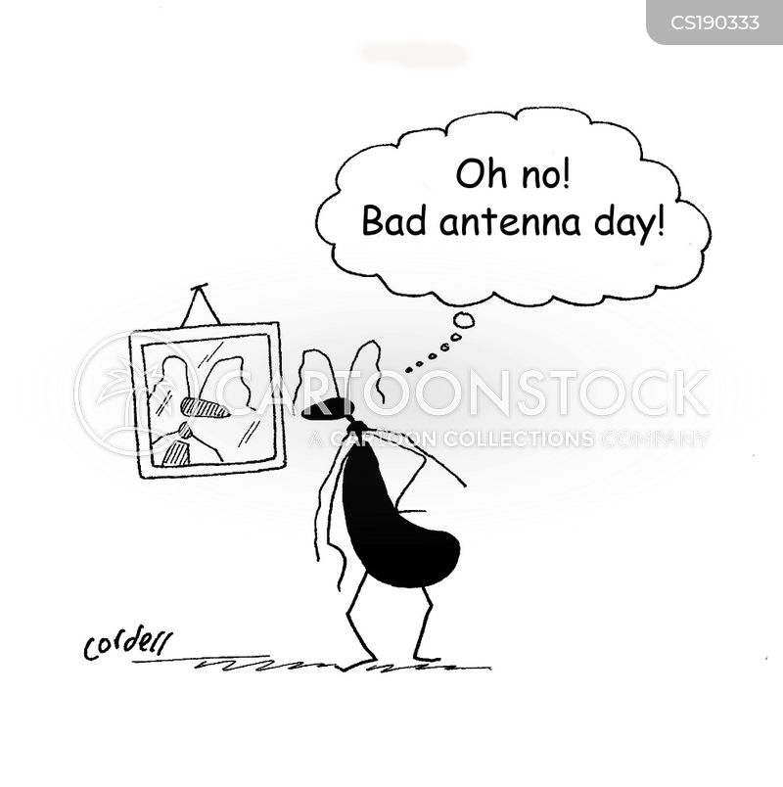
SIXTH SENSE WITH ANTENNA ON HIGH FREQUENCY

Slide 16
QUESTIONS PLEASE ?!?

Slide 17
Thank you
Thank you so much for your participation today.
If you have a question or comment, please feel free to email
Susan Barnes at
sbarnes@lgcmanagement.com
sbarnes@lgcmanassbgement.com
sbarnes@lgcmanagement.com

