Slide 1
Alumni Club Leaders Forum
September 16, 2026

Slide 2
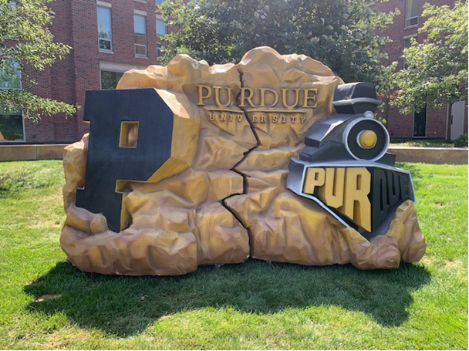
Purdue Alumni Clubs Forum
Reminders & Instructions
This forum is being recorded to share along with slides and chat content
Participants will be muted
Questions should be submitted using the chat function

Slide 3
Purdue Alumni Clubs Forum
Agenda
University Updates
Purdue for Life Updates
Silent Auctions and Crowdfunding – Presenter: Alyssa Collevechio, BBC
Big Ten Blood Drive - Presenter: Ali Walsh, Volunteerism - Engagement
Post ACES – Group Discussion Summary and Insight – Discussion on Resources and Recommendations
Alumni Club Leaders Network
Scholarship Updates
Operational Updates

Slide 4
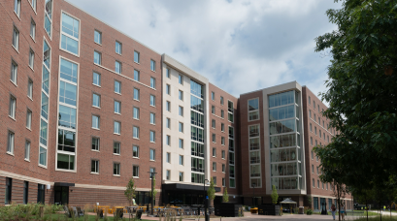
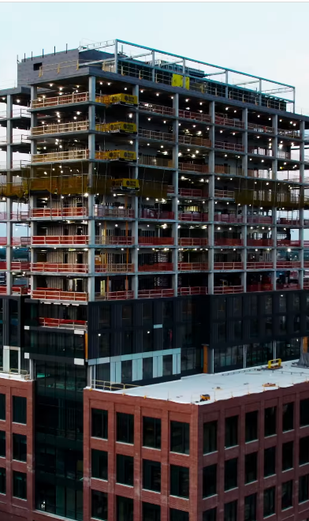
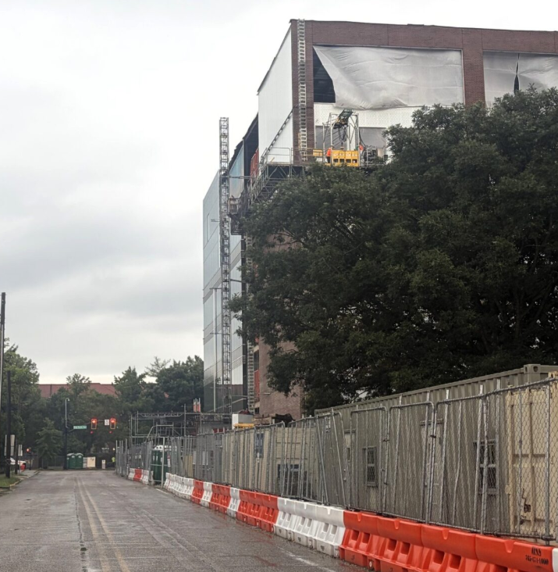
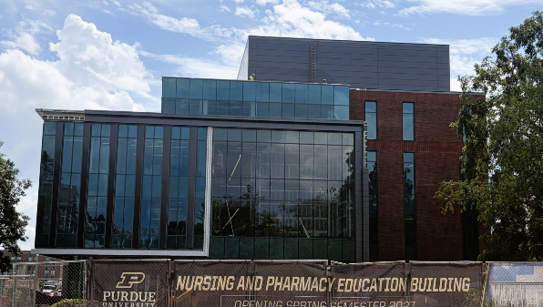
Purdue University Updates – Construction Update
Indianapolis
West
Lafayette
896 Beds
Construction continues on Purdue's Academic Success Building in Indianapolis, which will provide additional classrooms, laboratories, and student support spaces as Purdue expands its Indianapolis presence
South Hall
Mitch Daniels School of Business
The Darr-Chaney Hall of Pharmacy and Dauch Hall of Nursing
Notes:
Impact: Reinforces Purdue’s strength in career readiness and workforce alignment, enhancing its global competitiveness and reputation.

Slide 5

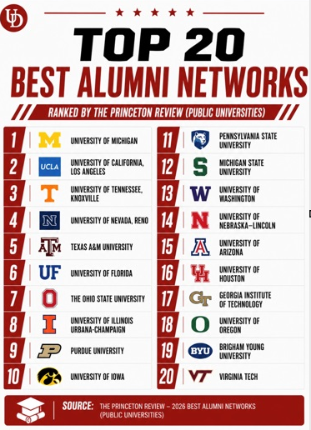

Purdue for Life Updates
🎥 Boiler Room: Purdue Football All-Access is a new 3-part docuseries produced by Purdue for Life and Purdue Football. Provides an exclusive behind-the-scenes look at Purdue Football, including student-athletes, coaches, and staff.
🤝 Highlights the power of collaboration across Purdue while strengthening connections with alumni, fans, and friends.
▶️ Watch on the Purdue Athletics YouTube channel: https://www.youtube.com/watch?v=ZAh42pB1df8
🚂 A great way to experience the stories, preparation, and passion behind the Boilermaker football program.
Source:
Notes:
Impact: Reinforces Purdue’s strength in career readiness and workforce alignment, enhancing its global competitiveness and reputation.

Slide 6

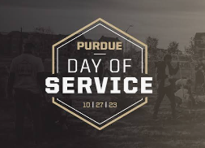

Purdue for Life Updates
November 5–7
Homecoming Parade
FRIDAY, NOVEMBER 6
6:30–8PM
Boilermaker Boulevard
SATURDAY, NOVEMBER 7
TIME TBA
Fall 2026 Purdue Day of Service
October 30th
Beautify campus Friday morning from 9 – Noon
Registration open at Purdue Serves.
Session 1 – July 15-16
Session 2 – July 22-23

Slide 7

Dauch Football Saturdays are Back!
Join us for games, refreshments, and giveaways before heading over to Ross-Ade Stadium
Please Help us Promote – Share on Your Socials!
Sept. 12th (Wake Forest) – Time: Noon
Sept 26th (Notre Dame) – Time: Noon
  Alumni Clubs are hosting, stop by Dauch to see us!
Oct. 10th (Minnesota) – Time: TBD
Nov. 21st (Wisconsin) – Time: TBD
To register, visit:
https://events.blackthorn.io/3ktO526/4a9GNs7tm9
More Info:
https://events.purdue.edu/event/game-days-at-dauch
Notes:
12:00-1:00 PM: Lunch, Recognition, Alumni Club Awards, Group Photo – Props
1:00-1:30 PM: Training
1:30-2:30 PM: Goals Discussion and Best Practice Sharing
2:30-3:00 PM: Debrief

Slide 8
Broad-based campaigns digital fundraising opportunities
Alyssa Crawford, Campaign Strategy Advisor
Annual.giving@purdueforlife.org

Slide 9
Crowdfunding
What is it?
Purdue Crowdfunding is a peer-to-peer fundraising campaign that allows groups to raise money for meaningful projects that impact Purdue within a specific and controlled timeframe (28 days).
Successful campaign goals range from $2,000 - $5,000.
Low-donation amounts, high donor count.
Custom project page promoted on Purdue Crowdfunding site.
Personal outreach efforts.
How would philanthropic dollars help your alumni club priorities?
PFLF hosts two crowdfunding windows per year:
  Fall: October 5 – November 2
  Spring: February 16 – March 16
  Purdue University Crowdfunding
To apply: https://connect.purdue.edu/portal/s/crowdfunding-request

Slide 10
Crowdfunding
What makes a project a good fit?
Cause-based
Anchored gifts
  Ex: a $50 gift = 1 travel opportunity for a student
Potential project ideas:
  Scholarship
  Student impact // student experience
Important Notes:
  Projects to support scholarships/PAA funds held within PFLF only
  Fundraising for event expenses is not allowable
  Determination of what the crowdfunding is supporting can't be changed once the project is live

Slide 11
Crowdfunding
Application + Project Request
Complete + submit initial crowdfunding project request form: https://connect.purdue.edu/portal/s/crowdfunding-request
  Questions: Please connect with Alumni Clubs Team alumniclubs@purdueforlife.org
Broad-Based Campaigns (BBC) will review project request and confirm internal approvals
Once internal approvals are confirmed, clubs will be contacted by a BBC team member to submit the content request form
Clubs submit content request form
  The content form is where you will provide custom copy for the project page, case for support, photos, video, etc.
BBC will build custom project page and share with club for approval.
Page goes live on October 5!

Slide 12
Crowdfunding
Completing the Crowdfunding Form
Timeline
To apply:
https://connect.purdue.edu/portal/s/crowdfunding-request
For Unit*: Enter Purdue Alumni Association*
For University account/designation for funds to be deposited – Please work – Please reach out to alumniclubs@purdueforlife.org secure the account/designation number
September 22 – project request application due
September 28 – content request form due
Ongoing – project page approvals
October 5 – all projects launch
November 2 – all projects close
* A Club list is currently not available

Slide 13
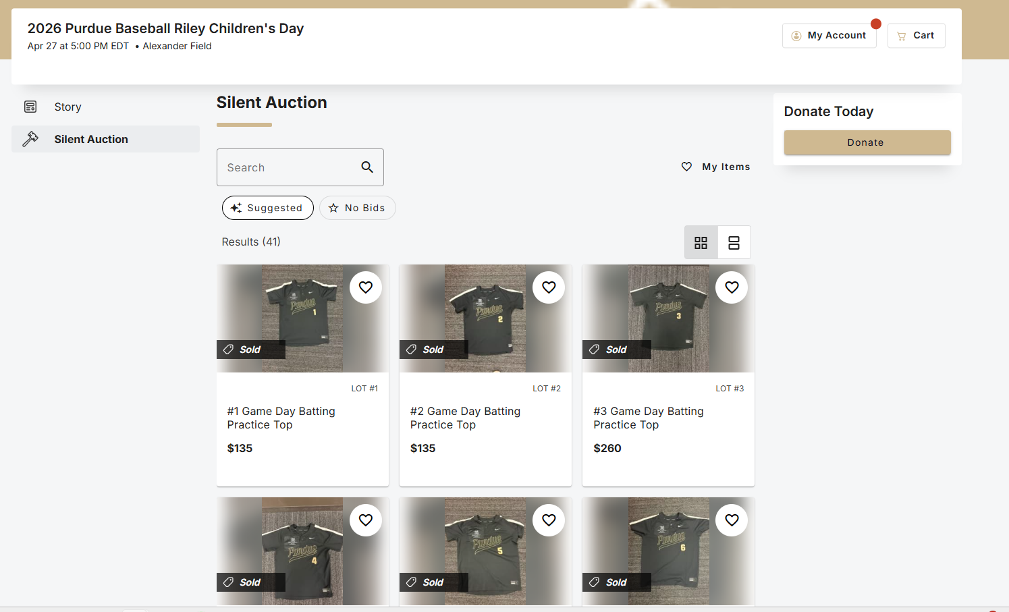
Online Silent Auction
What is it?
Take your event to the next level by hosting an online silent auction with mobile bidding.
Auctions to support scholarships/PAA funds held within PFLF only.
Can be hosted with or without a physical event.
One-time donation opportunity.
Important notes:
  Determination of what the auction is supporting can’t be changed after the auction goes live.
  Picking and choosing who has a winning bid is determined by the software and not the club.
  Auction close/reconciliation and funds availability in gift account expectations.
To apply: https://connect.purdue.edu/s/bidpal-request
  Under School*: Select Purdue Alumni Association
  Under Designation: Work with the Alumni Clubs Team to get the designation account number
* A Club list is currently not available

Slide 14
Online Silent Auction
Application + Project Request
Complete + submit project request form: https://connect.purdue.edu/s/bidpal-request Questions: Please connect with Alumni Clubs Team alumniclubs@purdueforlife.org
Broad-Based Campaigns (BBC) will review project request and confirm internal approvals
Once internal approvals are confirmed, BBC team member will build custom project page shell
Clubs will be contacted by a BBC team member alerting of project approval and will provide helpful resource links for how to navigate the platform, add auction items, customize project page and more!
Clubs will receive notification from OneCause with registration information for the platform (this is how you will access your project)
Clubs will gain access to project page to upload silent auction packages and descriptions, photos, custom copy, case for support, etc.
To apply: https://connect.purdue.edu/s/bidpal-request
Notes:
To apply: https://connect.purdue.edu/s/bidpal-request

Slide 15
Questions?
Email our Annual Giving inbox: annual.giving@purdueforlife.org

Slide 16
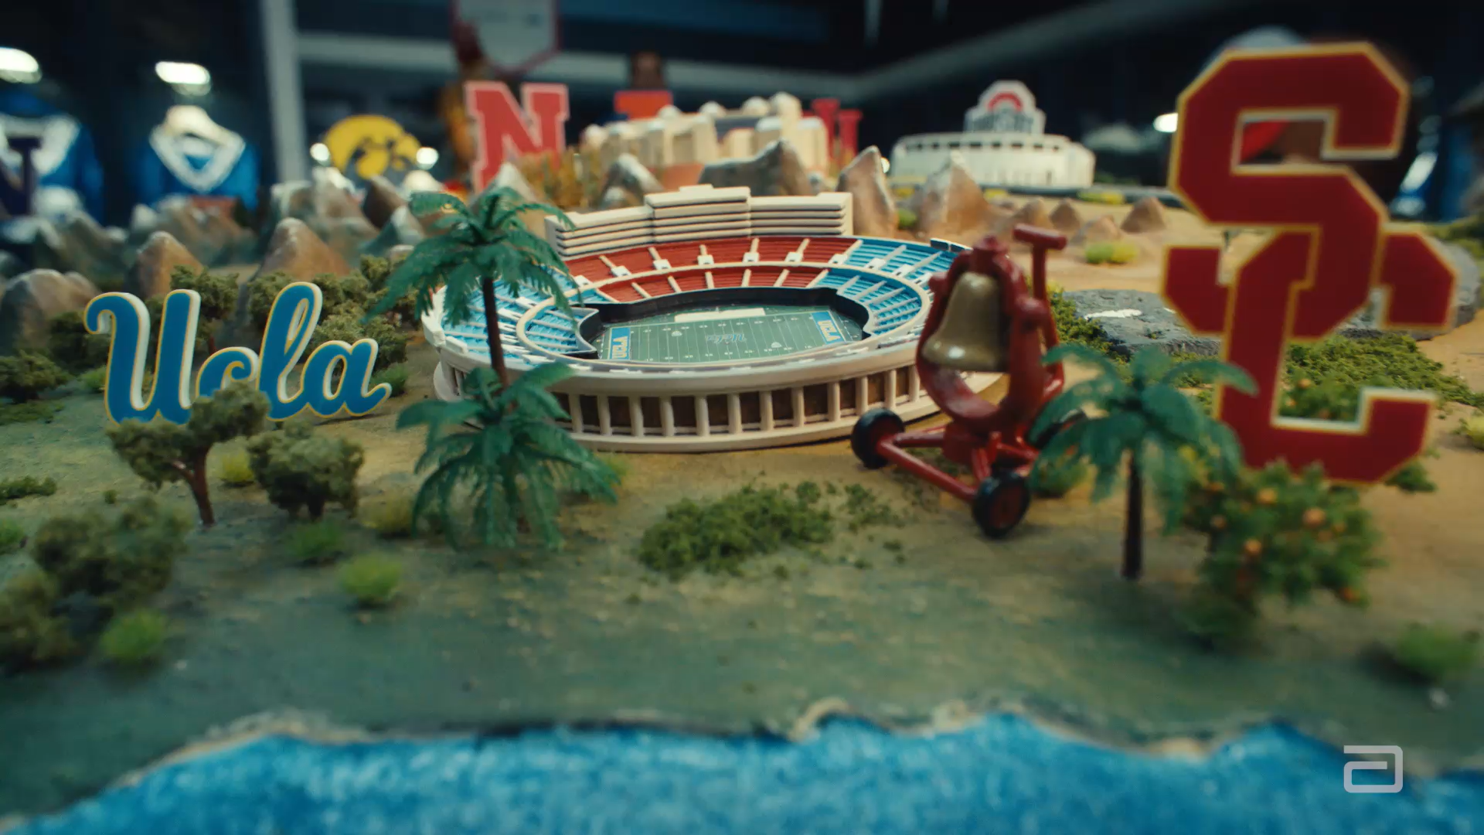

Big Ten Blood Drive
AUGUST 25TH – DECEMBER 5TH
Presenter: Ali Walsh

Slide 17
ABOUT THE COMPETITION:
Purdue is competing against all other Big Ten universities
The university with the most recorded blood donations will receive a $1 million award to support student or community health initiatives
Abbott will donate $1 per donor up to $10,000 to Purdue + send a Purdue t-shirt to donors
The WHY:
Blood donations support patients facing emergencies, surgeries, cancer treatments, chronic illnesses, and other medical needs. The U.S. blood supply is currently at a critical level.
One blood donation can help save up to three lives.

Slide 18
HOW TO PARTICIPATE:
Donate at an eligible blood center or blood drive anywhere in the world
Record the donation through Abbott’s competition website
Select Purdue University so the donation counts toward Purdue’s total
Consider hosting a drive in your community
Share about the competition with fellow Boilers, friends, and family!
Visit https://bigten.org/abbott/purdue/
OR
Text GIVEBLOOD to 222688 (ABBOTT).

Slide 19
HOW CLUBS CAN HELP:
Share campaign posts on social media (we will provide a toolkit ASAP!)
Include the campaign in newsletters and emails
Encourage members, family, and friends to donate.
Challenge another Purdue alumni club to a competition!
Recognize local donors on social media
Host a blood drive in your community
How to host a blood drive –
Connect with a local blood center representative in your community
Identify potential dates and locations within the competition window
Promote the drive to area alumni via email/social media campaign
During the drive: ensure donors know how to register their donations for Purdue
Note: If someone attempts to donate and is turned away for any reason, they may still record their donation for the competition.

Slide 20
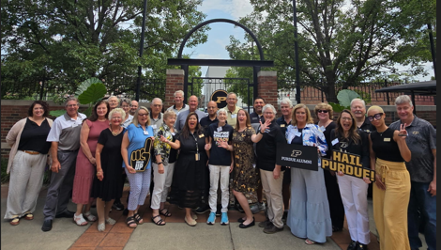
ACES Group Discussion:
Summary and Insights

Slide 21


Current State: Insights from Club Leaders:
Programming & Events
Membership & Alumni Engagement
Clubs are looking for new and diversified event offerings
Interest exists in reaching underserved geographic areas and hosting events where alumni live, not solely where board members reside.
Event timing matters. Clubs should avoid conflicts with major local activities such as church events, sporting events, and community festivals.
Clubs are exploring partnerships with other Big Ten alumni groups and local Purdue-affiliated organizations.
Leaders expressed interest in identifying Purdue-owned businesses for partnerships and event opportunities.
Clubs want more effective ways to understand member interests through surveys and feedback.
Building personal relationships and creating welcoming environments remains critical.
Alumni often need opportunities to engage before considering volunteer or leadership roles.
Board engagement events can help reduce intimidation and strengthen connections.

Slide 22



Current State: Insights and Opportunities
Young Alumni Engagement
Communications & Marketing
Fundraising & Financial Sustainability
Young alumni want authentic connections rather than recruitment-focused interactions.
They are highly protective of their time and expect clear value from participation.
Small, specific volunteer opportunities are more appealing than large commitments.
Clubs should focus on listening, flexibility, and understanding life-stage challenges.
Clubs continue to experience email fatigue and unsubscribe challenges.
Questions remain about the most effective mix of social media platforms.
Leaders are interested in storytelling resources, social media guidance, and communication templates.
Clubs want greater visibility and effectiveness from their websites and social media channels
Clubs are interested in sponsorship opportunities with Purdue-affiliated businesses.
Leaders discussed fundraising events, restaurant partnerships, scholarship-focused ticketing, and donor engagement strategies.
There is interest in identifying business owners within club communities as potential supporters.

Slide 23
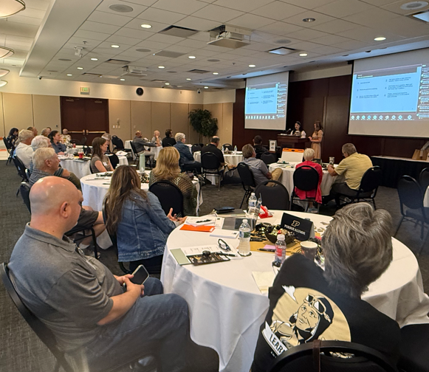
What is Working: Best Practices Shared
Programming & Events
Membership & Alumni Engagement
Communications
Board meet-and-greet events that allow members to interact informally with leaders.
Surveying alumni to understand interests and volunteer preferences.
Recruiting volunteers with clear expectations and defined responsibilities.
Personally connecting with prospective leaders before asking them to serve.
Regular and consistent social media posting.
Using scholarship recipient and donor stories to demonstrate impact.
Leveraging club email accounts as consistent organizational contact points.
Movie theater watch party that sold out and became an annual tradition.
Fish Fry events and community partnerships.
Trivia Nights.
Wine Tours.
Euchre and Game Nights.
Sunset Bat Cruise hosted by the Purdue Austin Club.
Big Ten Cornhole competitions.
Cross-organizational events with other alumni groups.

Slide 24
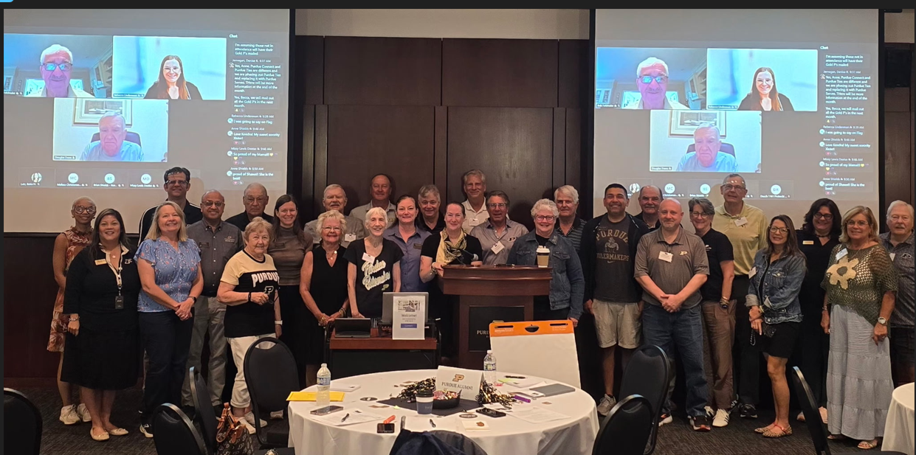
What is Challenging
Data & Member Information
Membership Growth
Volunteer Capacity
Difficulty maintaining accurate alumni contact information.
Members relocate without updating records.
Invalid or outdated email addresses limit outreach efforts.
Reaching alumni outside traditional event locations.
Converting casual attendees into active volunteers and leaders.
Engaging younger alumni who may have different expectations and interests.
Recruiting and retaining board members.
Identifying future leaders.
Avoiding volunteer burnout.
Communications
Fundraising & Sponsorship
Email saturation from multiple Purdue sources.
Determining the most effective social media channels.
Managing multiple platforms with limited volunteer capacity.
Identifying Purdue-affiliated businesses.
Building sponsor pipelines.
Expanding scholarship fundraising efforts

Slide 25
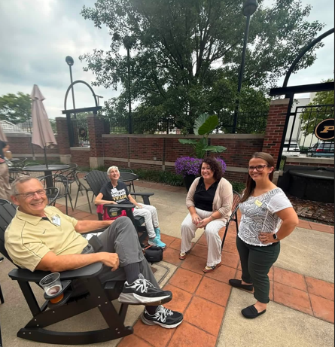
Resources and Support Needed
Data & Technology
Leadership Development
Greater use of dashboards and heat maps to identify alumni concentrations.
Continued support for maintaining accurate alumni records.
Purdue Connect promotion tools.
Club email account resources and guidance.
Position descriptions and volunteer role templates.
Recruitment resources.
Board development tools.
Fundraising
Sponsorship guidance.
Fundraising best practices.
Identification of Purdue-owned businesses and alumni business leaders.
Communications
Storytelling templates.
Social media best practices.
Newsletter content examples.
Save-the-date communication strategies.

Slide 26
Recommendations: Short-Term Window
Membership & Engagement
Encourage clubs to conduct annual member interest surveys.
Promote board engagement events that introduce members to club leadership.
Provide clubs with volunteer role descriptions and recruitment templates.
Encourage targeted outreach to underserved geographic areas.
Communications
Develop a storytelling toolkit for clubs.
Provide social media platform recommendations and best practices.
Share examples of high-performing club communications.
Create guidance on managing club email accounts and social media administration.
Data & Technology
Train clubs on using dashboards and heat maps.
Promote Purdue Connect and alumni record updates.
Encourage QR code usage on club marketing materials.
Fundraising
Add "Business Owner" identification opportunities to club surveys.
Share sponsorship outreach examples and successful fundraising models.
Highlight successful club fundraising activities and scholarship initiatives

Slide 27
Recommendations: Short-Term (6-12 Months)
Membership & Engagement
Encourage clubs to conduct annual member interest surveys.
Promote board engagement events that introduce members to club leadership.
Provide clubs with volunteer role descriptions and recruitment templates.
Encourage targeted outreach to underserved geographic areas.
Communications
Develop a storytelling toolkit for clubs.
Provide social media platform recommendations and best practices.
Share examples of high-performing club communications.
Create guidance on managing club email accounts and social media administration.
Fundraising
Add "Business Owner" identification opportunities to club surveys.
Share sponsorship outreach examples and successful fundraising models.
Highlight successful club fundraising activities and scholarship initiatives
Data & Technology
Train clubs on using dashboards and heat maps.
Promote Purdue Connect and alumni record updates.
Encourage QR code usage on club marketing materials.
Upcoming Discussion: October 28 Forum @2:30pm (Brainshare Component)

Slide 28
Recommendations: Long-Term
Membership Growth Strategy
Develop a coordinated strategy for engagement in underserved markets.
Create regional growth plans based on alumni population data.
Expand outreach to recent graduates and relocating alumni.
Communications Modernization
Build a comprehensive club communications toolkit.
Establish a consistent storytelling framework across clubs.
Explore additional digital engagement channels for younger audiences.
Fundraising & Sustainability
Develop a Purdue Alumni Club fundraising handbook.
Build a database of Purdue-owned businesses and alumni business leaders willing to support clubs.
Expand scholarship fundraising training and resources.
Knowledge Sharing
Create an ongoing best-practice library featuring successful club programs, events, communications, and recruitment strategies.
Establish peer-to-peer forums where clubs can regularly exchange ideas and solutions.
Club Leadership Development
Establish a structured leadership pipeline program.
Develop onboarding and succession planning resources.
Create leadership training opportunities throughout the year.
Upcoming Discussion: October 28 Forum @2:30pm (Brainshare Component)

Slide 29
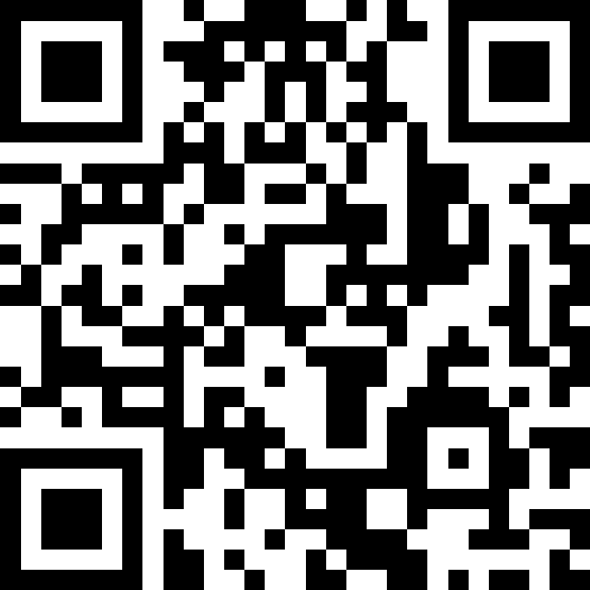
Discussion Questions
If we could only accomplish three of these short-term recommendations this year, which should be the highest priority and why?
What best practices and innovative approaches can help deepen engagement among alumni who regularly participate in events?
Is there additional training or resources would increase your confidence in using data for club planning? Is there additional information you would like to see in the Club Leaders Dashboard?
How can we cultivate a leadership experience that is rewarding, flexible, and meaningful for alumni?
We are developing a Fundraising Handbook – what information would be most helpful to you?
Please pull out your phone and help shape the conversation by sharing your feedback.

Slide 30
Introducing:
Alumni Club Leaders Network

Slide 31
Alumni Club Leaders Network
Connecting Club Leaders. Sharing What Works. Strengthening Our Network.
What is it? A peer-to-peer mentoring network designed to connect experienced alumni club leaders with those seeking guidance, ideas, and support.
The Network Will:
  Connect club leaders across the alumni network
  Share successful strategies, best practices & lessons learned
  Solve common club challenges through peer collaboration
  Strengthen club growth, engagement & sustainability
Who Can Participate?
  Mentors — Share expertise, experiences, successful practices & lessons learned
  Mentees — Seek guidance, ideas, resources & support
Potential launch: 6-month pilot with a limited number of participants

Slide 32
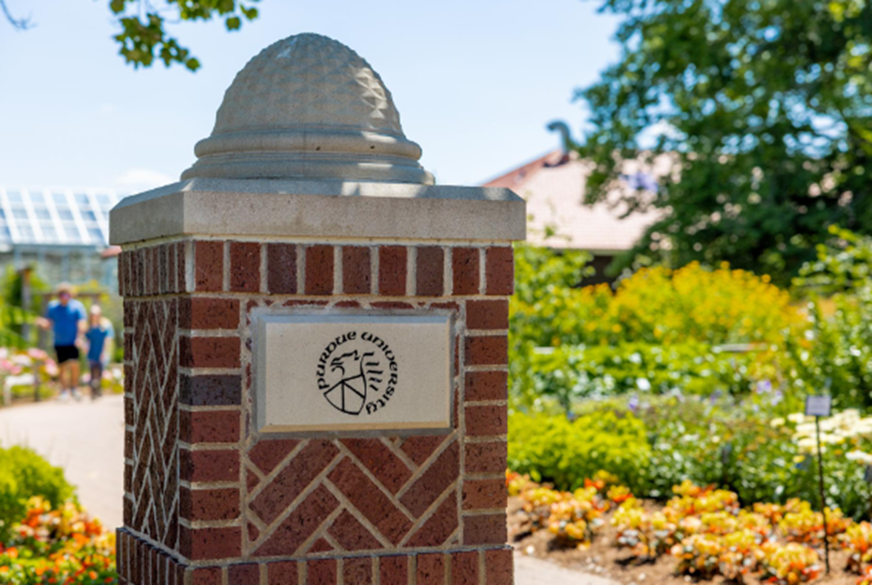
Alumni Club Leaders Network
How the Network Works: A Flexible Model Built Around Club Needs
IDENTIFY
Interest & Needs Assessment
Participants identify:
  Areas of expertise
  Areas where they need support
  Mentoring preferences & goals
CONNECT
Match & Build Cohorts
Participants may connect through:
  One-to-one mentor/mentee partnerships
  Small peer cohorts
  Topic-specific learning groups
  Matches consider experience, club size/maturity, goals and areas of need.
3. LEARN & COLLABORATE
Ongoing Peer Connection
  Share best practices & success stories
  Discuss challenges and lessons learned
  Spotlight innovative club programs
  Participate in problem-solving discussions
4. Monthly virtual Deep-Dive sessions around high-interest club topics

Slide 33
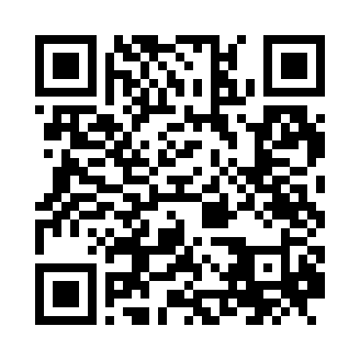
Register for Alumni Club Leaders Network
The goal isn't to create another program for club leaders — it's to create a network where club leaders can learn from each other.

Slide 34
Alumni Clubs Scholarships
Notes:
Leanne lastd section

Slide 35
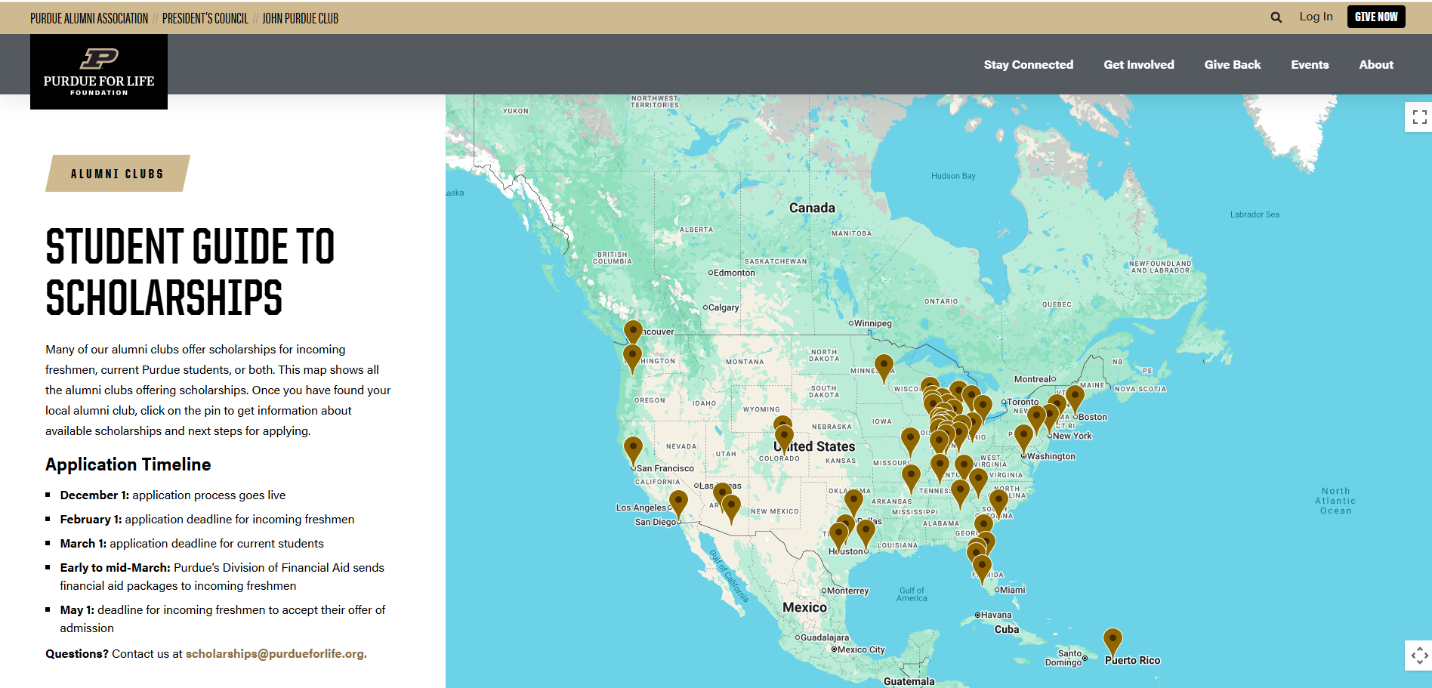
Scholarships: What’s New?
Coming soon: online form replacing the pdf application. Testing to begin in Oct/Nov
New location/New Look: STUDENT GUIDE TO SCHOLARSHIPS - https://www.purdueforlife.org/current-students/
  Still linked on the Scholarship Awarding Information website
  Now linked under Student Opportunities—Alumni Club Student Scholarships
  https://www.purdueforlife.org/student-opportunities/
New Interactive Map to find Scholarships (similar to our Game Watch Map)
  Each club has a pin marker on the map that displays eligibility requirements and how to apply (links to the app for clubs that use our application)
  Application timeline is prominently displayed

Slide 36
Scholarship Fundraising
Before You Fundraise: Determine your Club’s Goal
Scholarship Support Fund
  Supports current and upcoming scholarship awards
  Functions as a spending account
  Creates immediate impact for students
Scholarship Endowment Fund
  Builds a permanent source of scholarship support
  Invested for long-term growth
  Creates lasting impact for future generations

Slide 37



Scholarship Fundraising
Best Practice
Decide the fundraising goal.
Clearly communicate which fund is being supported.
Honor the donor's designation.
Tell donors:
Which fund receives the gift
How the gift will be used
Whether the impact is current or long-term
Avoid a "Decide Later" Approach
Don't use the Support Fund as a temporary holding account for gifts intended for the Endowment.
Moving gifts later may require donor permission and create stewardship challenges.

Slide 38
Scholarship Timeline
Oct: Planning
  SAVE THE DATE - 10/8 7:30 PM EST: Scholarship Preparation Session for Committee Chairs, Club President(s), Scholarship Committee Members. Attendance strongly recommended. Link to registration: https://events.blackthorn.io/3ktO526/4a9GQp4mu5
  Expect a higher volume of applications this year. Consider increasing awards and committee members
Nov: Budget & committee formation
  Recruit and confirm scholarship committee members
  Review funding projections, determine your awarding budget and planned amounts
  Begin promoting the scholarship application opening December 1st
Dec-Jan: Application launch & freshman review
  Promote application on your social media and at all events and game watches
  All funds must be deposited in your account by January 15
  Finalize your timeline for application review, discussion, and award decisions

Slide 39
Scholarship Timeline
Feb-Mar: Award decisions
  Deadline for freshmen Feb 15
  Deadline for current students March 31
Apr-Jun: Award processing
  May 1 college decision deadline
  May 10 Clubs team reviews admitted freshmen enrollment status and notifies clubs of changes requiring action
Jul-Sep: Compliance & closeout
  August DFA completes final review of student aid packages. Clubs team notifies clubs if awards are reduced or removed.
  September all scholarship activity for current academic year is shutdown. Focus moves to next academic year.

Slide 40
Alumni Clubs: Operational & Processes Updates
Notes:
Leanne lastd section

Slide 41
Operations Reminders
August Disbursements and Scholarship Bonus transfers have been sent for all clubs who've completed all the annual requirements (leadership roster, Statement of Integrity signed by all board members, Quarterly Treasurer reports submitted, Annual Agreement signed by President and Treasurer)
PLEASE NOTE:
Review the Financial policies in the agreement, Purdue Alumni Club Volunteer and Financial Policies Agreement for FY25 (PDF)
Reminder that club engagements funds cannot be used to purchase alcohol, salaries or honorariums for Club officers, membership fees and gift cards (non-reimbursable expenses)
Alcohol Policy
Engagement funds cannot be used to pay for alcohol.
However, venue-negotiated event packages may include food and alcoholic beverages as part of a bundled ticket price (e.g., meal + two drink tickets).
Notes:
This allows clubs to offer event packages that include food and a limited number of alcoholic beverages, provided alcohol is not purchased as a separate reimbursable expense.

Slide 42
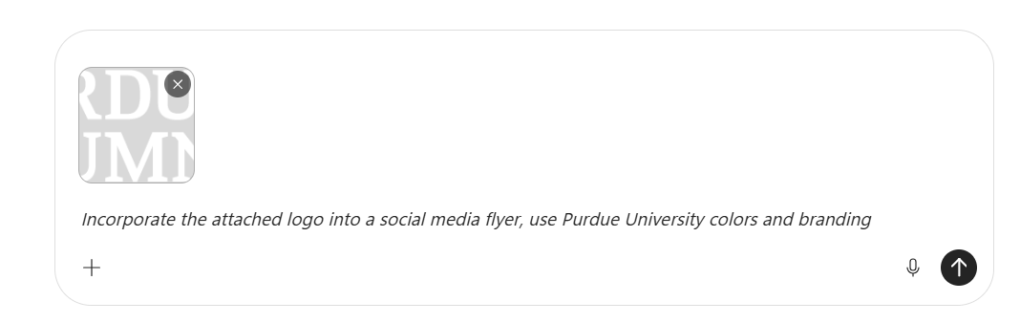
General Operational Tips
Alumni Club Forum
Clubs should make a concerted effort to have at least one board member attend the monthly club leaders' forum
Recognition Program
Official club representation (High School, recruiting events, speaking engagements, Purdue events, etc.) must be reported via the Volunteer Event Submission Form to receive event credit for the Recognition Program points
Creating Flyers and Social Media Graphics
Clubs may create their own promotional materials if they fulfill this requirement
All materials must include the club's official logo.
How to add the logo to an AI image? Upload the club logo as a reference image in the chat ⬇️
Copilot example: You can upload the file by using the + or drop the file in the new search/new chat bar
AI-generated results should be reviewed carefully, as logos may not be reproduced accurately.
To ensure brand consistency, you could also add the official logo file to the final design using your design software whenever possible.

Slide 43
Newsletter Template:
Newsletter template launched in August and replace old template soon on request form.
  See the August Newsletter sent by Alumni Clubs Team
  Note: Either newsletter template can be used
User handbook will be sent with the newsletter template
  If you need additional help, please reach out to LeAnne (lewilliams@purdueforlife.org)
Download and use the new banners & images MarComm team has created for club use
Notes:
Banners: https://link.us-1.lytho.us/i/178533946533635ff2430-b409-4030-bb8b-1beec4f0eeee#page-c869e67e-96b0-4942-8a79-3c3c884ab829
MarComm Images: https://link.us-1.lytho.us/i/1726749883194a66cc55e-764f-4b96-a440-f377f9098b5a#purdue-for-life-foundation-photos
Newsletter Template: Open doc
Newsletter Handbook: Open doc

Slide 44
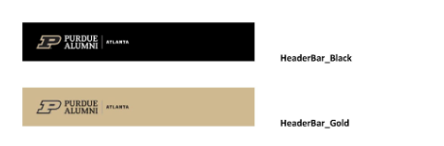
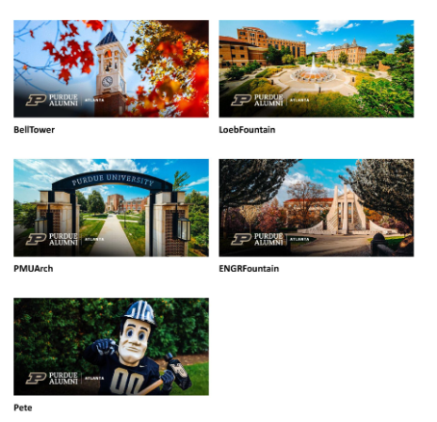
New Banners
Email and Blackthorn graphic examples are shown.
Specific club graphics can be downloaded with link we'll provide.
Notes:
Banners: https://link.us-1.lytho.us/i/178533946533635ff2430-b409-4030-bb8b-1beec4f0eeee#page-c869e67e-96b0-4942-8a79-3c3c884ab829
Newsletter Template: Open doc

Slide 45
Communications Reminders
Engagement and Event Request Form:
  Submit all Event & Communications: Emails, Events with Emails, Newsletters, and Game Watches
  Important notes:
    Email Submissions: Need at least four (4) business days from submission to send.
    Events with Emails:
      Need at least seven (7) business days for Event registration site build, four (4) business days for 1st email send = 11 business days from submission to 1st email send.
      Events submitted 30 or more days out from event will receive:
        1 Event invitation Email
        1 Reminder Email
        1 Pre-event email to those registered (can be changed to 2nd reminder upon request)
      Events submitted less than 30 day out from event:
        Will receive 1-2 emails – Invitation & Pre-Event – dependent on how close submission is to event.
To ensure consistency and maximize reach, all club email communications should be coordinated through this process. Direct communications from club leaders should be reserved for emergency situations or post-event follow-up (Volunteer Data Training Required)
Notes:
https://purdueuniversity.my.site.com/community/s/eventrequest

Slide 46
Digital Business Cards
PURDUE FOR LIFE FOUNDATION: DIGITAL BUSINESS CARDS THROUGH BLINQ
Setting Up Your Digital Business Card:
  Go to https://blinq.me to create your free digital business card
  Click the “create my card” button on the homepage
  Follow the directions below to ensure a consistent design across the foundation
    Use the PFLF logo provided
    Add Club Details (Name, Email, Phone, Website, Social Media Accounts)
"How To" Guide will be emailed out after the Forum, also located on the Club Leaders Facebook Page.
Notes:
https://purdueuniversity.my.site.com/community/s/eventrequest

Slide 47
Emergency Event Communication & Processes
What to do When an Event Plan Changes Unexpectedly:
QUICK CHECKLIST
When an event needs to be changed, postponed, or canceled:
☐ Make the decision and confirm the updated event details.
☐ Notify Purdue for Life Foundation as soon as possible if the event was submitted through PFL or involves registration, payments, refunds, or other PFL support. (alumniclubs@purdueforlife.org)
☐ Determine who needs to be notified — registered attendees, venue, speakers, volunteers, partners, etc.
☐ Send an email to registered attendees as soon as possible.
☐ Update social media and any other places where the event was promoted.
☐ Clearly communicate refunds, if applicable. If refunds are needed, work with PFL to determine the appropriate process.
☐ Save a copy of the communication for your club's records.

Slide 48
Emergency Event Communication & Processes
Put the important information first. Attendees should be able to quickly understand:
  WHAT changed?
  WHEN is the change?
  WHERE should I go?
  WHAT do I need to do?
Keep the explanation brief: You do not need to provide every detail behind an emergency decision. Focus on the information attendees need.
Be consistent: If the event is canceled or moved, make sure the email, registration page, social media, and other promotional materials reflect the same information.
Don't promise refunds before confirming the process: If a refund may be applicable, let attendees know that the club will work with the Purdue for Life Foundation to determine next steps.
Communicate quickly: For last-minute changes, email registered attendees as soon as possible. Consider additional communication through social media or other channels used to promote the event.

Slide 49
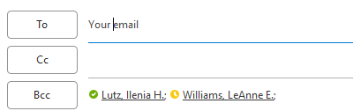
Emergency Event Communication & Processes
EMAIL TEMPLATES – Will be provided post-Forum
Setting Up Emails:
  Enter your email address or the Club email address in the “To” field.
  Always copy alumniclubs@purdueforlife.org in the Carbon Copy (CC) field.
Place all recipients in the Blind Carbon Copy (BCC) field to protect their privacy and prevent recipients from seeing one another’s email addresses.
Data Privacy:
  To access the event-specific registrant and contact information, Club leaders must complete Volunteer Data Training and sign the Volunteer Confidentiality Agreement.
  Access to registrant information will only be provided after both requirements have been completed.
  We recommend that Club Presidents and Event volunteers complete the training.
  For questions or assistance, please contact alumniclubs@purdueforlife.org.

Slide 50


Game Watches
Each club hosting will receive:
  QR code for this registration site.
  An attendee report if anyone registered for their game watch
  Clubs can also request 1 game watch swag box for every 4 game watches they host. Engagement funds can be used to purchase additional swag for these events.
Monday 12:00pm ET (noon ET): Deadline for Game Watch Map & Emails
  Email schedule:
    September 16
    October 14
    November 11
    December 16
Clubs who follow process will be entered to win a signed ball at the end of the season to be used for fundraiser purposes (only). ​

Slide 51
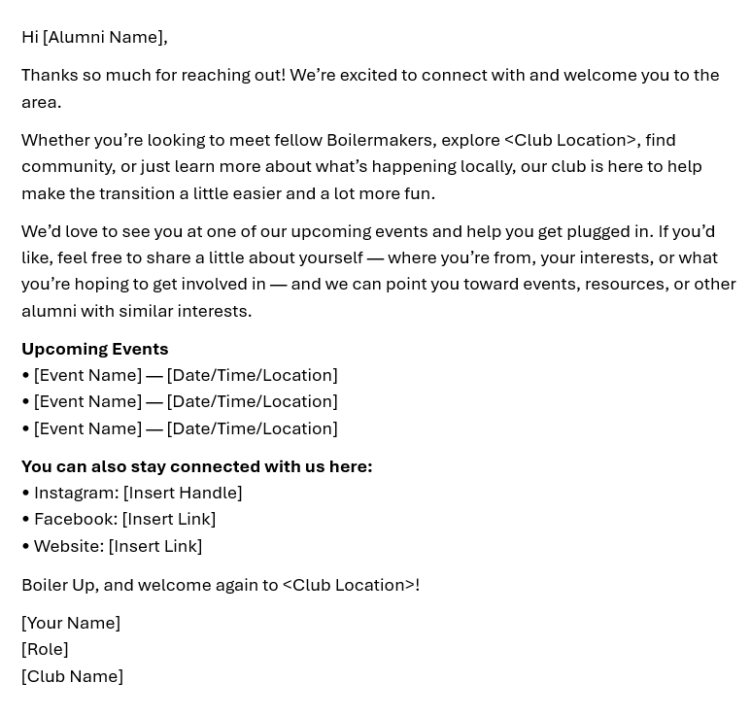
Update: “Welcome to the Club” Emails
PASE Collaboration: Emails to Purdue, Purdue Global graduates for the last 5 years were send around 8/14/26. This population was automatically added to the Club distribution.
Southwest Florida
Nashville
Lehigh Valley
Evansville
Bartholomew
Indianapolis
SW Washington
East Tennessee
Phoenix
Atlanta
St. Louis
San Diego
Northwest Indiana
Milwaukee
Cass County
Clinton County
16 Clubs provided local Community Info

Slide 52
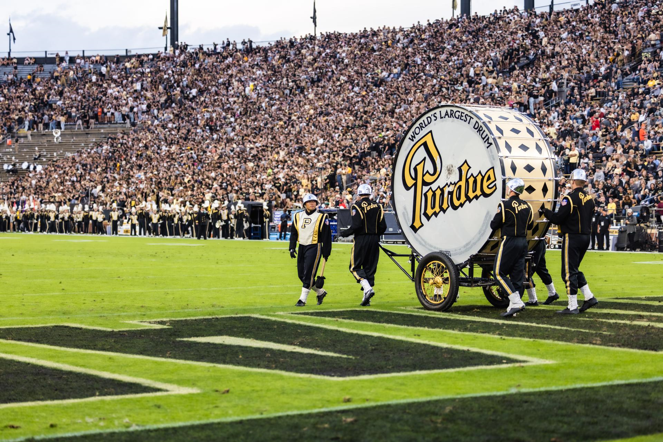
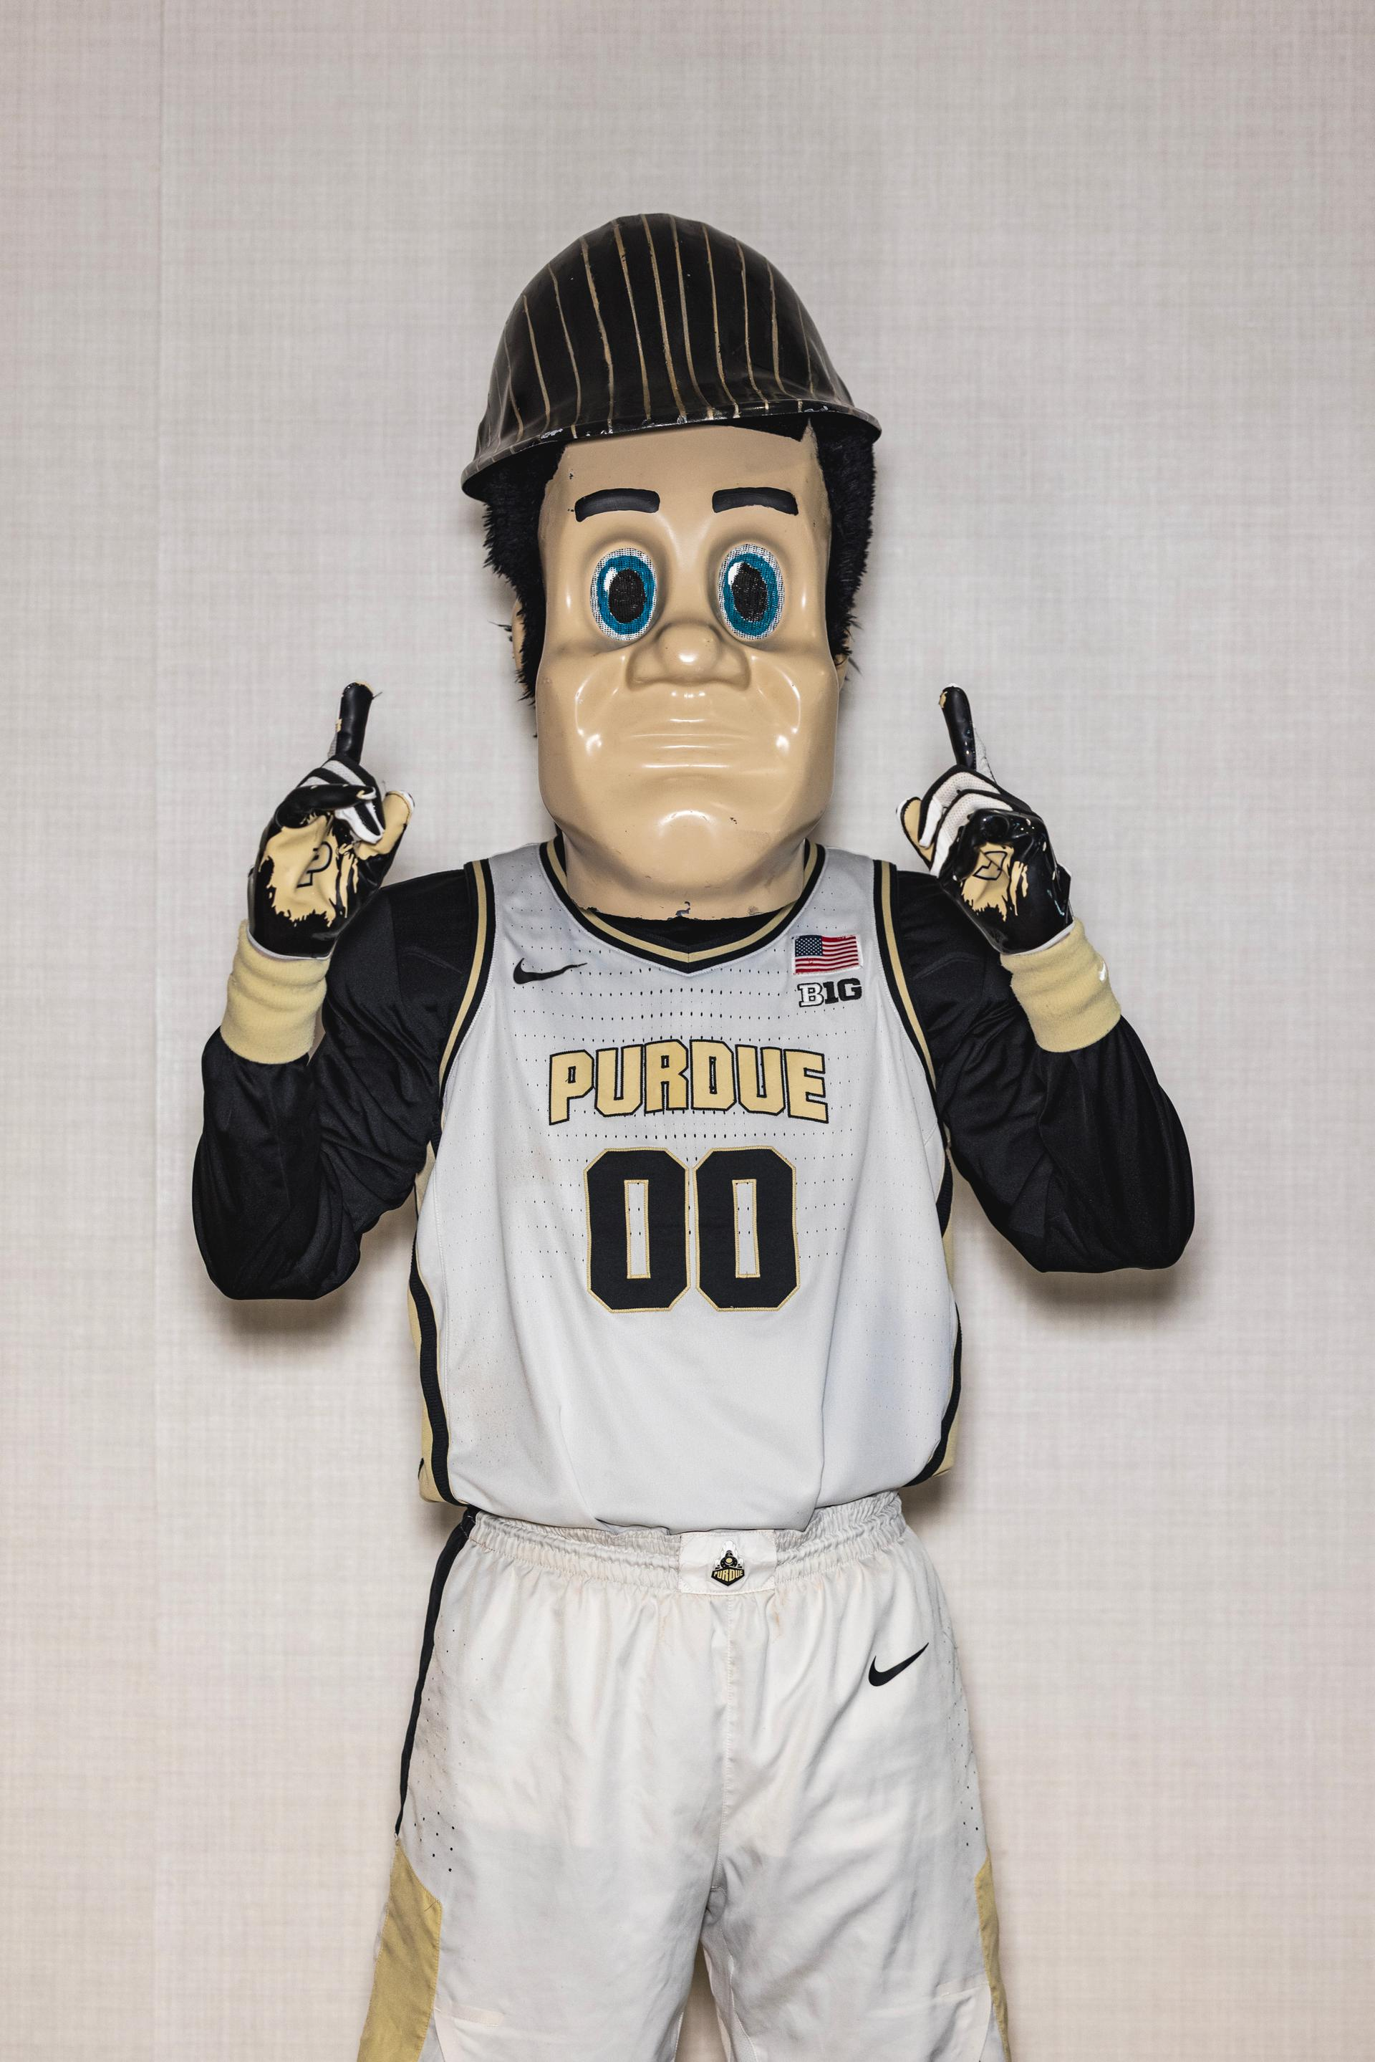
Homecoming Tickets
AND THE WINNERS ARE:
Donald Brunn, PAC Bartholomew County
Nadia Conti, PAC Fort Wayne
Glenn Youngstedt, PAC Southwest Michigan

Slide 53


Alumni Clubs Task Force – 10/9 Kick-Off
Lisa Pluckebaum,
PAA Board
Jim Overman,
PAA Board
Julie Tovey
Purdue Alumni Club of Upstate SC
Junhui Qu
Purdue Alumni Club of NYC
Lauren Handwerk
Purdue Alumni Club of Phoenix
Michelle Hannah
PAA Board
Sara Nash
Purdue Alumni Club of Indianapolis
Raj Melkote,
Purdue Alumni Club of Boston
Rochelle Zou
Purdue Alumni Club of Chicago
We’ll provide regular updates on the Task Force priorities and progress

Slide 54
Activities through December
SEPTEMBER
Football Season
OCTOBER
Scholarship Committee
Training
NOVEMBER
Homecoming Scholarships Readiness
DECEMBER
Purdue Winter Recess
Student Events
September 19 PFLF Tailgate Purdue vs. UCLA
West Coast and Arizona Clubs
Help Promote Dauch Football Tailgates
September 26: Alumni Clubs Saturday – Noon
Most sessions: 2 hours prior to game time
Event Submission Reminder
Game Watches Submit Mondays by Noon
Scholarships
October 8 – 7:30pm ET Committee Chairs Training
Alumni Clubs Task Force
Kick-Off October 9
October 28 Forum
How to start an Endowment and Events
<Location>@purduealumni.org Email Tenants Roll Out
Recognition Program Check
Homecoming – Nov. 5-7
Scholarships
Timelines and actions
Online Application testing (basically the same one, no PDF)
Budget
Committee Members names due
Thanksgiving
Closed Nov. 26-27*
Scholarship Applications
Application launch on Dec 1
PACT Newsletter (No Forum) Week of Dec. 7
PFLF Year End Closing
Dec. 24th to January 1st.*
Deadline to submit event, email requests by December 11*. 5PM
JANUARY 2027
Brain Share #2 Wed. January 20
* Tentative dates
Notes:
Denise will add dates in Outlook for Team
Reminder

Slide 55
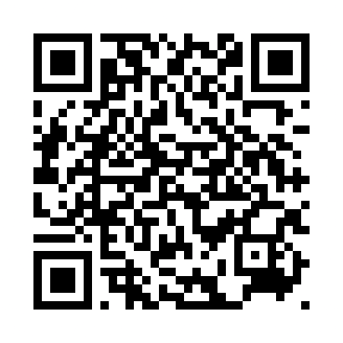
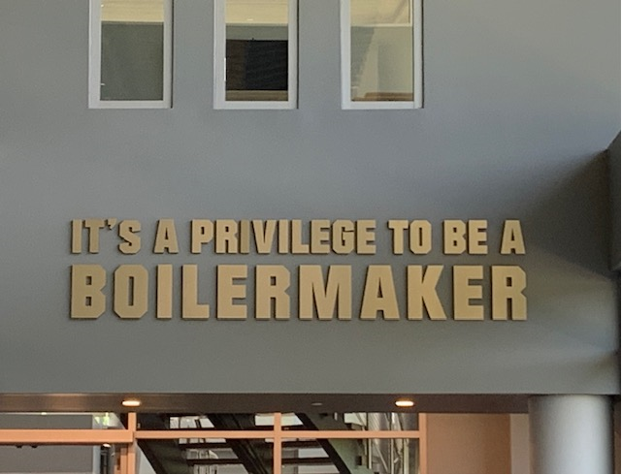
Thank you!
The next forum will be Wednesday, October 28, 2026 at 2:30 pm ET
  Theme: How to Start an Endowment – Speaker: Marcus Knotts
  Brainshare: Events + New Ideas/What’s working
Recordings of past forums are available on the Alumni Club Resource Library website: https://www.purdueforlife.org/alumni-leaders/clubs/resource-library/
Register for all the 2026-2027 Forums

Slide 56
September Forum Resources
Forum Slides
Game Watch QR Code Flyer
New Newsletter & Handbook
Links to: Banners & Images |Logos
Digital Business Cards "How To" PDF
Emergency Event Cheat Sheet & Email Templates
Post-ACES Summary & Insights
2026-2027 Big Ten Championships Athletic Calendar: Big Ten 2026-27 Olympic Sports Tournaments And Championships.
  Check the events dates out to see if they will be in your area: https://bigten.org/article/60267/
Prize Opportunity – The first person who emails alumniclubs@purdueforlife.org sharing 1 learning from reviewing this deck will win a prize!

