Slide 1
Alumni Club Leaders Forum
October 2023

Slide 2
Purdue Alumni Club Forum
Reminders & Instructions
This forum is being recorded to share later along with the slides and chat content.
Participants will be muted.
Questions should be submitted using the chat function.

Slide 3

Purdue Alumni Club Forum
October 2023 Forum
University Updates
Purdue for Life Foundation Updates
Alumni Club Updates
Training: Event Listing & Email Submissions

Slide 4
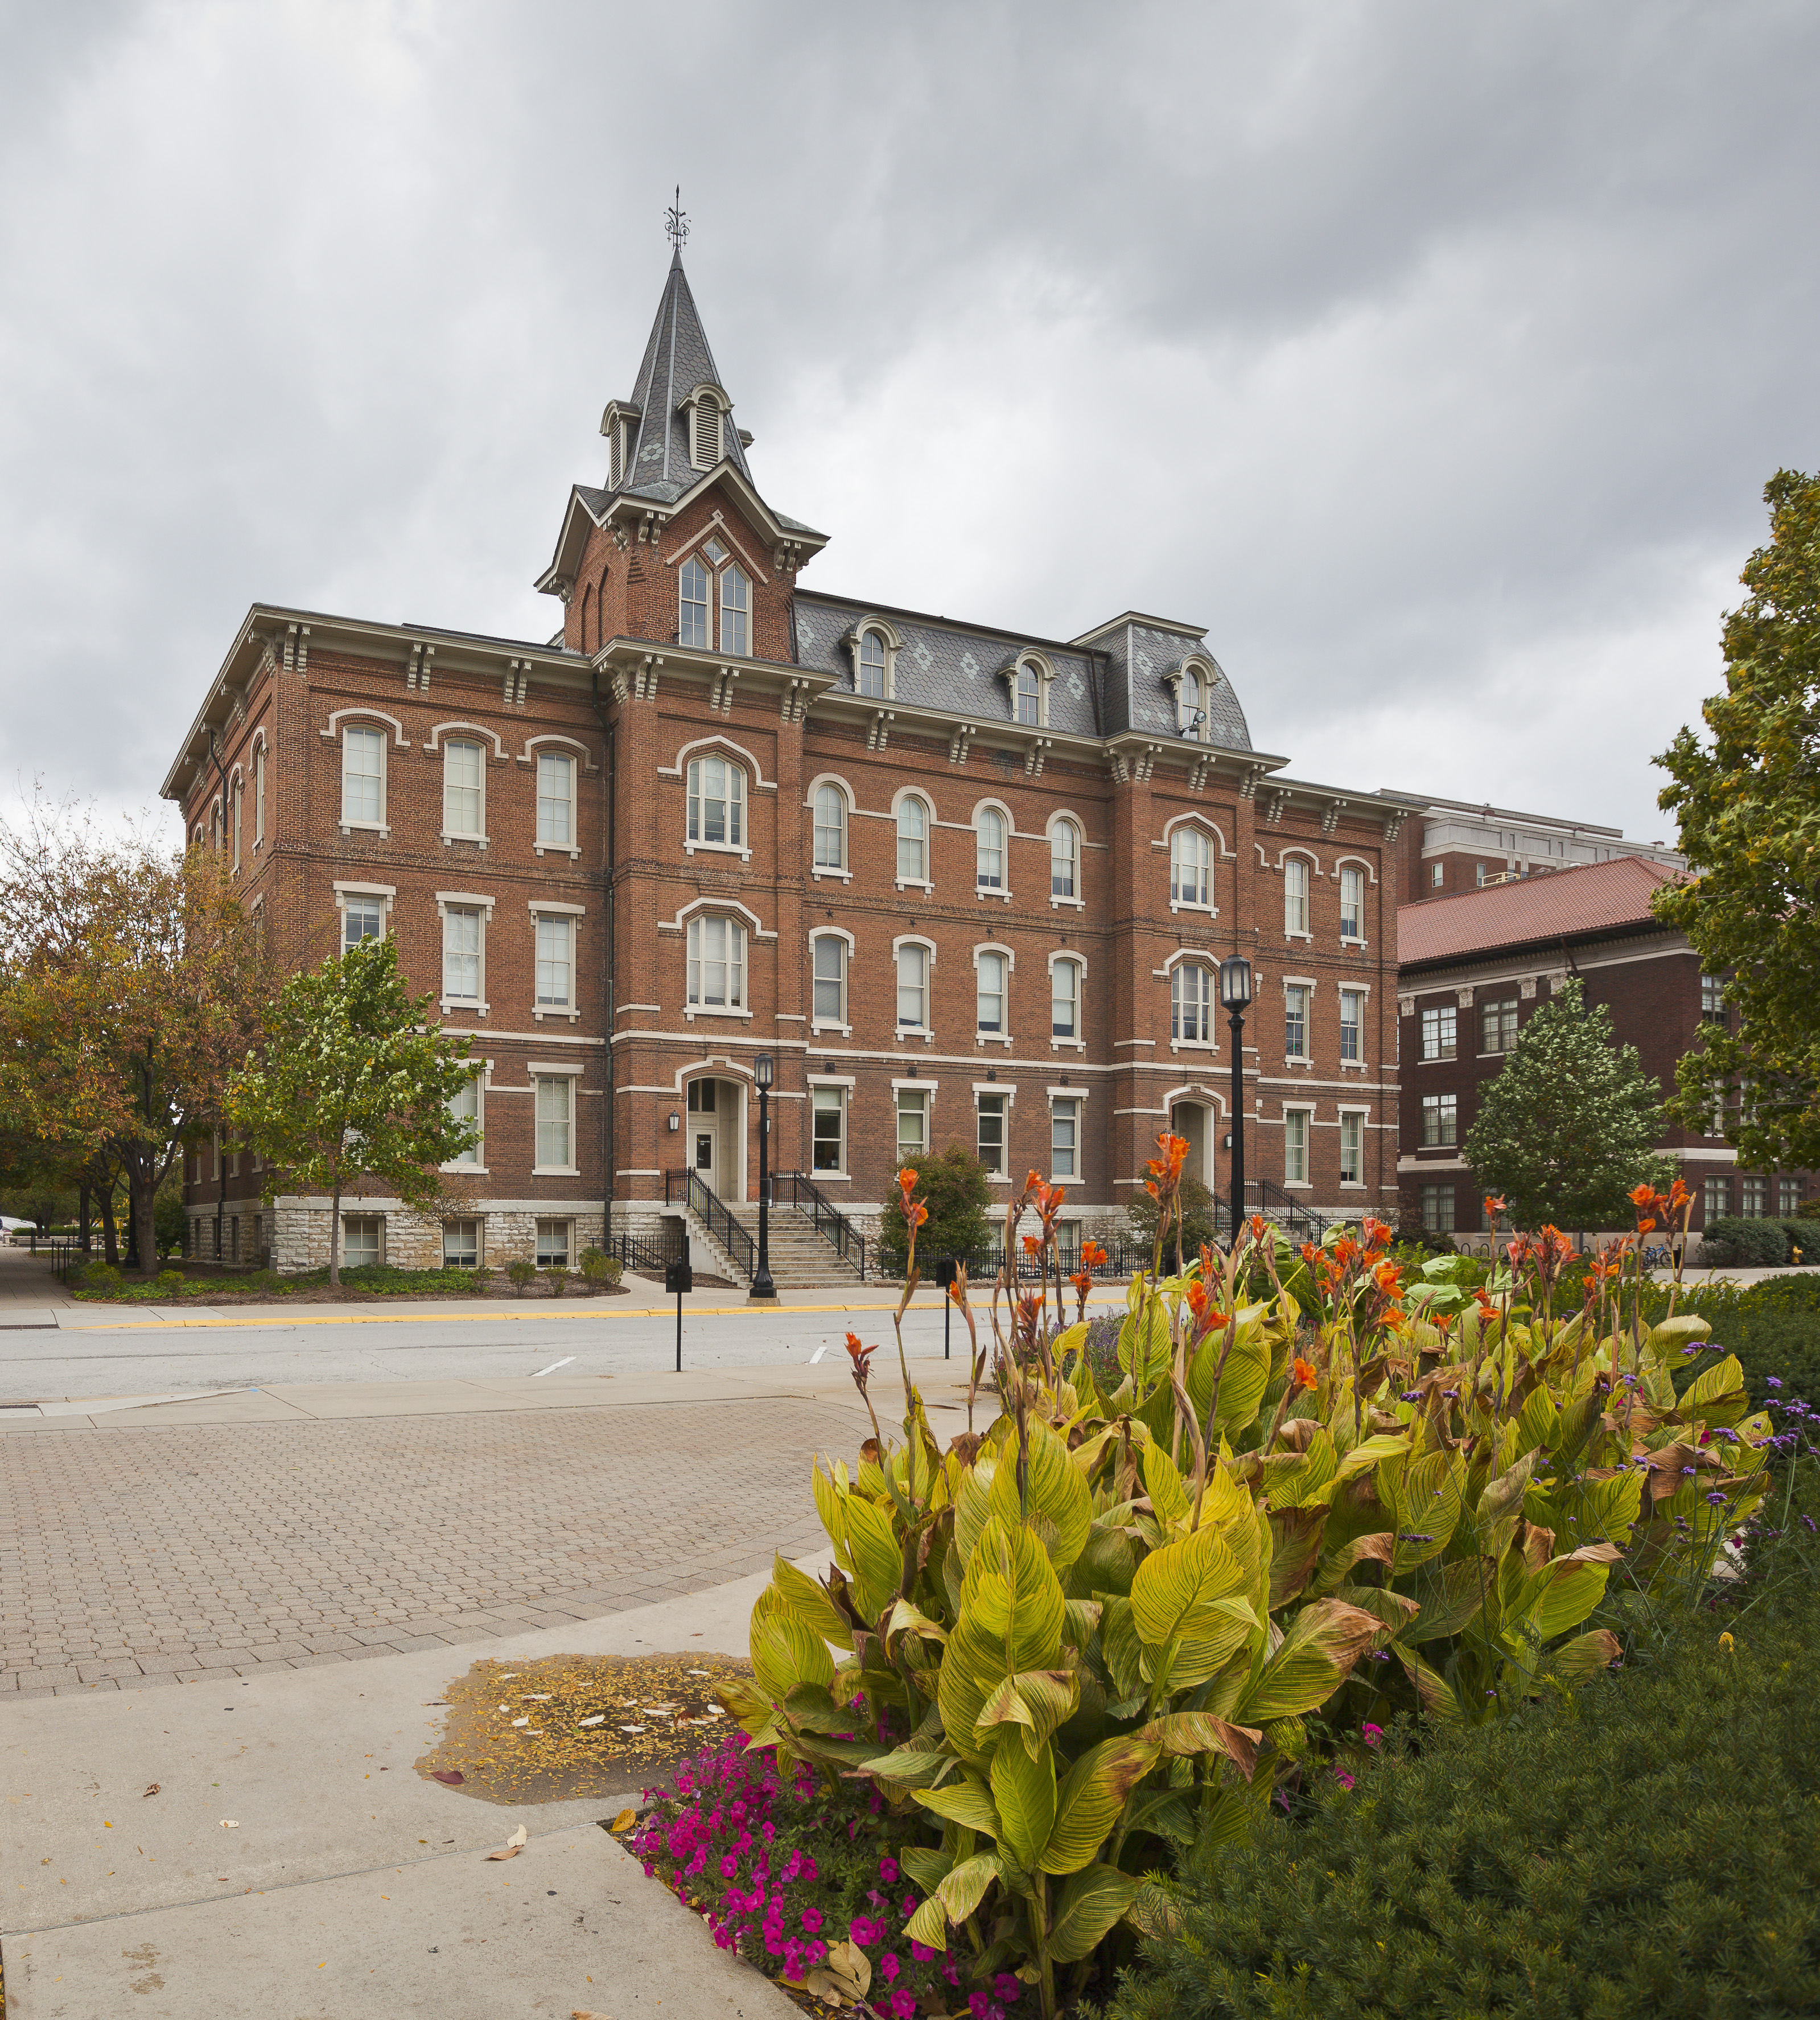
Purdue Alumni Club Forum
University Updates
Spring Family Weekend
  First time ever – April 12-14
President Mung continues to travel Indiana and across the United States
  October 22 in Chicago
  November 7 in Washington, D.C.

Slide 5

Purdue Alumni Club Forum
Purdue for Life Foundation Updates
Soliciting proposals for speakers for next summer’s women’s conference
  Deadline is October 27
  Conference is June 17-18
The New Medical Affinity Network

Slide 6
Purdue Alumni Club Forum
Alumni Clubs
Club leaders survey
Quarterly Financial Reports
Game Watches
  Peacock subscriptions
  Basketball schedules
Club agreement
  Updates are being made to remove items and clarify certain points
New Staff
  Susie Saberniak – Director, Alumni Club Operations

Slide 7
Thank you!
Forums are the third Wednesday of every month and take place on Zoom.
Registration links will be sent to all club leaders every month.

