Slide 1
Alumni Club Leaders Forum
November 19, 2025

Slide 2
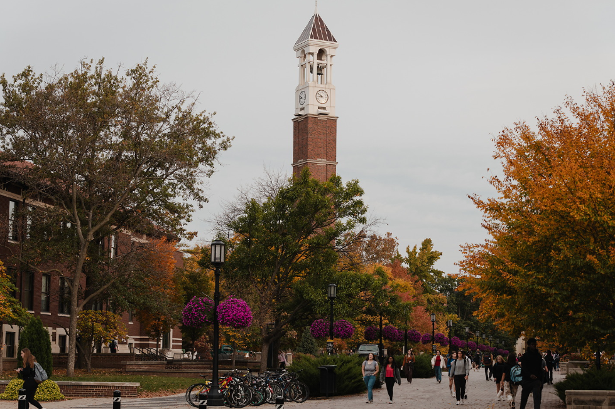
Purdue Alumni Clubs Forum
Reminders & Instructions
This forum is being recorded to share along with slides and chat content
Participants will be muted
Questions should be submitted using the chat function

Slide 3
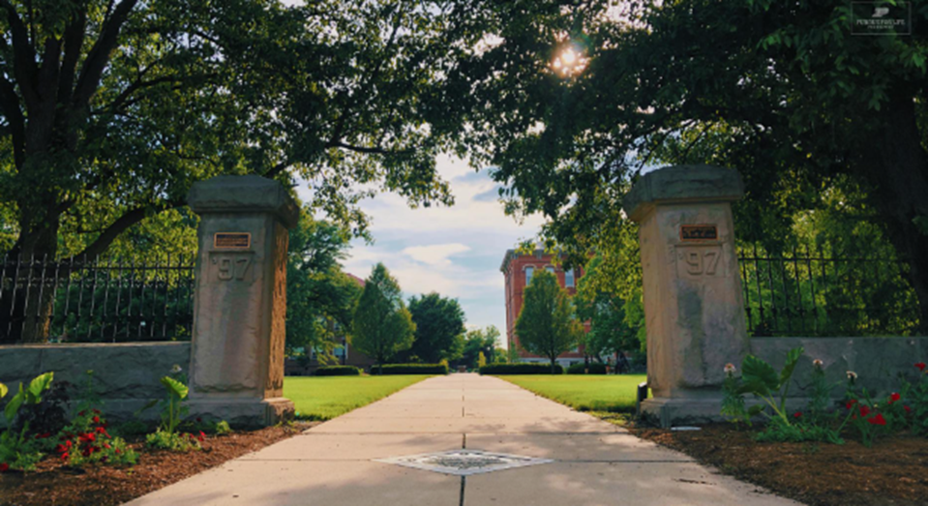
Purdue Alumni Clubs Forum
Agenda
Welcome Darien Thompson!
Guest speaker: David Cooper, Chief Investment Officer, Purdue Research Foundation - Endowment Portfolio Update, Spending Distribution Discussion, Macro & Market Update
University Updates
Alumni Clubs Updates
Scholarships – timeline, applications, scholarship committees, promotion
Game watches
General Fall Meetings Updates

Slide 4
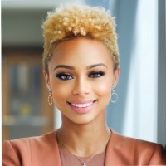
Welcoming Darien E. Thompson
Alumni Clubs Senior Specialist at Purdue For Life Foundation
Career Highlights
Director of Student Success & Urban Engagement - Purdue University Northwest · Full-time
Director, Business Opportunity Program (BOP) Future Scholars Camp - Purdue University Daniels School of Business
Student Athlete, Women's Basketball - Purdue University Northwest (2013-2017)
Hobbies: Line dancing instructor, Lego collector

Slide 5


November 19, 2025
Purdue Alumni Association:
Clubs Presentation
Private and Confidential | For Intended Recipient Use Only

Slide 6

CONTENTS
November 19, 2025
Purdue alumni association: Clubs presentation
PAGE | TOPIC
3 | Endowment Portfolio Update
18 | Spending Distribution Discussion
22 | Macro & Market Update
Notes:
MARKET VALUE CHANGE
Note: Market values reported for NACUBO include PIP plus separately held less trusts. Net Investment Return is net of Office of Investment expenses.
The percentages were calculated by taking the dollar amount and dividing it by the beginning of the fiscal year balance.
¹Net Investment Return does not match Cambridge reported performance due to valuation timing of some of the alternative asset classes as well as cash flow impact which is adjusted in Modified Dietz methodology utilized by Cambridge.
ASSET ALLOCATION VS TARGET RANGE¹
¹Allocation will not equal 100% due to cash balance. Cash balance as of May 31, 2018 was 0.8%.
Note: For Real Estate and Natural Resources, private and public allocations are combined.

Slide 7
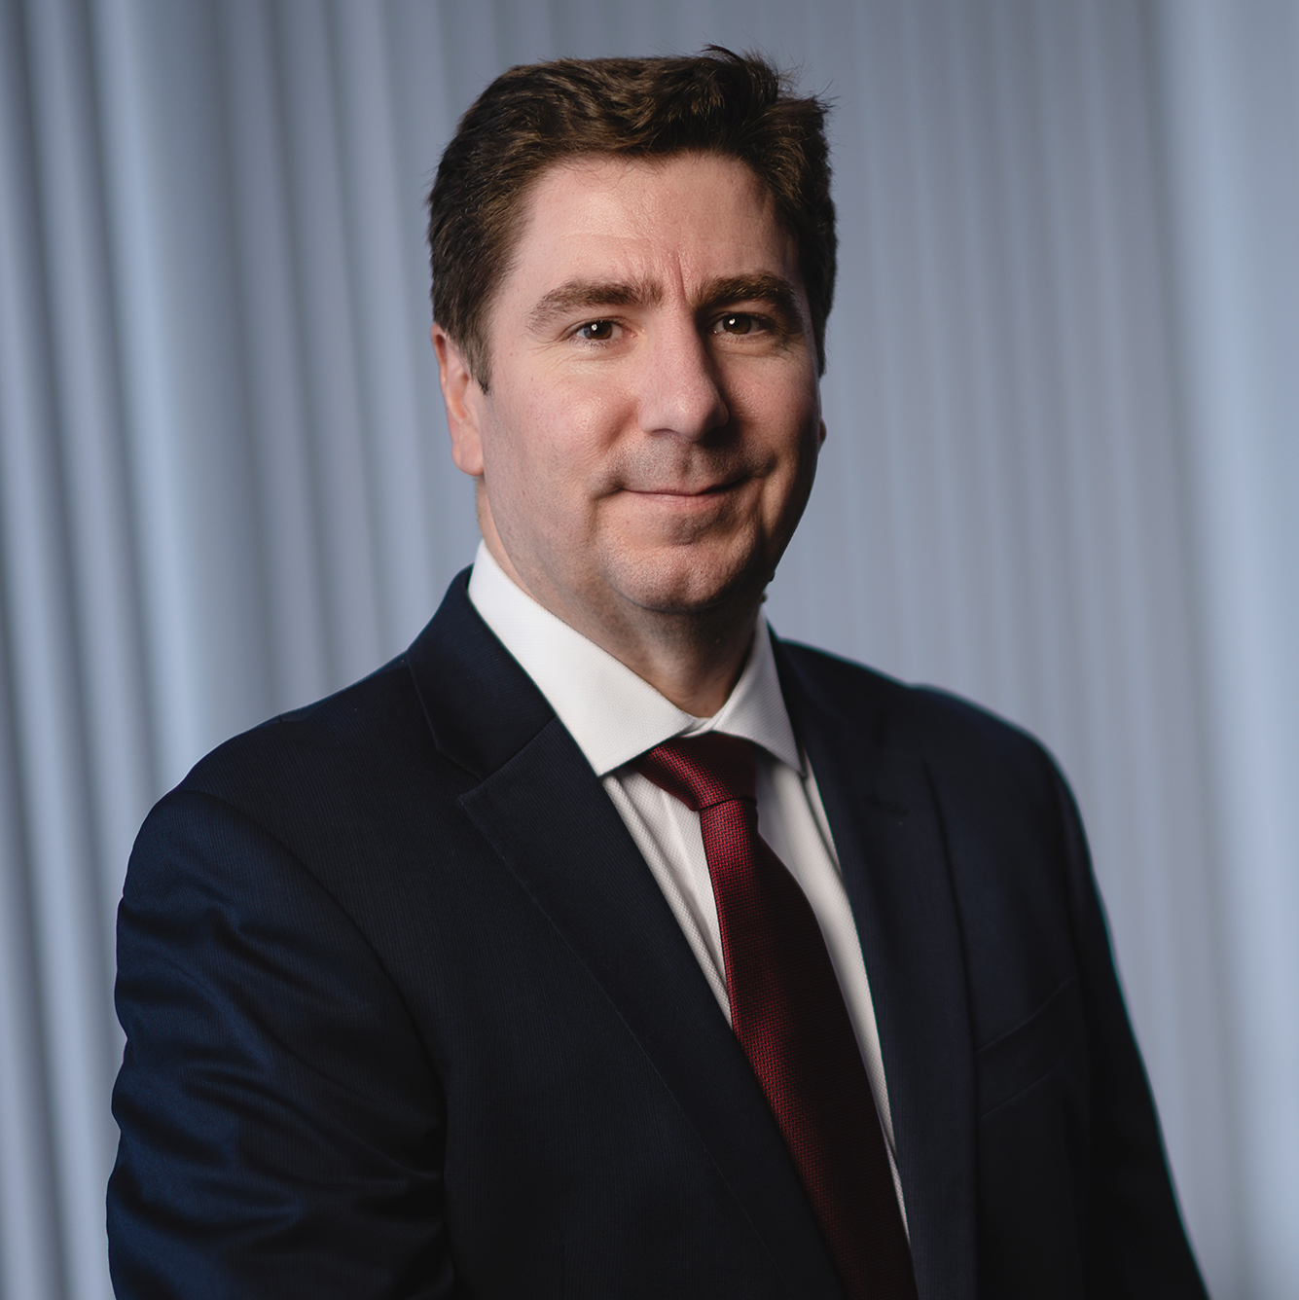
Endowment Portfolio (‘pip’) update
Purdue alumni association: Clubs presentation
David C. Cooper
Chief Investment Officer
Sam Fehrman
Senior Investment Officer
Private and Confidential | For Intended Recipient Use Only
7
COLLABORATION | DRIVE | GROWTH | HARMONY | INNOVATION | INTEGRITY | RESPECT | RESPONSIBILITY
Notes:
MARKET VALUE CHANGE
Note: Market values reported for NACUBO include PIP plus separately held less trusts. Net Investment Return is net of Office of Investment expenses.
The percentages were calculated by taking the dollar amount and dividing it by the beginning of the fiscal year balance.
¹Net Investment Return does not match Cambridge reported performance due to valuation timing of some of the alternative asset classes as well as cash flow impact which is adjusted in Modified Dietz methodology utilized by Cambridge.
ASSET ALLOCATION VS TARGET RANGE¹
¹Allocation will not equal 100% due to cash balance. Cash balance as of May 31, 2018 was 0.8%.
Note: For Real Estate and Natural Resources, private and public allocations are combined.

Slide 8
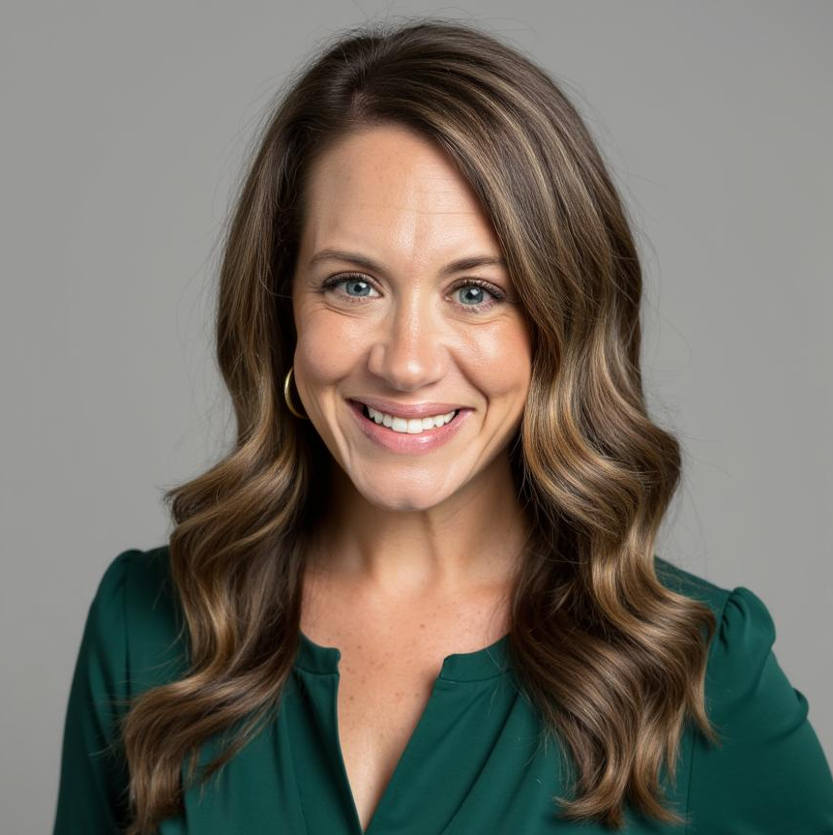
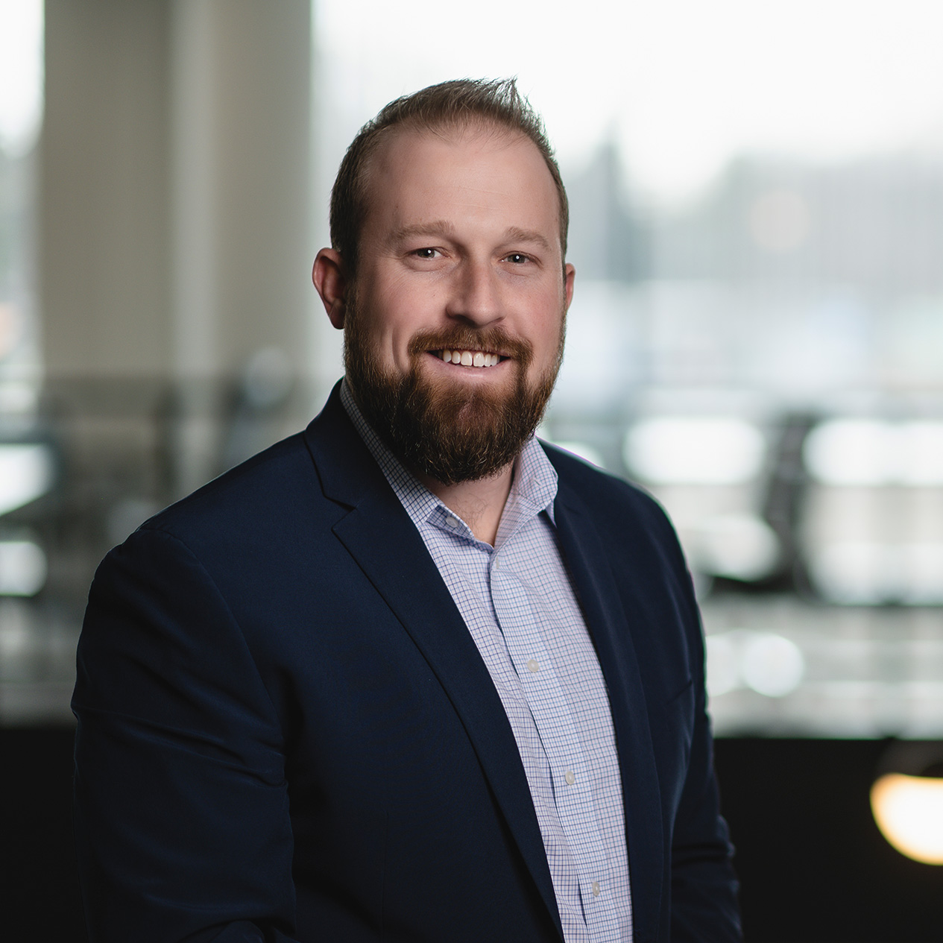
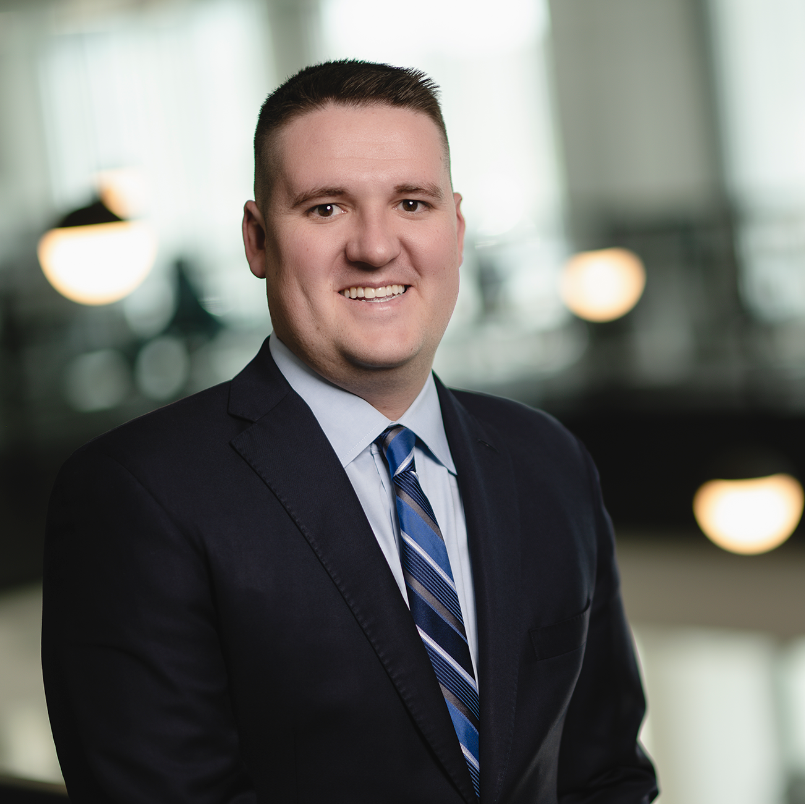
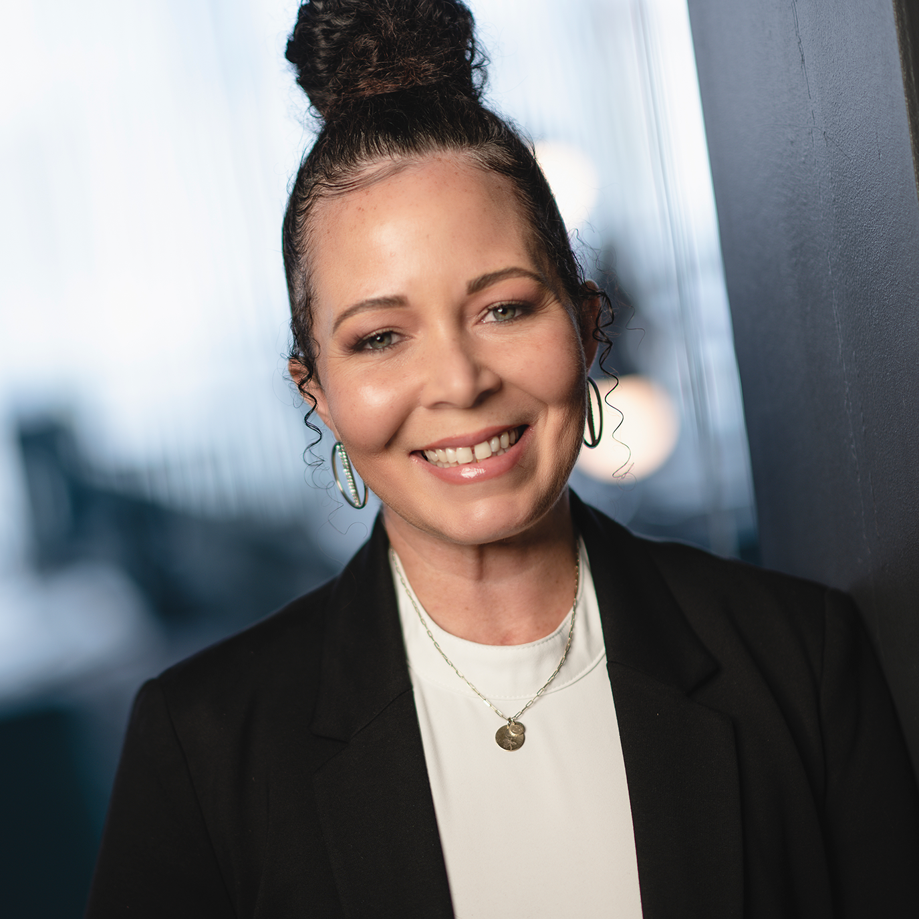
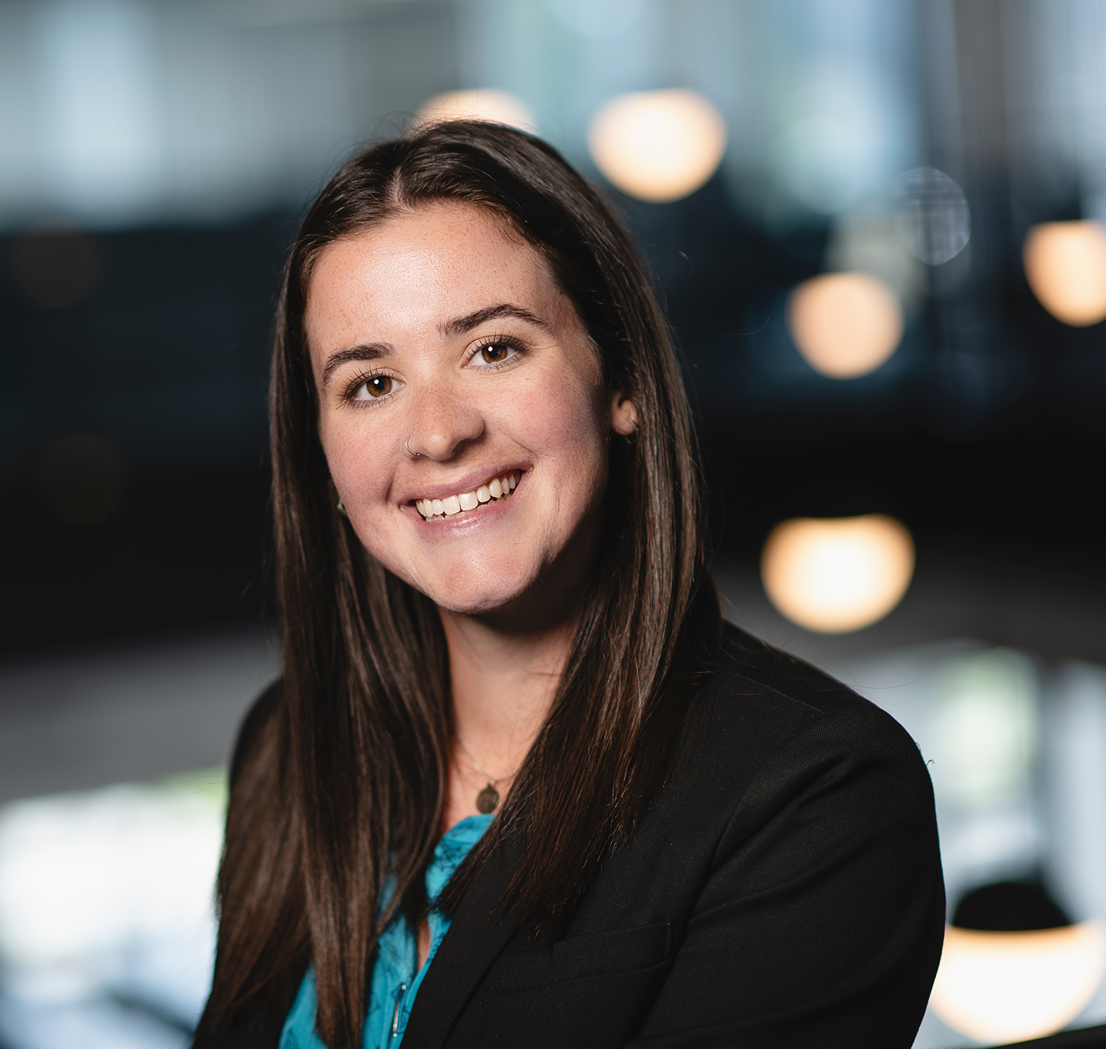
PIP PORTFOLIO UPDATE | AS OF JUNE 30, 2025
Purdue alumni association: Clubs presentation
Team
The Purdue Research Foundation (‘PRF’) exists for the sole benefit of Purdue University. The Office of Investments, housed under PRF, is charged with managing the University’s Endowment assets, as well as a cash pool from the University’s balance sheet.
David Cooper
Melanie Martin
Chief Investment Officer
Executive Assistant
to Chief Investment Officer
Blair Webb
Managing Director
Sam Fehrman
DeAndra Ballard
Senior Investment Officer
Manager of Investment Performance and Reporting
Lauren Tibbets
Investment Associate

Slide 9
Funds under management
PIP PORTFOLIO UPDATE | AS OF JUNE 30, 2025
Purdue alumni association: Clubs presentation
Total Endowments
$4,437
ENDOWMENTS
$3,573
PIPC-QUASI ENDOWMENT
$766
SEPARATELY HELD
$98
PURDUE UNIVERSITY
$2,448
PURDUE RESEARCH FOUNDATION**
$1,088
PURDUE ALUMNI ASSOCIATION
$37
** Purdue Research Foundation includes
Purdue Global-Quasi of $19.8
Notes:
MARKET VALUE CHANGE
Note: Market values reported for NACUBO include PIP plus separately held less trusts. Net Investment Return is net of Office of Investment expenses.
The percentages were calculated by taking the dollar amount and dividing it by the beginning of the fiscal year balance.
¹Net Investment Return does not match Cambridge reported performance due to valuation timing of some of the alternative asset classes as well as cash flow impact which is adjusted in Modified Dietz methodology utilized by Cambridge.
ASSET ALLOCATION VS TARGET RANGE¹
¹Allocation will not equal 100% due to cash balance. Cash balance as of May 31, 2018 was 0.8%.
Note: For Real Estate and Natural Resources, private and public allocations are combined.

Slide 10
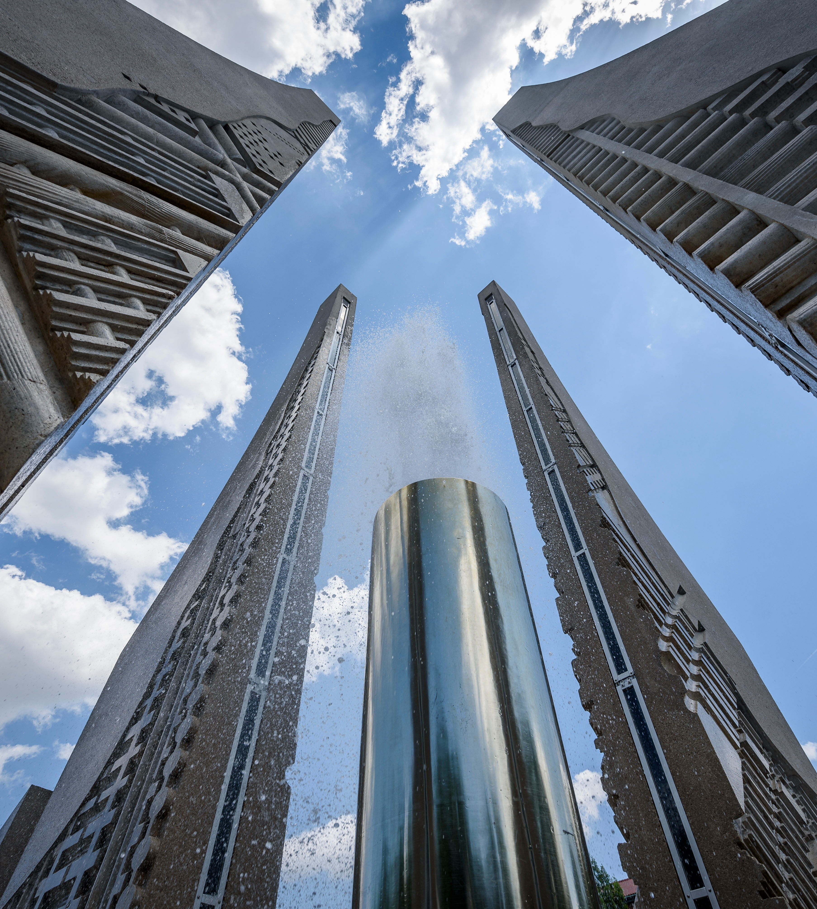

OFFICE OF INVESTMENTS
PIP PORTFOLIO UPDATE | AS OF JUNE 30, 2025
Purdue alumni association: Clubs presentation
Achieve a long-term total rate of return for the Endowment that is greater than distributions, inflation, and all costs.
Imperatives for Endowment Assets
1
Achieve the needed long-term rate of return as efficiently and effectively as possible by focusing on net return per unit of risk (Sharpe Ratio¹ > 0.50).
2

Slide 11
PIP PORTFOLIO UPDATE | AS OF JUNE 30, 2025
Purdue alumni association: Clubs presentation
Endowment Assets
★ All-Time High
$4,438

Slide 12
Percent to Various thresholds
PIP PORTFOLIO UPDATE | AS OF JUNE 30, 2025
Purdue alumni association: Clubs presentation
Current PIP Market Value
$4.44B
BTG – Distribution Trigger:
-46%
BTG – S&P 500 Trigger:
-35%
Break the Glass (‘BTG’) – Distribution Trigger indicates the instantaneous decline in Endowment market value that would make the annualized most recent distribution exceed 5.5% of Endowment market value.
BTG – Equity Trigger indicates the instantaneous decline in equities that would breach a 35% drawdown from the most recent high.
Categories with ‘Return Imperative’ are based on a 7.2% annualized return.
Notes:
MARKET VALUE CHANGE
Note: Market values reported for NACUBO include PIP plus separately held less trusts. Net Investment Return is net of Office of Investment expenses.
The percentages were calculated by taking the dollar amount and dividing it by the beginning of the fiscal year balance.
¹Net Investment Return does not match Cambridge reported performance due to valuation timing of some of the alternative asset classes as well as cash flow impact which is adjusted in Modified Dietz methodology utilized by Cambridge.
ASSET ALLOCATION VS TARGET RANGE¹
¹Allocation will not equal 100% due to cash balance. Cash balance as of May 31, 2018 was 0.8%.
Note: For Real Estate and Natural Resources, private and public allocations are combined.

Slide 13
PIP PORTFOLIO UPDATE | AS OF JUNE 30, 2025
Purdue alumni association: Clubs presentation
Fytd Performance Vs. Expected Return
 | Expected Return Imperative
Spending | 4.0%
Inflation | 2.0%
PFL | 1.2%
Total | 7.2%
+2
+1
STANDARD DEVIATIONS
-1
-2
+/- 2 Standard Deviations contains 95% of expected observations
+/- 1 Standard Deviation contains 68% of expected observations
13
Notes:
MARKET VALUE CHANGE
Note: Market values reported for NACUBO include PIP plus separately held less trusts. Net Investment Return is net of Office of Investment expenses.
The percentages were calculated by taking the dollar amount and dividing it by the beginning of the fiscal year balance.
¹Net Investment Return does not match Cambridge reported performance due to valuation timing of some of the alternative asset classes as well as cash flow impact which is adjusted in Modified Dietz methodology utilized by Cambridge.
ASSET ALLOCATION VS TARGET RANGE¹
¹Allocation will not equal 100% due to cash balance. Cash balance as of May 31, 2018 was 0.8%.
Note: For Real Estate and Natural Resources, private and public allocations are combined.

Slide 14
PIP PORTFOLIO UPDATE | AS OF JUNE 30, 2025
Purdue alumni association: Clubs presentation
FY25 in Review: Investment Returns
The Endowment ended FY25 with $426 million in investment gains and a 10.5% net return. Investment gains in dollars for FY25 ranked third, trailing FY21 and FY24.
Note: FY17 through FY25 investment return ($) from Bridge Chart data. FY02 through FY16 estimated by multiplying each fiscal year’s beginning ‘Total Combined Entities’ market value by fiscal year % return. Prior to FY02, investment impact is estimated by multiplying Endowment market value (sourced from NACUBO) reporting by fiscal year return in Caissa. Analysis begins with FY98, the first full year with monthly data available in Caissa.
Note: Dollars shown in millions.
Important Disclosures and Footnotes appear at the end of this report.
14

Slide 15
PIP PORTFOLIO UPDATE | AS OF JUNE 30, 2025
Purdue alumni association: Clubs presentation
10-Year Performance Vs. Imperatives
10-Year Sharpe Ratio
0.73
$2,540 vs. $2,043
Investment Performance
$601 Purdue Cost Inflation
$1,095 Spending Distribution
$310 PFL
$37 BNYM, CA, OOI, Accounting
15
Notes:
MARKET VALUE CHANGE
Note: Market values reported for NACUBO include PIP plus separately held less trusts. Net Investment Return is net of Office of Investment expenses.
The percentages were calculated by taking the dollar amount and dividing it by the beginning of the fiscal year balance.
¹Net Investment Return does not match Cambridge reported performance due to valuation timing of some of the alternative asset classes as well as cash flow impact which is adjusted in Modified Dietz methodology utilized by Cambridge.
ASSET ALLOCATION VS TARGET RANGE¹
¹Allocation will not equal 100% due to cash balance. Cash balance as of May 31, 2018 was 0.8%.
Note: For Real Estate and Natural Resources, private and public allocations are combined.

Slide 16


Performance vs. benchmark
PIP PORTFOLIO UPDATE | AS OF JUNE 30, 2025
Purdue alumni association: Clubs presentation
RETURN
RISK
Return Imperative (Return > distributions, inflation, and all costs)
Risk Imperative (Sharpe Ratio > 0.50)
Notes:
MARKET VALUE CHANGE
Note: Market values reported for NACUBO include PIP plus separately held less trusts. Net Investment Return is net of Office of Investment expenses.
The percentages were calculated by taking the dollar amount and dividing it by the beginning of the fiscal year balance.
¹Net Investment Return does not match Cambridge reported performance due to valuation timing of some of the alternative asset classes as well as cash flow impact which is adjusted in Modified Dietz methodology utilized by Cambridge.
ASSET ALLOCATION VS TARGET RANGE¹
¹Allocation will not equal 100% due to cash balance. Cash balance as of May 31, 2018 was 0.8%.
Note: For Real Estate and Natural Resources, private and public allocations are combined.

Slide 17
PIP PORTFOLIO UPDATE | AS OF JUNE 30, 2025
Purdue alumni association: Clubs presentation
Asset Class Performance Breakdown¹
ASSET CLASS | MONTH | CYTD | FYTD | 1 YEAR | 3 YEAR | 5 YEAR | 10 YEAR | FY2024
U.S. Equity | 5.1% | 5.8% | 15.4% | 15.4% | 19.1% | 16.1% | 12.8% | 23.2%
Global ex U.S. Equity | 3.4% | 20.8% | 19.3% | 19.3% | 15.5% | 11.5% | 6.7% | 10.7%
Emerging Markets Equity | 7.2% | 14.5% | 9.0% | 9.0% | 11.2% | 8.4% | 5.0% | 17.9%
Hedge Funds | 0.7% | 4.2% | 10.0% | 10.0% | 8.5% | 8.6% | 3.6% | 9.2%
Public Real Estate | 0.8% | 5.3% | 11.2% | 11.2% | 3.8% | 6.0% | 5.0% | 5.4%
Private Real Estate | 0.2% | 2.8% | 3.7% | 3.7% | 0.1% | 6.5% | 8.4% | -2.1%
Public Natural Resources | 4.2% | 1.4% | -1.6% | -1.6% | 10.1% | 16.3% | 1.5% | 13.4%
Private Natural Resources | 0.0% | -1.4% | 2.3% | 2.3% | 5.7% | 13.5% | 1.8% | 5.8%
Private Equity/Venture Capital | 0.1% | 2.9% | 4.3% | 4.3% | -1.7% | 16.9% | 14.0% | 6.6%
Fixed Income | 1.1% | 4.6% | 7.2% | 7.2% | 4.4% | 1.8% | 2.6% | 5.5%
Cash | 0.4% | 2.1% | 4.9% | 4.9% | 4.8% | 2.9% | 2.0% | 5.7%
Total Endowment | 2.5% | 7.2% | 10.5% | 10.5% | 8.6% | 12.4% | 8.4% | 11.7%

Slide 18
Asset Allocation vs. Target range¹
PIP PORTFOLIO UPDATE | AS OF JUNE 30, 2025
Purdue alumni association: Clubs presentation
Notes:
MARKET VALUE CHANGE
Note: Market values reported for NACUBO include PIP plus separately held less trusts. Net Investment Return is net of Office of Investment expenses.
The percentages were calculated by taking the dollar amount and dividing it by the beginning of the fiscal year balance.
¹Net Investment Return does not match Cambridge reported performance due to valuation timing of some of the alternative asset classes as well as cash flow impact which is adjusted in Modified Dietz methodology utilized by Cambridge.
ASSET ALLOCATION VS TARGET RANGE¹
¹Allocation will not equal 100% due to cash balance. Cash balance as of May 31, 2018 was 0.8%.
Note: For Real Estate and Natural Resources, private and public allocations are combined.

Slide 19
Disclosures & footnotes
Office of Investments Team Imperatives
¹Sharpe Ratio is a measure of efficiency. The CFA Institute defines it as a measure of the excess return earned above cash per unit of risk (i.e., [Portfolio Return – Cash] /Standard Deviation).
Market Value Change
Note: Market values reported for NACUBO include PIP plus separately held less trusts. Net Investment Return is net of Office of Investment expenses. The percentages were calculated by taking the dollar amount and dividing it by the beginning of the fiscal year balance.
¹Net Investment Return does not match Caissa calculated performance due to valuation timing of some of the alternative asset classes as well as cash flow impact which is adjusted in Modified Dietz methodology utilized by the Caissa platform.
Fiscal Year 2025 Performance Vs. Expectations
Note: Target return (expected return) conservatively assumes 7.2% nominal return net (per fiscal year) of third-party investment manager expenses.
Standard Deviation: +/- 1 Standard Deviation contains 68% of expected observations and +/-2 Standard Deviations contains 95% expected observations.
Performance Breakdown
Source: Cambridge Associates, Caissa (Note: Endowment performance prior to December 31, 2018, is performance as calculated by Cambridge Associates. Endowment performance beginning January 2019 is a hybrid data set of Cambridge calculated performance (pre-January 2019) and Caissa calculated performance (post-January 2019)).
Note: Time periods greater than one year are annualized. All returns are shown net of fees. As of June 30, 2025, private investments reporting valuations as of March 31, 2025, were 94.7%. Investment returns after June 30, 2019, are presented as Modified Dietz rates of return.
¹Lagged private investment valuations will be included in performance in the month they are received and not retrospectively updated as of the valuation date per the PRF Performance Policy.

Slide 20
Disclosures & footnotes
Asset allocation vs. target range
Asset Allocation targets are as follows:
Note: For Real Estate and Natural Resources, private and public allocations are combined.
¹Fixed Income includes Cash. Cash balance as of June 30, 2025, was 0.7%.
U.S. Equity 20.0%
Global ex-U.S. Equity 15.0%
Emerging Market Equity 5.0%
Hedge Funds 12.5%
Real Estate 10.0%
Natural Resources 5.0%
Private Equity/Venture Capital 25.0%
Fixed Income 7.5%

Slide 21
Disclosures & footnotes
PIP Total Fund Benchmark Composition History
 | Russell 3000 Index | MSCI EAFE Index (N) | FTSE Developed ex-U.S. Index | MSCI Emerging Markets Index (N) | Ftse Emerging Markets China A Inclusion index | MSCI Emerging Markets ex China Index | HFRI Fund of Funds Diversified Index | FTSE NAREIT All Equity REITs Index | Asset Weighted Benchmark based on Manager Index | MSCI World Natural Resources Index (N) | CPI-U + 5% | BBG Barc Aggregate Bond Index
From 02/01/94 to 12/31/98 | 45% | 10% |  | 3% |  |  | 15% | 5% |  |  | 2% | 20%
From 01/01/99 to 03/31/06 | 45% | 10% |  | 3% |  |  | 15% | 5% |  | 2% |  | 20%
From 04/01/06 to 12/31/07 | 36% | 15% |  | 5% |  |  | 15% | 7% |  | 7% |  | 15%
From 01/01/08 to 06/30/10
From 07/01/10 to 09/30/16 | 28% | 13% |  | 5% |  |  | 25% | 7% |  | 7% |  | 15%
From 10/01/16 to 07/31/20 | 40%¹ | 15% |  | 5% |  |  | 15% |  | 9% | 6%¹ |  | 10%
From 08/01/20 to 11/30/21 | 40%¹ |  | 15% |  | 5% |  | 15% |  | 9% | 6%¹ |  | 10%
From 12/01/21 to 12/31/2022 | 45%² |  | 15% |  | 5% |  | 12.5% |  | 10% | 5%² |  | 7.5%
From 01/01/2023 to Present | 45%² |  | 15% |  |  | 5% | 12.5% |  | 10%² | 5%² |  | 7.5%

Slide 22
Spending distribution discussion
Purdue alumni association: Clubs presentation
David C. Cooper
Chief Investment Officer
Sam Fehrman
Senior Investment Officer
Private and Confidential | For Intended Recipient Use Only
22
COLLABORATION | DRIVE | GROWTH | HARMONY | INNOVATION | INTEGRITY | RESPECT | RESPONSIBILITY
Notes:
MARKET VALUE CHANGE
Note: Market values reported for NACUBO include PIP plus separately held less trusts. Net Investment Return is net of Office of Investment expenses.
The percentages were calculated by taking the dollar amount and dividing it by the beginning of the fiscal year balance.
¹Net Investment Return does not match Cambridge reported performance due to valuation timing of some of the alternative asset classes as well as cash flow impact which is adjusted in Modified Dietz methodology utilized by Cambridge.
ASSET ALLOCATION VS TARGET RANGE¹
¹Allocation will not equal 100% due to cash balance. Cash balance as of May 31, 2018 was 0.8%.
Note: For Real Estate and Natural Resources, private and public allocations are combined.

Slide 23



SPENDING DISTRIBUTION
Purdue alumni association: Clubs presentation
Spending Distribution Mechanics
The Endowment distribution is currently calculated as 4% (stated spending rate) multiplied by the trailing 12-quarter average market value (calculation base). Distributions from the Endowment are paid out twice per year; once in May and once in November.
FY25 Total Endowment Distributions
$128 million
FY25 PAA Distributions
$1.4 million
Stated Spending Rate
Calculation base
Annual Endowment Distribution
x
=
Stated in Investment Policy Statement (‘IPS’), up to 5%, meant to balance current support with long-term growth of capital base.
Set in IPS, Endowment may spend on the trailing 12-quarter average market value or current market value; smoothing over the average trailing 12-quarters helps provide budget stability and insulate the distribution amount from wide swings in portfolio value.
23
Notes:
MARKET VALUE CHANGE
Note: Market values reported for NACUBO include PIP plus separately held less trusts. Net Investment Return is net of Office of Investment expenses.
The percentages were calculated by taking the dollar amount and dividing it by the beginning of the fiscal year balance.
¹Net Investment Return does not match Cambridge reported performance due to valuation timing of some of the alternative asset classes as well as cash flow impact which is adjusted in Modified Dietz methodology utilized by Cambridge.
ASSET ALLOCATION VS TARGET RANGE¹
¹Allocation will not equal 100% due to cash balance. Cash balance as of May 31, 2018 was 0.8%.
Note: For Real Estate and Natural Resources, private and public allocations are combined.

Slide 24





SPENDING DISTRIBUTION
Purdue alumni association: Clubs presentation
Historical Spending
FY25 was the largest spending distribution in the Endowment’s history and marked the twelfth consecutive year that spending distributions from the Endowment exceeded $100 million. These distributions support world-changing Boilermaker research and discovery.
Spending Support Categories
Instruction & Research
Scholarships
Loans & Student Awards
Fellowships
Construction
24
Notes:
MARKET VALUE CHANGE
Note: Market values reported for NACUBO include PIP plus separately held less trusts. Net Investment Return is net of Office of Investment expenses.
The percentages were calculated by taking the dollar amount and dividing it by the beginning of the fiscal year balance.
¹Net Investment Return does not match Cambridge reported performance due to valuation timing of some of the alternative asset classes as well as cash flow impact which is adjusted in Modified Dietz methodology utilized by Cambridge.
ASSET ALLOCATION VS TARGET RANGE¹
¹Allocation will not equal 100% due to cash balance. Cash balance as of May 31, 2018 was 0.8%.
Note: For Real Estate and Natural Resources, private and public allocations are combined.

Slide 25
SPENDING DISTRIBUTION
Purdue alumni association: Clubs presentation
Real Impact
Had someone given a $1 million endowed gift 10-years ago, the endowment would have awarded nearly $440,000 in scholarships and would currently have a market value of ~$1.3 million. This represents over $94,000 increase in real purchasing power (market value increase in excess of inflation, spending, and all costs).
Notes: Hypothetical simulation of an endowed scholarship gift over the period ending June 30, 2025. For the first three years of the f the simulation, spending and PFL expense uses the actual effective rate over those fiscal years in the calculation. Following the first three years, the trailing 12-quarter average market value is used for the calculation.
25
Notes:
MARKET VALUE CHANGE
Note: Market values reported for NACUBO include PIP plus separately held less trusts. Net Investment Return is net of Office of Investment expenses.
The percentages were calculated by taking the dollar amount and dividing it by the beginning of the fiscal year balance.
¹Net Investment Return does not match Cambridge reported performance due to valuation timing of some of the alternative asset classes as well as cash flow impact which is adjusted in Modified Dietz methodology utilized by Cambridge.
ASSET ALLOCATION VS TARGET RANGE¹
¹Allocation will not equal 100% due to cash balance. Cash balance as of May 31, 2018 was 0.8%.
Note: For Real Estate and Natural Resources, private and public allocations are combined.

Slide 26
Macro & Market Update
Purdue alumni association: Clubs presentation
David C. Cooper
Chief Investment Officer
Sam Fehrman
Senior Investment Officer
Private and Confidential | For Intended Recipient Use Only
26
COLLABORATION | DRIVE | GROWTH | HARMONY | INNOVATION | INTEGRITY | RESPECT | RESPONSIBILITY
Notes:
MARKET VALUE CHANGE
Note: Market values reported for NACUBO include PIP plus separately held less trusts. Net Investment Return is net of Office of Investment expenses.
The percentages were calculated by taking the dollar amount and dividing it by the beginning of the fiscal year balance.
¹Net Investment Return does not match Cambridge reported performance due to valuation timing of some of the alternative asset classes as well as cash flow impact which is adjusted in Modified Dietz methodology utilized by Cambridge.
ASSET ALLOCATION VS TARGET RANGE¹
¹Allocation will not equal 100% due to cash balance. Cash balance as of May 31, 2018 was 0.8%.
Note: For Real Estate and Natural Resources, private and public allocations are combined.

Slide 27
MACRO & MARKET UPDATE
Purdue alumni association meeting
Macroeconomic Overview
The current market environment has many cross currents.
Geopolitics | Escalating tensions (tariff / trade negotiations, military conflicts)
Central Bank Activity | The Federal Reserve cut interest rates in September for the first time since December 2024, and the market is currently pricing two additional cuts before year end
Inflation | Uncertain go-forward expectations combined with potentially inflationary monetary / fiscal policy
Deglobalization | Economic and geopolitical shifts away from globalization (stalling global trade, increased military spending)
High Debt Levels | Large and growing fiscal deficit (US interest expense is projected to grow at 5.5% annually over the next 30y)¹
Expensive Valuations | US equity valuations are stretched and approaching levels last seen in the dot-com era, notwithstanding a brief period following COVID
Source: Blackstone Multi-Asset Investing, CIO Perspectives.
¹ Source: Congressional Budget Office as of January 2025.
27

Slide 28
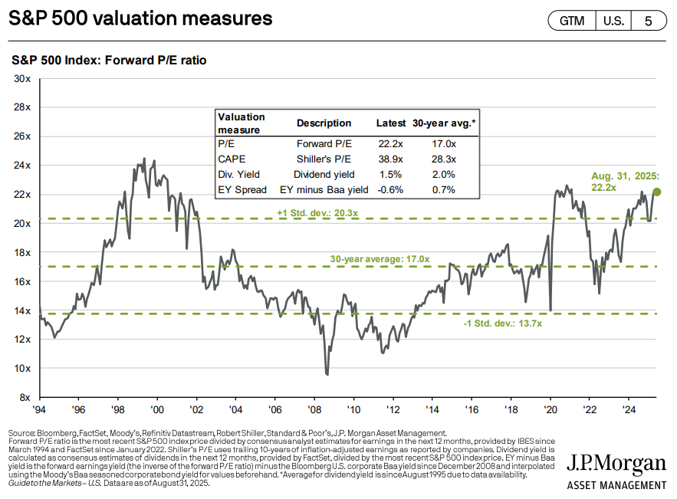
MACRO & MARKET UPDATE
Purdue alumni association meeting
Equity Valuations
Valuations are stretched and are approaching early 2000s levels.
28

Slide 29
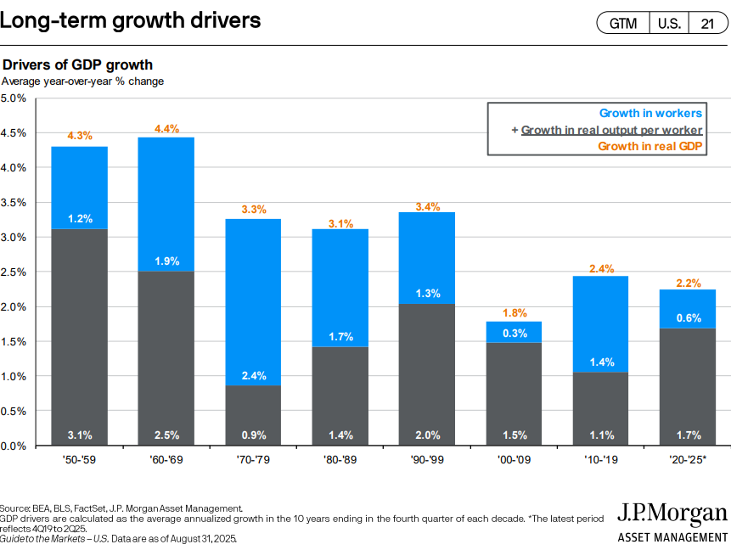
MACRO & MARKET UPDATE
Purdue alumni association meeting
Growth Drivers
Since the 90s, growth has largely been driven by output versus labor. Will AI continue this trend?
29

Slide 30
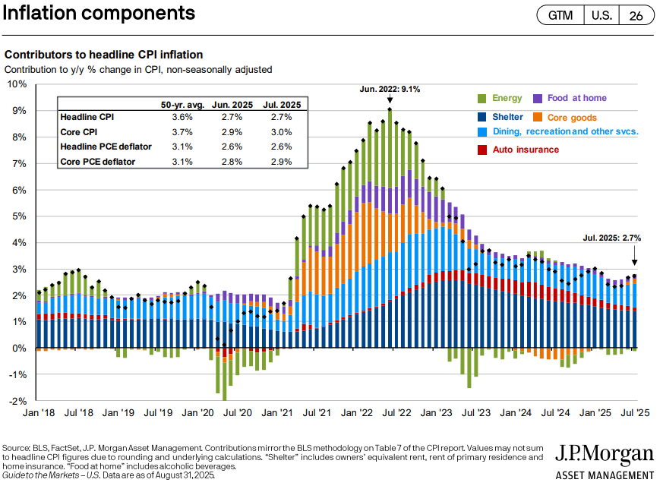
MACRO & MARKET UPDATE
Purdue alumni association meeting
Components of Inflation
Inflation has benefitted from a declining shelter component. This has been more than offset by the resumption of goods inflation and increases in dining inflation.
30

Slide 31

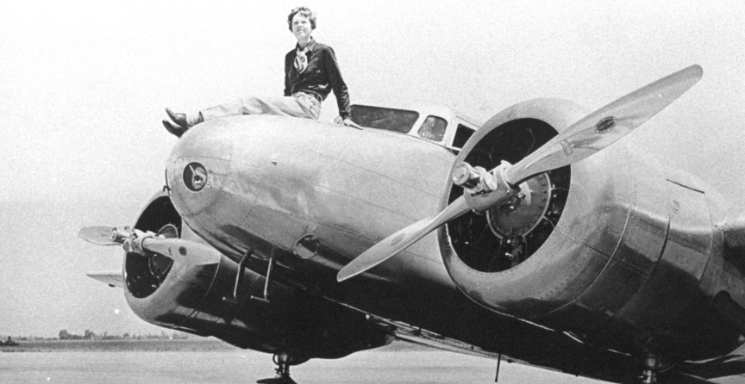
Purdue Alumni Clubs Forum
University Updates
Expedition to search for Amelia Earhart's plane has been postponed to 2026.
See the full article here: Expedition Postponed to 2026
Purdue Global Commencement Weekend: a record high of 3,147 graduates participated in virtual and in person ceremonies October 11th.
See the full article here: Purdue Global celebrates the achievements of record number of graduates

Slide 32
University Updates: 2025-2026 Enrollment
2025-2026 Freshman Class
Profile: https://admissions.purdue.edu/become-student/class-profile/
86,953
97%
43%
71%
# applications
Admit Rate
% Indiana residents Admit rate
% Admitted students who provided test scores
63,883
3.70-4.0
35
$13,890
# of Early Action applicants
High School G.P.A, Middle 50%
Average Classroom Size
Average Undergraduate Financial Aid package
28-34
23,070
ACT Middle 50%
# Regular Decision applicants
1220-1480
SAT Middle 50%

Slide 33
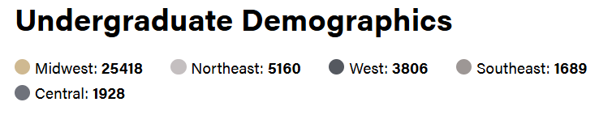
University Updates: 2025-2026 Enrollment
2025-2026 Enrollment
Full class profile: https://admissions.purdue.edu/become-student/class-profile/
57,310
Enrollment: Top 4 Colleges
33.2%
14.6%
11.9%
9.4%
# Total Enrollment
43,067
College of Engineering
College of Science
Polytechnic Institute
Daniels School of Business
# Undergraduate (75%)
13,317
# Graduate

Slide 34
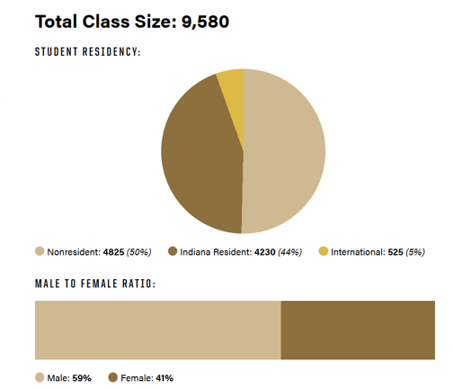
University Updates
2025-2026 Enrollment
Full Class profile: https://admissions.purdue.edu/become-student/class-profile/
1st Year Students
Transfer Students
Total Enrollment: 4,457
Incoming Transfers: 903
International Students
Total Enrollment: 9,270
Undergraduate Students: 3,974
121 Countries Represented

Slide 35
Scholarships
PFLF
DFA

Slide 36
PFLF Scholarship Timeline – Students
Dec. 1st
Jan. 15th
Feb. 1st
March 1st
Application goes live (All Students)
Admission Decisions for Early Action Applicants
Incoming freshman application deadline
Current student application deadline

Slide 37
PFLF Scholarship Timeline – Clubs
Date | Actions
November 21 | Alumni Clubs Team send letter to Clubs with scholarship projected award, timelines including for budget adjustments, the Committee Form Survey link
December 1st | Application goes live
 | NEW – Clubs confirms to Alumni team the expected projected award (increasing or decreasing the amount)
December 19 | Scholarship committee names are due
January 15th | Deadline for clubs to have money deposited into their accounts to increase award amount
 | Deadline for Scholarship committee members need to sign the Statement of Integrity and Volunteer Conduct form (if they have not already done so as a club officer)
February 15th | Deadline for scholarship committees to submit incoming freshmen ranking sheet to PFL
March 31st correction 3/15/26 | Deadline for scholarship committees to submit current Purdue student ranking sheet to PFL

Slide 38

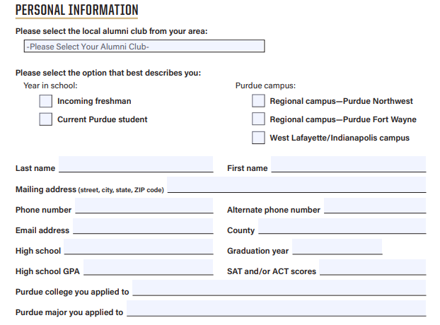
PFLF Scholarship Application Form
Overview
Full-page responses for each question and still limiting to 500 words:
Academic and Community Involvement
Work Experience
Essay Questions - Why Purdue/Impact of Scholarship/Educational Goals

Slide 39
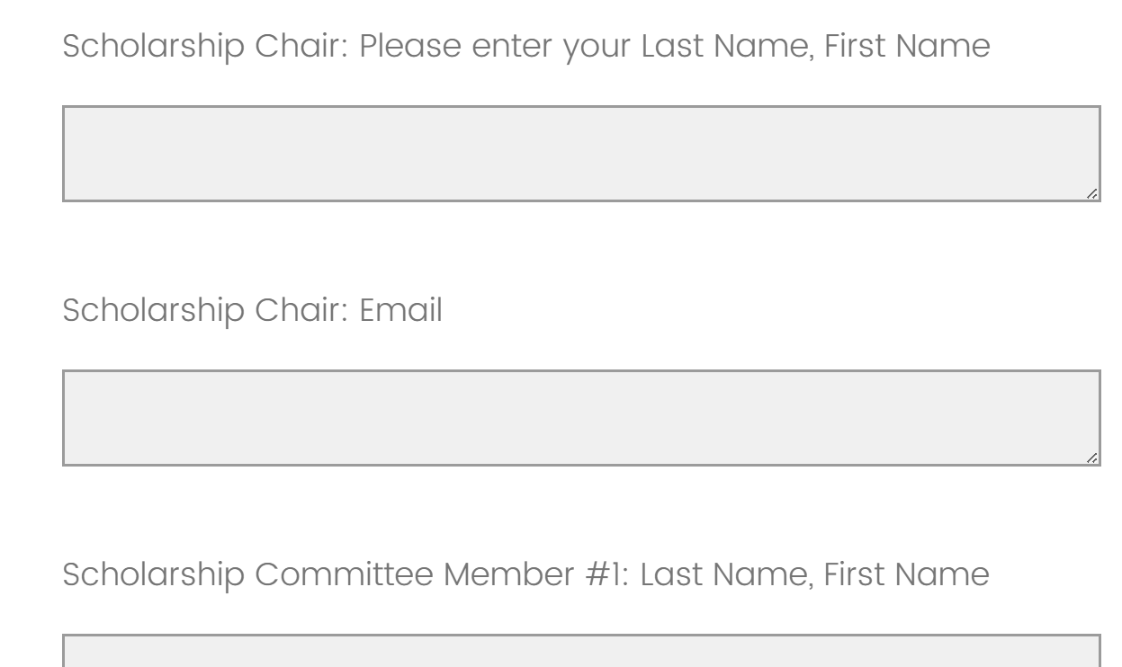
Scholarship Committees Submission Deadline
By January 15th
Submit your Committee Members name and email before or by this deadline
You can have up to 9 members. The average committee is 4 members
Scholarship committee members need to sign the Statement of Integrity and Volunteer Conduct form if they have not already done so as a club officer
If there is conflict of interest, volunteer should recuse from application review process.

Slide 40
Scholarship Budget Adjustment Request Form
By December 1st
Please email to drjernagan@purdueforlife.org the following:
Current Projected Amount
Increase or Decrease Amount
Revised Projected Amount
By January 15th
Deadline for clubs to donate additional funds to the scholarship support account to award more than the November projection amount. Action items
Donations after this deadline date to the club’s scholarship account should be utilized for next year’s award cycle, 2027-2028 academic year

Slide 41
DFA Managed Scholarships
Reminders
Selection process – There is no application, DFA selects based on financial need. They do not take requests nor recommendations as part of their process.
Awards - Based on available funding, DFA determines both the award amounts and the recipients.
There is no intake on breaking out the donation amounts in specific ways. DFA’s priority is to award as many scholarships to as many students as possible based on funds available.
Questions about DFA managed process? Please email alumniclubs@purdueforlife.org.
DFA MANAGED SCHOLARSHIPS
Evansville Scholarship
Falls Cities Scholarship
Las Vegas Scholarship
Los Angeles/Orange County Scholarship
New Jersey Scholarship
Puget Sound - Bob and Sarah Bateman Scholarship
San Francisco - John Thornberry
Southeast Michigan Scholarship
Tampa Bay - Eva Rousch Scholarship
Washington DC

Slide 42


SCHOLARSHIP PROMOTION

Slide 43
Scholarship Promotion – Alumni Club Teams Actions
Emails to Students and Parents
Admitted Students • Initial email: January 15 • Reminder: One week before the February 1st application deadline • New this year: Admitted students now have two weeks to apply (instead of one) and we’ll still align with DFA timelines so awards can appear in their Financial Aid packages.
Current Students • Initial email: Late December • Reminder: One week before the March 1 application deadline
NEW - Purdue for Life Social Media Pages
Admitted Students • Post with congratulations message (Jan 15–18) encouraging newly admitted students to apply for Alumni Club scholarships
Current Students • Post in early February highlighting how Alumni Clubs support students through scholarships (direct link to the scholarship application)

Slide 44

Scholarship Promotion – Alumni Club Teams Actions
Welcome Center/PASE
Post flyer in the Welcome Center with QR code to the application
Post the flyer on PASE social media
Admissions
August 2025: Provided list of scholarships to staff for awareness
We’ll post reminders in the Club Leaders Facebook Group to keep promotion going.

Slide 45
Scholarship Promotion - Club Leader Actions
Promote during In-Person Events: Take a moment to promote scholarships during in-person events, encourage friends and fans to apply or get the word out.
Use the flyer and PAA Scholarship Application tents and Scholarship flyer (will emailed by D. Jernagan)
If awarding to freshmen, reach out to local high schools – Send a flyer or a letter directed to High School counselor (High School staff directory or call the school)
Add to a club Newsletter or Social Media Posts
Clarity in Posts: Explicitly state the application processes, deadline, any relevant eligibility criteria and a link to the application
Additional Social Media training: May 2025 Social Media Best Practices - How to maximize social media postings, tools use, including pre-scheduling your posts
PFLF Interns Surveyed Last Year’s Stats
How many clubs promoted the scholarship via Social Media last year?
Facebook: 18
Instagram: 4
Facebook & Instagram: 3
Let’s increase our application numbers by promoting the scholarships!

Slide 46

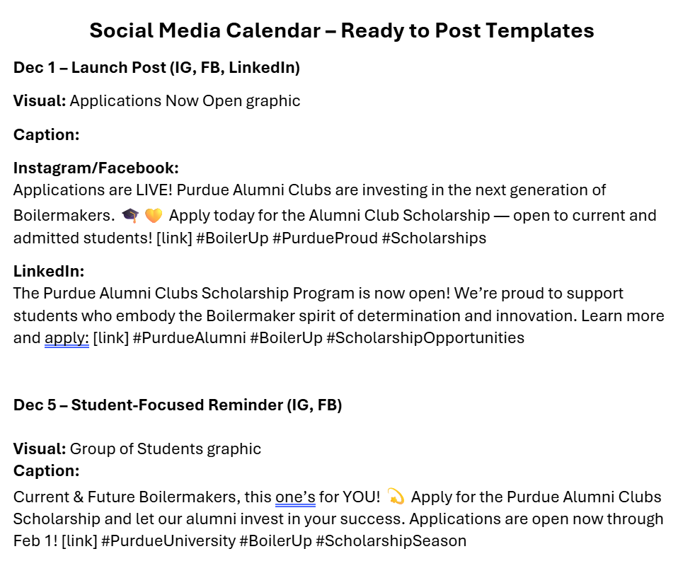
Scholarship Promotion - Club Leader Actions
Social Promotion
NEW - Social Media Posting - Ready to Post Templates
The Alumni Team will send the following post-forum:
Create and post flyer with QR code to the application in social media platforms
You can create a flyer via Canva or similar applications. The only requirement for Clubs is to use your Club’s official logo
Application QR code by Dec 1st to use on your flyers and social media promotion
Social Media Posting Templates
February In-Person Presentation – PSUB

Slide 47
Final Reminders

Slide 48
Coming Up Next
December
Student Events
Event Forms due
Nov 1 – Nov 20
Thanksgiving to
Dec. 1
Scholarship Applications Go Live
December
Promote Scholarships!
Mid-January
Keep on Promoting Scholarships!
Brain Share
January 21
7:30pm
February
NEW - Confirm by Dec. 1st expected projected award to Alumni Clubs
Student Email Data needs to be requested to Purdue which adds 2 weeks to the Process
Maximize your 3 emails
PFLF Closed Nov. 27-28
Last attendee reports to be sent 11/26
Prospective and current students can apply
Clubs begin promoting their scholarship(s)
No Forum: Alumni Club Newsletter
PFLF Foundation closes from Dec. 24th to January 2nd. - Submit your events form requests by December 12 5PM
Alumni Club will pick up the scheduling of Club Mid-Year Check-Ins
Engagement Funds Disbursement
Mid-year Check-Ins
(Jan-March)
Plan any survey's and begin planning for elections.
Agenda
General Fundraising ideas
Planning for PDOG
MARCH - Big Ten Tourney & March Madness planning
Finish the year strong
Admitted Freshman Scholarships
Students' applications due Feb. 1st
Scholarship committee freshmen rankings due Feb. 15th
Naples – Feb 11-15
Forum: February 18 – 7:30pm (PDOG, Elections Process)

Slide 49
Event Reimbursement Process & Support Options
Acknowledgement: We understand delays in reimbursement are inconvenient. Some steps are handled externally, but we’re monitoring the process and appreciate your patience while we improve it
We Understand the Impact: Delays can affect vendor payments or require out-of-pocket expenses. To help, we offer:
Advance Payments: We can cover deposits/invoices via corporate card, deducted from registration fees.
Direct Vendor Payments: We can pay vendors directly (3–6-week processing), starting before the event.
Other Arrangements: Special cases may qualify for alternative solutions—contact Denise or Ilenia early.
Important: Advance notice is essential. Once your event date/venue is confirmed, reach out ASAP so we can strategize with you. The earlier you involve us in the process, the more options we can determine.

Slide 50
Engagement & Events Form & Game Watches
Fixes Include:
Community Type Options:
Alumni Clubs – for all club leaders (select your club from the dropdown list)
PFLF Club Staff – for internal use only
Information Now Successfully Captured:
Event date, time, and time zone
Venue name
Registration fees
Game Watch Submissions:
Basketball season dates updated through the regular season
Added Notes box for extra details (e.g., multiple locations or optional scholarship donation links)

Slide 51
Engagement & Events Form & Game Watches
Current Glitches:
Number of tickets available is still not populating — please include this in the Additional Notes section.
Game Watch Submission Form is temporarily offline.
Until resolved, please email lewilliams@purdueforlife.org and alumniclubs@purdueforlife.org with:
Date(s) of your game watch
Location(s)
Optional scholarship donation link (Endowed or Supported)
Deadline for Submission: Mondays at 12:00pm (noon ET)
Attachments: The system is currently not accepting attachments via the form.
After submitting your event, please email any attachments (newsletters, flyers, etc.) to alumniclubs@purdueforlife.org, and we’ll upload them to your case.

Slide 52
Events Information and Reminders
Footer Option: You can request a footer in the notes section of the event form to promote:
Upcoming events,
Game watches,
Scholarship applications
They can be included in all club newsletters, event invites, and other communications during each season
You must request the footer for each event submission.
Recognition Program - If you would like to know where your club currently stands in the Recognition Program, please contact lewilliams@purdueforlife.org.

Slide 53
Student Events for PASE – Volunteers Needed
Coffee and Conversations - Tuesday, Dec. 2nd (9 am-12 pm) - Boilermaker Station Welcome Center, Stewart Room 102
Students are invited to network and talk with Purdue alumni about topics such as career paths, life after Purdue, or field-specific experiences. Free coffee and donuts will be provided for alumni volunteers. # Volunteers Needed: 10
Alumni Networking Night - Thursday, March 5th 6-8:30 pm) - Dauch Alumni Center
This ticketed evening event centers on meaningful networking and conversation, featuring heavy hors d’oeuvres and desserts. It’s one of our largest annual programs and draws students from all majors to practice their networking skills. A guest speaker may also be included (TBD). # Volunteers Needed: 75
Career Readiness Night (Formerly Mock Career Fair) – Wed., April 15th (6-9 pm) - 2nd Floor, Stewart Center
This is PASE’s largest annual event, where students can have their résumés reviewed, participate in mock interviews, network, and attend panel discussions on a range of topics. All activities are facilitated by Purdue alumni, providing a valuable opportunity to help prepare the next generation of Purdue graduates for their careers. # Volunteers Needed: 30-40
Please complete the Alumni Volunteer Form to Sign Up

Slide 54
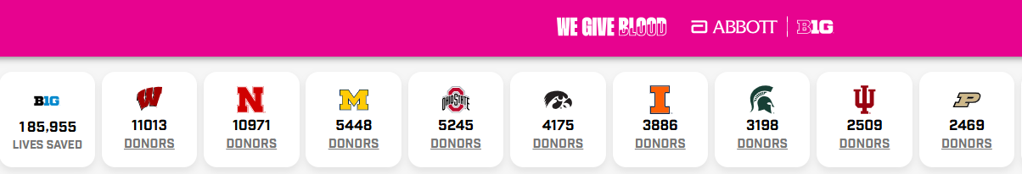
Big Ten Blood Drive $1 Million Competition– Aug. 27- Dec. 5th
Winner Announced at the Big Ten Football Championship Game on Dec. 6
Abbott and the Big Ten are teaming up to address critical blood shortages!
The school with the most participation will receive $1 million to advance student or community health
Purdue campus blood drive page: bit.ly/Purdueblood – updated as new drives are added
For donors in Versiti states (IN, IL, OH, MI, WI):
Schedule your appointment through Versiti
Enter “Purdue” in the Notes section so staff can confirm your donation counts toward the Big Ten/Abbott Challenge and guide you
Clubs in these states interested in hosting a blood drive may contact Amanda Manley, amanley@versiti.org
For donors in all other states:
Schedule your appointment at bigten.org/abbott
Remember to take a photo of your donation card to upload after donating

Slide 55
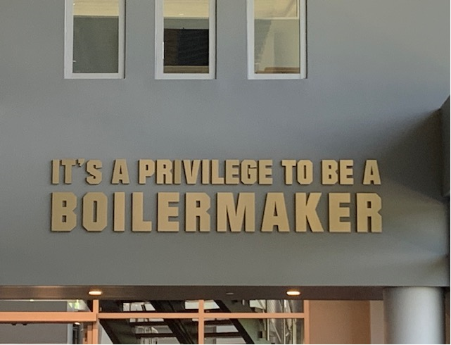
Thank you!
Newsletter, December (No Forum) – Look out for the Alumni Clubs Team Newsletter around Dec. 9th (Mid-Year Recognition Program standings, Scholarship Promotion Updates/Ideas, Winter Shutdown reminders)
Brain Share #2, Wednesday, January 21 at 7:30 pm – Agenda: Overview of the Election Process Readiness and Overview; PDOG Updates
Forum, Wednesday, February 18 at 7:30 pm – Agenda: Overview of the Election Process Readiness and Overview; PDOG Updates
Recordings of past forums and Brain Shares are available on the Alumni Club Resource Library website: https://www.purdueforlife.org/alumni-leaders/clubs/resource-library/

