Slide 1
Alumni Club Leaders Forum
May 27, 2026

Slide 2
Purdue Alumni Clubs Forum
Reminders & Instructions
This forum is being recorded to share along with slides and chat content
Participants will be muted
Questions should be submitted using the chat function

Slide 3
Purdue Alumni Clubs Forum
Agenda
University Updates
Purdue for Life Updates
Alumni Clubs Updates
  Engagement Strategies
  Alumni Leaders’ Dashboard
  Next Steps - “Welcome to the Club” and Tools for Clubs
  ACES update
  Reminder of Awards
  PDoG Club Challenge Winners

Slide 4
Purdue University Updates
President Mung Chiang Announcement:
Purdue President Mung Chiang has announced that he has accepted the position of President at Northwestern University. While we will certainly be sad to see him leave Purdue, we are grateful for his vision, leadership, and commitment to the University during his time here. We wish President Chiang and his family all the very best as they begin this next chapter.
As we reflect on this news, it is important to remember that the work of PFL continues. Our mission remains unchanged: to help those who love Purdue stay connected, get involved, and give back. Victories & Heroes: Your Campaign for Purdue continues to be our top priority, and thanks to your incredible work, we have already surpassed $2.2 billion raised and recently reached the campaign’s halfway point.
Should you need any talking points, please use the following:
President Mung Chiang has informed Purdue’s Board of Trustees that he has accepted the role of president of Northwestern University, effective July 1, 2026.
Dr. Yingkei Hui (Purdue First Lady) will also transition to Northwestern Memorial Hospital as an internal medicine physician.
The Board of Trustees will appoint an interim president in the coming weeks.
A national search for Purdue’s next permanent president will begin shortly thereafter.
Purdue Metrics:
14 years of frozen tuition
#8 Public University in the United States
“New Ivy” designation
The Purdue Board of Trustees appointed Mitch Daniels to serve as interim president of Purdue University, effective July 1.
Notes:
50 Purdue free courses: https://www.purdue.edu/newsroom/2026/Q1/purdue-expands-lifelong-learning-portfolio-to-50-free-online-courses-for-alumni/
PWN registration: https://www.purdueforlife.org/womens-conference/
Purdue Day of Service: https://events.blackthorn.io/en/3ktO526/2026-spring-day-of-service-4a9GQp1lhd/overview
GPU

Slide 5

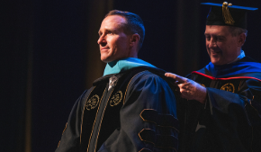
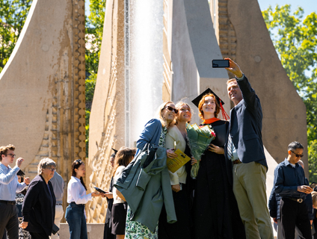
Purdue Alumni Clubs Forum: Updates
Day of Giving Success (3rd highest ever) - During Purdue University’s 13th Day of Giving on April 29, 2026, Boilermakers around the globe came together to make victories possible throughout the 24-hour online, social media-driven fundraising effort. Their collective generosity resulted in $95.5 million raised through 34,454 gifts, which brought Purdue Day of Giving’s cumulative total since its launch in 2014 to $697.6 million.
Purdue celebrates over 10,000 graduates for second consecutive year at spring commencement ceremonies - The Class of 2026 in spring, the largest to date for Purdue’s main campus (West Lafayette, Indianapolis and online), included 7,748 undergraduates, 2,296 graduate students, 268 students from professional programs and 90 students from Purdue Polytechnic Institute’s statewide programs. Drew Brees received an honorary doctorate from the Mitch Daniels School of Business.
Notes:
50 Purdue free courses: https://www.purdue.edu/newsroom/2026/Q1/purdue-expands-lifelong-learning-portfolio-to-50-free-online-courses-for-alumni/
PWN registration: https://www.purdueforlife.org/womens-conference/
Purdue Day of Service: https://events.blackthorn.io/en/3ktO526/2026-spring-day-of-service-4a9GQp1lhd/overview
GPU

Slide 6


Purdue for Life Updates
Travel 2026-2027 new catalog of travel trips is out - https://www.purdueforlife.org/travel/
FYE Campaign – Fun Swag!
  Gifts of $10 - $74.99 = Purdue Sunglasses
  Gifts of $75+ = Sunglasses & Beach Towel
  Can give to any fund; gift must be made prior to June 30th

Slide 7
ACES 2026

Slide 8
Advancing Club Engagement and Strategy (ACES) Conference
📣 Mark your calendars! Join us Advancing Club Engagement and Strategy (ACES) Conference — two days of collaboration, innovative ideas, and meaningful connections with fellow club leaders.
📍 Location: Dauch Alumni Center
📅 Schedule:
Wednesday, August 5
  Sessions: 1:00–5:00 PM*
  Social Hour: 5:30–6:30 PM
Thursday, August 6
  Sessions: 8:30 AM–1:30 PM*
  Networking Session: 1:30–2:30 PM
💻 Virtual Attendance Available: All conference sessions will also be offered live via an online platform, allowing virtual attendees to participate in real time.
Notes:
https://forms.office.com/Pages/ResponsePage.aspx?id=7UBb4sj5uUSUIP4chmQYVJAryX-3njNFhtAyci0RbKtUMjYzNUdPVUs1WjRHRktFVERBVFJWMkMwWS4u

Slide 9
ACES Conference – Additional Information
🤝 1:1 Meetings* with the Alumni Clubs Team:
Morning of August 5
Afternoon of August 6
*Virtual meetings can also be scheduled
🍽️ Included with your free Registration
Wednesday: Afternoon snacks
Social Hour: Hors d'oeuvres & beverages
Thursday: Breakfast & lunch
Travel Support: Engagement funds may be used to help subsidize conference-related travel expenses, including hotel, meals, and transportation (please note: alcohol is not eligible).
Up to $150 per in-state traveler
Up to $300 per out-of-state traveler
Itemized receipts must be uploaded through the bank statement portal to document how funds are used.
Notes:
https://forms.office.com/Pages/ResponsePage.aspx?id=7UBb4sj5uUSUIP4chmQYVJAryX-3njNFhtAyci0RbKtUMjYzNUdPVUs1WjRHRktFVERBVFJWMkMwWS4u

Slide 10
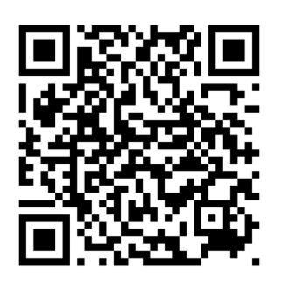
ACES Conference – Registration and Award Nominations
Registration:
You can register for:
In-Person (Day 1, Day 2, Both)
Virtual
Wednesday Night Social Hour
1:1 Meeting with Team Member
Awards & Nominations (Due June 30) – Your opportunity to recognize your outstanding volunteers and clubs
Boilermaker Pride Award Nomination: https://purdue.ca1.qualtrics.com/jfe/form/SV_3rNBcxPTnG8tibc
ACES Awards Nominees: https://purdue.ca1.qualtrics.com/jfe/form/SV_e2uGFdPpDqHtdHM
Notes:
https://forms.office.com/Pages/ResponsePage.aspx?id=7UBb4sj5uUSUIP4chmQYVJAryX-3njNFhtAyci0RbKtUMjYzNUdPVUs1WjRHRktFVERBVFJWMkMwWS4u

Slide 11

Engagement Strategies

Slide 12

Graduates of the Last Decade (GOLD) Engagement Strategies
What GOLD Want:
Meaningful Connections
Career & Networking Opportunities
Flexible Involvement
Social/Community Experiences
Authentic Engagement Over Formal Structure
Key Strategies for Clubs:
Create Experiences, Not Just Meetings
  Happy hours, game watches, city outings, wellness events, social mixers
Add Professional Value
  Networking nights, mentorship, AI/career workshops, industry panels
Offer Micro-Volunteer Opportunities
  Event support, social media ambassadors, mentors, young alumni committees
Prioritize Digital Engagement
  Instagram Reels, GroupMe/WhatsApp, alumni spotlights, interactive content
Build Belonging & Community
  “Welcome to the City” events, affinity groups, young alumni socials
Notes:
https://forms.office.com/Pages/ResponsePage.aspx?id=7UBb4sj5uUSUIP4chmQYVJAryX-3njNFhtAyci0RbKtUMjYzNUdPVUs1WjRHRktFVERBVFJWMkMwWS4u
May we will discuss great events, strategic planning for end of year.

Slide 13

General Summer Engagement Ideas - Discussion
Popular Summer Events
  Signature events - Annual Golf Outings, Student Send-Offs
  Family Events
  Picnics
  Hiking trails in national parks
  Winery Events
  Coffee Shop Meet Ups
  Volunteering Events (e.g., planting a garden, beach clean ups, etc.)
Other Engagement Tips
Ensure there is a point of contact to follow up with newcomers. Ask for their mobile number or connect via LinkedIn to invite/encourage them to upcoming events
Be open to ideas – If a group of alumni, parents or friends have an suggestion for an event, learn about their interest and encourage them to make the event happened while working with a board member.
Notes:
https://forms.office.com/Pages/ResponsePage.aspx?id=7UBb4sj5uUSUIP4chmQYVJAryX-3njNFhtAyci0RbKtUMjYzNUdPVUs1WjRHRktFVERBVFJWMkMwWS4u
May we will discuss great events, strategic planning for end of year.

Slide 14



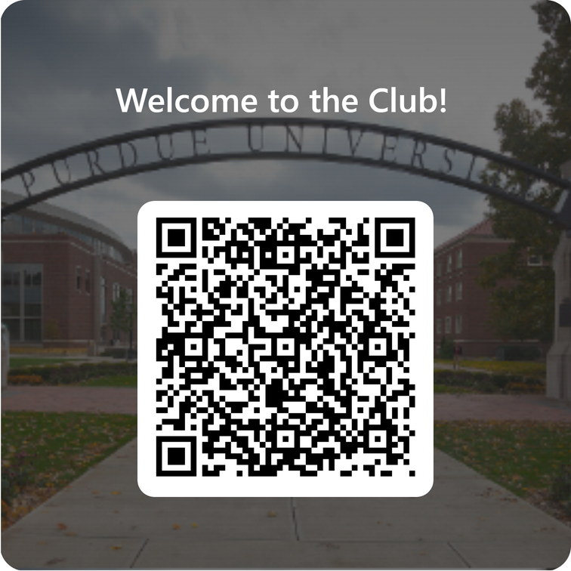
Student Pathways to Clubs
We have created a way for you to communicate to recent grads in your area specifically for clubs via a “Welcome to The Club” email.
The “Welcome to the Club” email.
We will email graduates who wish to connect with their local Club.
Please respond to Carol Smith's Survey by June 16.
Club Info is needed
Fill out the form in the QR to help create a “Welcome to the Club” email.

Slide 15
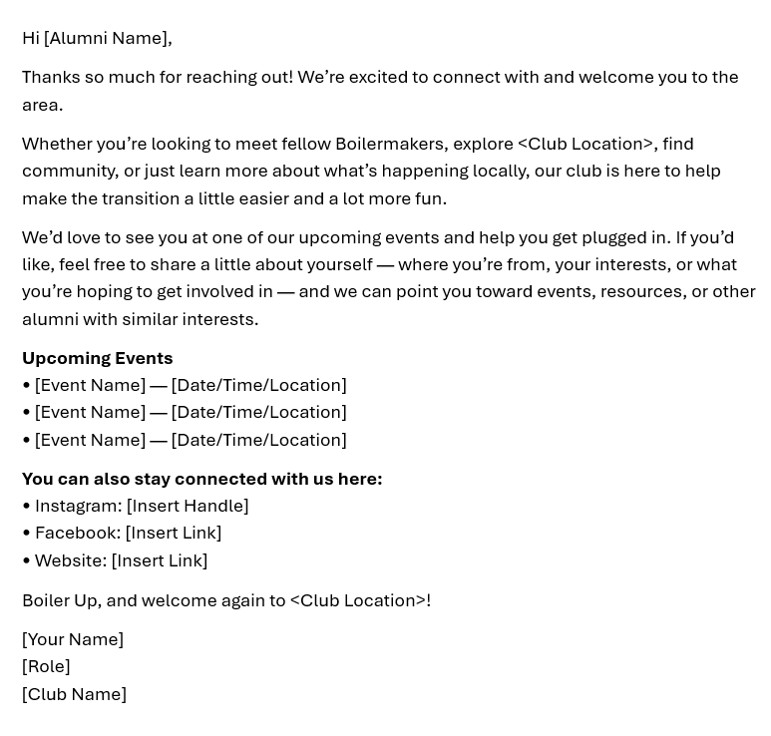
Resources Available : Welcome to the Club Email Reply
Reply Email Template:
Carol's email to be sent out on 7/10 to graduates
Customizable to each club
Add upcoming events and ways to stay connected
Will send link to document within 48 hours of forum
Notes:
https://forms.office.com/Pages/ResponsePage.aspx?id=7UBb4sj5uUSUIP4chmQYVJAryX-3njNFhtAyci0RbKtUMjYzNUdPVUs1WjRHRktFVERBVFJWMkMwWS4u
May we will discuss great events, strategic planning for end of year.

Slide 16
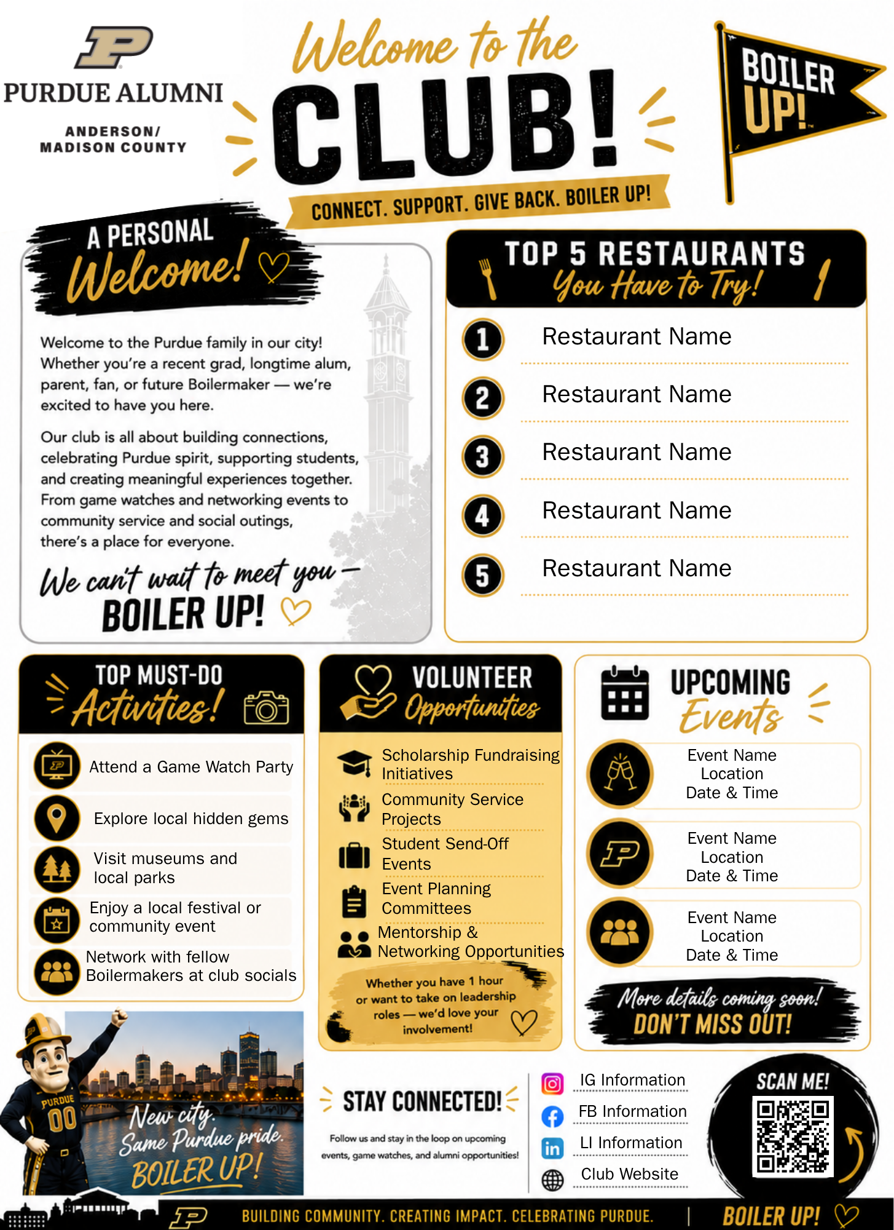
Social Media Resource:
Customizable to each club
Editable Canva link
Share via your club's social media pages

Slide 17
Reminders & Updates:
Operations

Slide 18
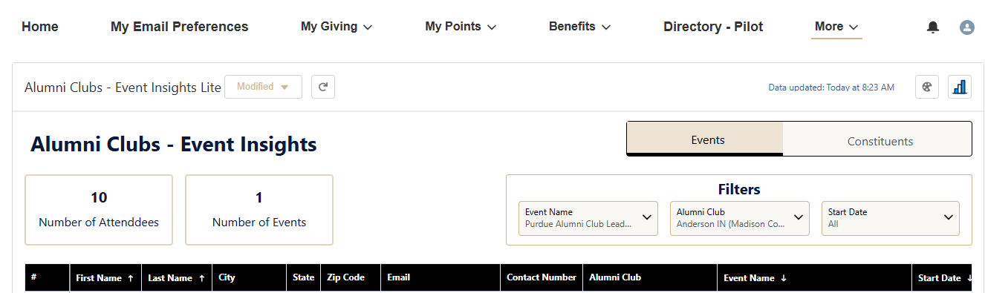
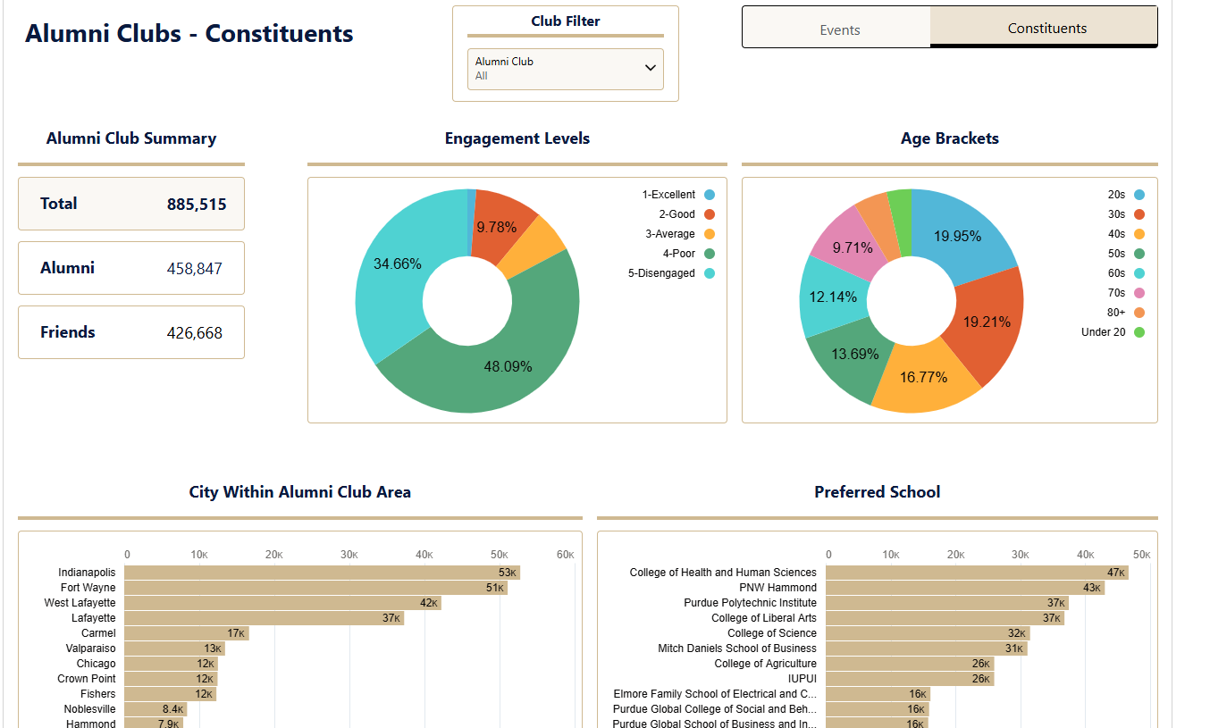
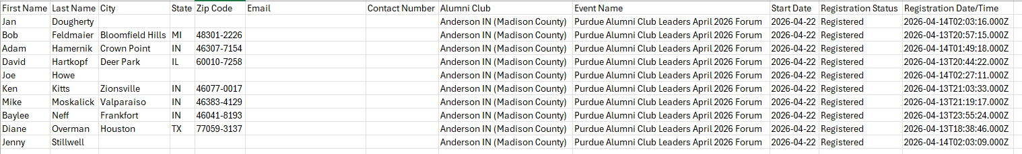
Operational Reminders & Updates:
Alumni Leaders' Dashboard
Notes:
Pull up the dashboard.

Slide 19
Operational Reminders & Updates:
Alumni Leaders' Dashboard (cont.)
This dashboard will give you direct access to attendee lists for all of your open events, so you’ll no longer need to email us each time you want an update. You’ll be able to log in whenever you’d like to review registration activity.
In addition to attendee lists, the dashboard also includes a Constituents tab, where you can explore helpful insights such as:
  Number of alumni and friends in your area
  Engagement levels
  Age brackets
  Cities represented
  Schools/Colleges
For more information and to gain access please reach out to alumniclubs@purdueforlife.org

Slide 20
Operational Reminders & Updates:
Alumni Leaders' Dashboard (cont.)
Access Requirements & Visibility:
  Completion of the annual Data Privacy Training
  Demonstrated need to view event attendee lists
  Designate 1-2 leaders for access (maximum number is 2)
  DO NOT share Usernames/Passwords with other individuals
    Access is through the leader's personal Purdue for Life Portal account (formerly Purdue Connect) which contains sensitive personal information such as:
      Personal giving history
      Contact details
      Personal preferences and engagement data that can be updated by whoever logs in.
For more information and to gain access please reach out to alumniclubs@purdueforlife.org

Slide 21
Let’s Finish the Year Strong with a Great Calendar of Events
Funds are based on
Submission of the annual agreement.
Adherence to the annual agreement requirements.
Submission of the volunteer agreement by each individual board member.
Submission of quarterly financial reports.
Number of Purdue Alumni Association (PAA) members in the club’s geographic area.
The standing of the club based on the recognition program
  Gold = $2.50 per PAA member in the club’s geographic zip code area and $500 in operational funds
  Silver = $1.50 per PAA member and $500 in operational funds
  Bronze = $500 (flat amount)
Scholarship donation (if Gold or Silver)
  Gold = $1,000 ($500 for clubs that have accounts outside of the Purdue Research Foundation)
  Silver = $600 ($300 for clubs that have accounts outside of the Purdue Research Foundation)
Gold = 8 events, including 1 Scholarship Fundraising Event
Silver = 5 event, including 1 Scholarship Fundraising Event
Bronze = 3 events
Recognition Program
3rd Quarter FY '25-26
Gold = 43
Silver = 6
Bronze = 9
FY '24-25 Final Results:
Gold = 37
Silver = 6
Bronze = 11
Recognition Numbers have been updated through 3rd quarter, reach out to LeAnne if you want to know your club's status.
Notes:
https://forms.office.com/Pages/ResponsePage.aspx?id=7UBb4sj5uUSUIP4chmQYVJAryX-3njNFhtAyci0RbKtUMjYzNUdPVUs1WjRHRktFVERBVFJWMkMwWS4u
May we will discuss great events, strategic planning for end of year.

Slide 22
Operational Reminders & Updates:
W-9 & Federal Tax ID Clarification
We've identified a past miscommunication regarding W-9s and Federal Tax ID numbers.
All alumni clubs use the Purdue Alumni Association (PAA) Federal Tax ID – not the Purdue for Life Foundation (PFLF) or Purdue Research Foundation (PRF) ID.
If a venue, sponsor, employer, or vendor requests a W-9 or Federal ID, contact alumniclubs@purdueforlife.org.
Ilenia or Denise will provide the correct documentation.
We apologize for the confusion caused by prior communication indicating otherwise.
Notes:
We recently reviewed our processes and discovered there has been some confusion around W‑9s and Federal Tax ID numbers. To clarify, all alumni clubs operate under the Purdue Alumni Association, not the Purdue for Life Foundation or Purdue Research Foundation. Because of this, clubs must use the PAA Federal ID. If anyone requests a W‑9 or tax ID, please reach out to alumniclubs@purdueforlife.org, and Ilenia or Denise will provide the appropriate documentation. We recognize that different information was shared in the past and sincerely apologize for the confusion.

Slide 23

Emergency & After Hours Support
This process is intended for urgent, time-sensitive situations that require immediate communication to attendees before they travel to an event.
How to Submit an Emergency:
Email alumniclubs@purdueforlife.org
  CC LeAnne Williams
Submit at least 3 hours prior to the event start time
  Clearly describe the emergency and specify the action(s) needed
Examples of Emergencies:
Weather-related changes
Venue or location changes
Parking or arrival updates
Event cancellation or rescheduling
Sample Language:
“Due to the weather, we will be moving the picnic into Shelter 3, located near the west parking lot.”
“Due to an incident at the venue, we will be rescheduling this event to a future date.”

Slide 24
PFLF Offices Closure – Event, Email and Newsletter Submissions
The Purdue for Life Offices will be closed from Wednesday, July 1 through Monday, July 6. Our Offices will reopen on Tuesday July 7, 2026.
Please be advised of the following deadlines to submit email requests:
Emails going out before the closure should be requested by end of day Friday, June 19.
Emails going out during the closure should be requested by end of day Monday, June 22.
Requests submitted during the closure will be processed when the Foundation reopens on Tuesday, July 7, 2026 and will follow the standard 4-business day rule for build, data handling, quality assurance, and scheduling.

Slide 25
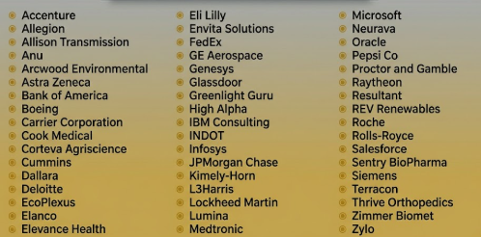
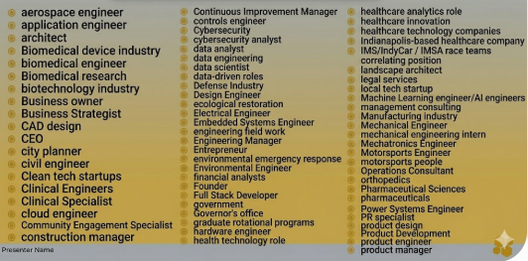
Indy Amplify Program: Experts Needed in Indy
Indy Amplified: Summer in the Circle City: the program is looking for 30 people in and around Indy!
If you have any leads on alumni from the following companies/industries, please email alumniclubs@purdueforlife.org

Slide 26
Purdue Day of Giving Wrap-Up

Slide 27

Purdue Day of Giving
Purdue Day of Giving:
3 Clubs hosted a PDoG Weekend event
25 clubs received a donation/participated
Scholarship Bonus to be awarded as follows:
  Participation Leadership Board Winners (#of Gifts):
    Jackson County = 307 ($1,000)
    Clinton County = 282 ($700)
    Cleveland = 83 ($500)
    Sarasota = 47 ($200)
  Donation Leadership Board Winners ($ of Gifts raised):
    Falls Cities = $16,400 ($1,200)
    Clinton County = $16,085 ($800)
    Jackson County = $14,410 ($600)
    Dayton = $5,272 ($500)
  Congratulations to all the Alumni Clubs who work hard to support Purdue Students with their Scholarship Fundraising efforts!

Slide 28
Alumni Clubs Team: Calendar

Slide 29
Coming Up Next
June
July
Board Transitions
ACES Prep
August
ACES
Board Elections Finalized
ACES Award Nominations
Election results submitted to Alumni Clubs Team by May 31, 2026
Start planning your board transitions, student send-offs,
family friendly events!
LeAnne Williams is hosting a Purdue Travel trip (5/29 – 6/6). If you email her during this time, please cc alumniclubs@purdueforlife.org.
PFLF Foundation closes from July 1-6.
Please be advised of the following deadlines to submit email requests:
Emails going out before the closure should be requested by end of day Friday, June 19.
Emails going out during the closure should be requested by end of day Monday, June 22.
ACES Awards Nominations are due June 30 – Nominate to reward board members and volunteers!
Boilermaker Pride Award Nomination: https://purdue.ca1.qualtrics.com/jfe/form/SV_3rNBcxPTnG8tibc
ACES Awards Nominees: https://purdue.ca1.qualtrics.com/jfe/form/SV_e2uGFdPpDqHtdHM
June 15 – Club leadership rosters are due
June 25 – Statement of Integrity submitted by all board members
The Alumni Clubs Team will be at:
PWN Annual Conference (Indy)
  June 24-25
Grandparents U
  July 16–17
  July 23–24
ACES Prep for your 2026-2027 Club Strategy Discussions. Forms will be sent by
mid July
Top 3 annual goals for your club
Calendar of event ideas, etc.
Event in a Box example to submit
ACES August 5-6!
In person
Ability to attend virtually

Slide 30
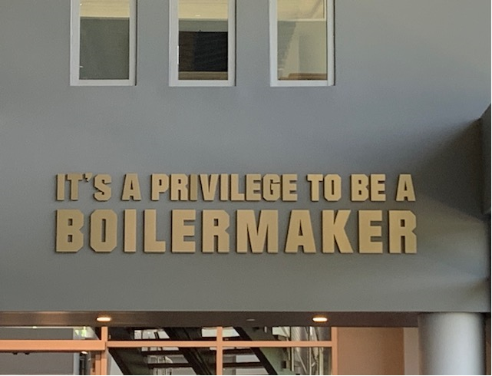
Thank you!
The next forum will be Wednesday, June 17, 2026, at 2:30pm ET.
Recordings of past forums are available on the Alumni Club Resource Library website: https://www.purdueforlife.org/alumni-leaders/clubs/resource-library/

