Slide 1
Alumni Club Leaders Forum
June 17, 2026

Slide 2
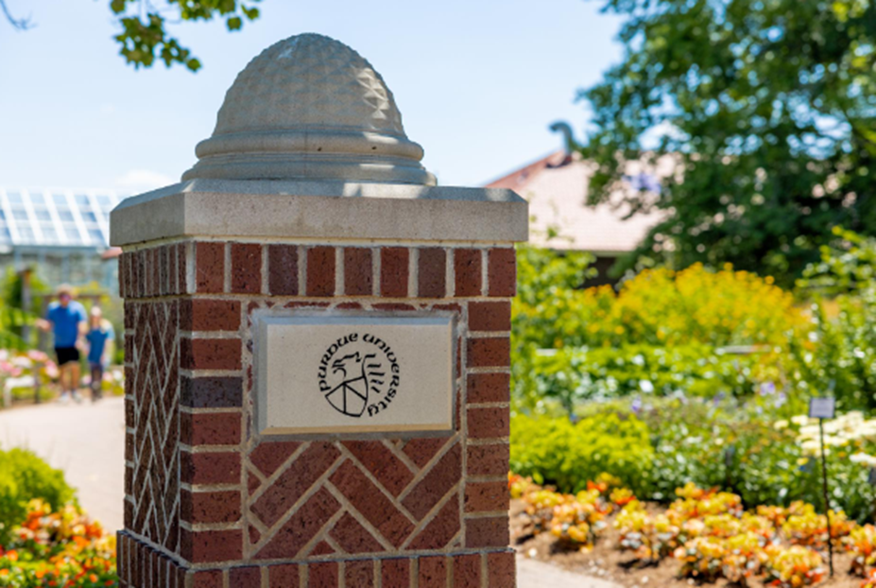
Purdue Alumni Clubs Forum
Reminders & Instructions
This forum is being recorded to share along with slides and chat content
Participants will be muted
Questions should be submitted using the chat function

Slide 3
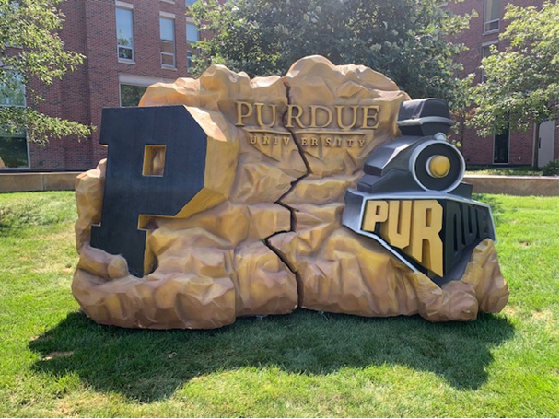
Purdue Alumni Clubs Forum
Agenda
University Updates
Purdue for Life Updates
Alumni Clubs:
  Preparing for FY 25/26
      Club Leaders Roster
      Club Agreement
      Statement of Integrity
      Planning for Transitions & Board Meeting Best Practices
  Recognition Program
  Game Watches
  ACES Updates
  Social Media Updates
  T-shirts: Trademarks and Licensing
  Reminders

Slide 4
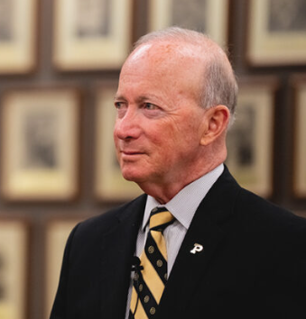
Purdue University Updates
Mitch Daniels as Interim President - The Board of Trustees asked Mitch to return as interim during the time they work to identify and select the next president for Purdue University.
  The Trustees will initiate a national search within the next weeks.
  It is expected that the process will take several months.
  President Daniels will stay on as interim president until the next president takes office.
  14th Year of Tuition Freeze
  Undergraduate tuition and mandatory fees at Purdue’s main campuses (West Lafayette and Indianapolis) remain frozen for a 14th consecutive year. Tuition and mandatory fees will also be frozen for Indiana residents at Purdue Fort Wayne and Purdue Northwest for the 2026–27 academic year.
Notes:
Impact: Reinforces Purdue’s strength in career readiness and workforce alignment, enhancing its global competitiveness and reputation.

Slide 5


Purdue University Updates
Moving up on the rankings
No. 1 public university in Indiana: Purdue ranks as Indiana’s top public university per the inaugural Subject100 placing No. 17 among U.S. public universities and No. 66 overall, highlighting the strong value of the Boilermaker experience.
Purdue’s global rise: Purdue climbed to No. 88 in the 2026 QS World University Rankings—its highest in 15 years—with a Top 25 U.S. ranking, No. 9 among public universities, No. 7 in the Big Ten, and No. 1 in Indiana, driven by major gains in employer reputation and a 35-spot jump in employment outcomes.
Hire Purdue Initiative
Connect the Next Generation of Boilermakers!
Visit Hire Purdue
Share Learning Opportunities
Ready to Recruit? Connect with the Employment Strategies Team
Notes:
https://www.purdue.edu/teaching-learning/hire-purdue/?utm_source=meta&utm_medium=cpc&utm_campaign=hirepurdue&utm_term&utm_content=video&fbclid=IwdGRleASe9RRleHRuA2FlbQEwAGFkaWQBqzD2i1Rc-3NydGMGYXBwX2lkCjY2Mjg1NjgzNzkAAR5UJniaUHm6P-85gCo_7KmVHI-FyIwNKkpKPiocNNxm-nQTpHA93sKi744T1g_aem_dAahyNGBxdnPbja3hkU60w&utm_id=120242922299660027

Slide 6
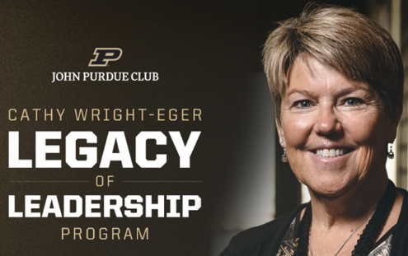
Purdue for Life Updates
Purdue Athletics has introduced the Cathy Wright-Eger Legacy of Leadership Program, a $22.5M scholarship endowment initiative honoring a key figure in its history.
Structure: 18 full-ride scholarship endowments—one for each varsity sport—funded at $1.25M each.
Early Momentum: $5M in commitments secured to date, including a $2.5M lead gift from alumna, author, and former swimmer Susan (Wolfle) Stoker.
Strategic Positioning: Aligns Purdue Athletics with the evolving shift toward roster-based models, enabling expanded scholarship opportunities while sustaining investment in the student-athlete experience.

Slide 7

Purdue Alumni Clubs Forum
Purdue for Life Updates
Grandparents University
  July 16 & 17 and July 23 & 24
  Designed for grandparents and grandchildren ages 7-14
    Field trips
    Two half-day class sessions
    Evening block party
    “Graduation” in Elliott Hall of Music

Slide 8
Alumni Clubs

Slide 9
New Board Members Onboarding Check List
Submit the Alumni Club Leadership Roster
  List all officers and board members
  Submit even if there are no changes to the current board
  https://www.purdueforlife.org/alumni-leaders/clubs/alumni-club-leadership-roster/
All board members need to sign the Statement of Integrity and Volunteer Conduct form
  Review and sign even if continuing on the board – this is a yearly requirement
  https://www.purdueforlife.org/alumni-leaders/clubs/alumni-leader-integrity-conduct-expectations/
Alumni Club Agreement
  Denise will send via Docusign to the president and treasurer
  Sign and return
Notes:
https://www.purdueforlife.org/alumni-leaders/clubs/alumni-club-leadership-roster/

Slide 10
Management of Board Member Transitions
Club Email
  Transition email access to new board members who need it
  If you have not set up a general club email address, we recommend doing so with at least two board members monitoring
Club Bank Account – president and treasurer need to be on the account
  New treasurer – new ACH (automatic clearing house) form will need to be submitted with updated treasurer information
  Take a moment to verify all the names that are on the bank account and those who are no longer board members, they need to be removed.
  If you haven’t set up ACH, reach out to alumniclubs@purdueforlife.org. and the form & instructions will be sent to you
    ACH is essentially direct deposit from PFL to the bank account. No need to mail checks and depositing them. We highly recommend setting this up!
Social Media – have at least two board members as administrators on the account(s)
  Take a moment to verify all the names that are on the social media account(s) and those who are no longer board members, they need to be removed.
Name Badges/Business Cards:
  https://www.purdueforlife.org/storefront/
  Club funds may be used for these items
  Business cards should be for the Club, not individual board members

Slide 11
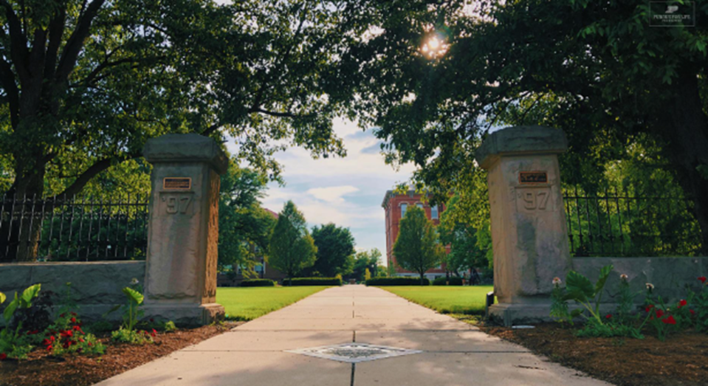
Club Agreement Highlights
Board members are expected to be active PAA members (annual or lifetime)
  Membership fees directly support our alumni clubs by providing engagement funds.
  If you have concerns about this, please contact alumniclubs@purdueforlife.org
Hold a minimum of three events during the fiscal year (July 1-June 30) to qualify for the recognition program
All email communication and event registrations need to go through the Purdue for Life system
Please refrain from maintaining alumni contact lists, as constituent preferences, contact information, statuses, and location may change over time.
Have at least one club leader attend the monthly forum
  In person or watch recorded session/review slides

Slide 12
Club Agreement Highlights
Bank Accounts
  Clubs are encouraged to spend engagement funds to engage constituents in the club’s area
  If a club maintains a significant year-end balance (typically $5,000 or more), we encourage leaders to actively invest those funds in advancing the club's mission rather than accumulating reserves. Consider opportunities such as:
    Contributing to the club's scholarship fund to support future Boilermakers.
    Hosting larger-scale events, outreach efforts, or engagement initiatives designed to connect with alumni who are not currently active with the club.
  Funds should be used to support meaningful alumni engagement, student support, and the long-term success of the club.
Utilize club funding responsibly
  Funds may not be used to purchase alcohol or gift cards
Timely submission of quarterly bank statements and financial reports
  Provides checks and balances to verify funds are being utilized properly and as needed
  Consider transferring your bank account to PEFCU – Advantages: no monthly banking fees, streamlined financial reporting, reduced quarterly statement-sharing requirements with PFLF (while still requiring receipts), and easier transitions between treasurers and officers through secure, fully remote online banking access. Please reach out to alumniclubs@purdueforlife.org to request more information.

Slide 13
Engagement Funds
Clubs who receive Gold, Silver, or Bronze status will receive the first engagement fund payment in August (50%)
  All forms need to be submitted to receive funds
    Updated alumni club leadership roster
    Signed Club Agreement by the president and treasurer
    All board members signed the Statement of Integrity
    Quarterly bank statements from the previous fiscal year
      4th Quarter due July 15: https://www.purdueforlife.org/alumni-leaders/clubs/alumni-club-quarterly-financial-report/

Slide 14
Recognition Program

Slide 15
The Finish Line is Near, - Keep Up the Great Work!
    Events Submitted July 1 – June 30:
      All events submitted through the system (either form) and provide opportunities for alumni to stay connected, get involved, or give back will be counted for the Recognition Program
        Events requiring registration and/or email send need to be submitted via the request form: https://purdueuniversity.my.site.com/community/s/eventrequest
          Includes Game Watches (Up to two count toward Recognition Program)
        Volunteer Events not requiring registration or email send, submit through the new Volunteer Event Submission form: https://www.purdueforlife.org/alumni-leaders/clubs/volunteer-event-submission/
      NOTE: Only events, email sends, & newsletters submitted in the system will be included in the Recognition Program!
Recognition Program
3rd Quarter FY '25-26
Gold = 43
Silver = 6
Bronze = 9
FY '24-25 Final Results:
Gold = 37
Silver = 6
Bronze = 11
Recognition Numbers have been updated through 3rd quarter, reach out to LeAnne if you want to know your club's status.
Notes:
https://forms.office.com/Pages/ResponsePage.aspx?id=7UBb4sj5uUSUIP4chmQYVJAryX-3njNFhtAyci0RbKtUMjYzNUdPVUs1WjRHRktFVERBVFJWMkMwWS4u
May we will discuss great events, strategic planning for end of year.

Slide 16
Recognition Program
    Newsletters
      What Counts?
        4 Newsletters = 1 point toward Recognition Program
        8 Newsletters = 2 points
        12 newsletters = 3 points
      Use Newsletters to get information out to alumni in your area
        Additional email send for events.
        Share information on Scholarship Program
        Share Social Media links
        News & updates about the club, events, etc.
    Resource Library: https://www.purdueforlife.org/alumni-leaders/clubs/resource-library/
      Training Video & Materials
      New training opportunities will be offered for the new submission forms in late July or early August

Slide 17
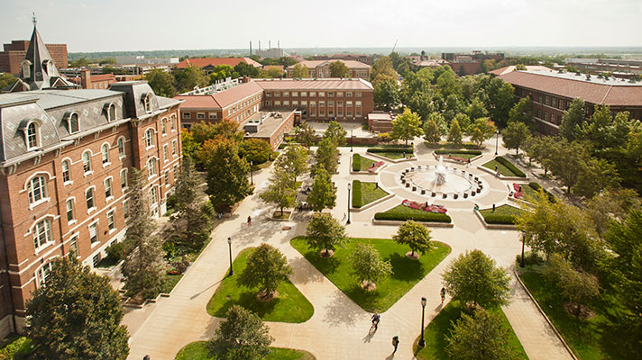
Volunteer Event Submission Form
Volunteer Event Submission form: https://www.purdueforlife.org/alumni-leaders/clubs/volunteer-event-submission/
Many clubs participate in community events that don’t require an email send or registration
    Volunteering at a local elementary/secondary school event
    Hosting a booth at a farmer’s market, county fair, etc.
    Club float in a parade
If this sounds like you, use the form to let us know of your participation so the event will count toward the recognition program
    Club Name
    Name of the Event
    Location of the Event
    Date of the Event
    Brief description of the club’s role
    Who attended

Slide 18
Game Watches

Slide 19
Game Watches: New Processes
Clubs hosting game(s) will fill out the same event form: https://purdueuniversity.my.site.com/community/s/eventrequest
Alumni Clubs Team will create:
  1 registration page for all clubs for both football/basketball with the following fields required:
    Name
    Email
    Drop down list of clubs
    Zip code
    Game Watch(es) they are attending
      Each week we will update the "Session" (game) with the clubs hosting

Slide 20
Game Watches (Cont'd)
Each club hosting will receive:
  QR code for this registration site.
  An attendee report if anyone registered for their game watch
  Clubs can also request 1 game watch swag box for every 4 game watches they host. Engagement funds can be used to purchase additional swag for these events.
Monday noon for deadline to be included on Game Watch Map & Emails that go out monthly
Clubs who follow process will be entered to win a signed ball at the end of the season​
Game Times/TV​ https://www.espn.com/college-football/team/schedule/_/id/2509/purdue-boilermakers​

Slide 21
Board Meetings

Slide 22
Board Meetings
Timing
  How often to meet? In-person? Virtual? Mix of both?
Best Practices
  Align your agenda based on club goals for the year and seasonal or annual events
  Pre-Meeting Prep
    Create an agenda and distribute before the meeting – ideally 5-7 days prior
      Include items that require review so attendees can be prepared to discuss during the meeting
    Encourage board members to submit discussion items in advance
    Identify who is leading each agenda item
  During the Meeting
    Start and end on time. If discussion runs over, table it or schedule another meeting
    Facilitation
      Focus on agenda items
      Encourage participation for all members and manage dominate personalities respectfully
      Summarize key points before moving on
      Guide the group to clear decisions or next steps

Slide 23
Board Meetings
Best Practices continued…
  Making Decisions – Discussions should lead somewhere
    Know when to end discussions and call for a vote or consensus
    Clarify who is responsible for action items resulting from a decision
  Respectful and Collaborative Environment
    Foster mutual respect, active listening, and constructive debate
    Challenge ideas. Not people
  Post-Meeting – Ensuring Action and Accountability
    Prompt and accurate meeting minutes. Distribute within 48-72 hours after the meeting
    Capture decisions made, action items, who is responsible, and deadlines
    Review action items at the start of each subsequent meeting
    Communicating outcomes. Who needs to know?
      Club population? Specific committees? PFL staff?

Slide 24

Board Meetings
Final Thoughts
  Feedback
    What is working in our meetings? What could we do better? Are the meetings productive?
    Consider doing a survey of board members
  Don’t be afraid to try new approaches
    The goal should be efficiency and effectiveness, not doing things because that’s how it’s always been done
  Meetings should be maximizing the club’s potential
    Making informed decisions
    Fostering collaboration
    Driving the club’s mission forward

Slide 25
ACES 2026

Slide 26
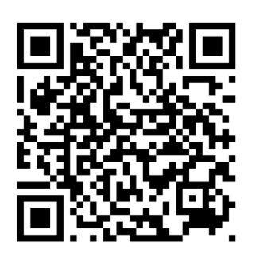
ACES
📅 Schedule:
Wednesday, August 5
  Sessions: 1:00–5:00 PM*
  Social Hour: 5:30–6:30 PM
Thursday, August 6
  Sessions: 8:30 AM–1:30 PM*
  Networking Session: 1:30–2:30 PM
Registration:
You can register for:
In-Person (Day 1, Day 2, Both)
Virtual
Wednesday Night Social Hour
1:1 Meeting with Team Member
Survey coming soon with session topics & schedule options!
Notes:
https://forms.office.com/Pages/ResponsePage.aspx?id=7UBb4sj5uUSUIP4chmQYVJAryX-3njNFhtAyci0RbKtUMjYzNUdPVUs1WjRHRktFVERBVFJWMkMwWS4u

Slide 27
ACES
🤝 1:1 Meetings* with the Alumni Clubs Team:
Morning of August 5
Afternoon of August 6
*Virtual meetings can also be scheduled
🍽️ Included with your free Registration
Wednesday: Afternoon snacks
Social Hour: Hors d'oeuvres & beverages
Thursday: Breakfast & lunch
Travel Support: Engagement funds may be used to help subsidize conference-related travel expenses, including hotel, meals, and transportation (please note: alcohol is not eligible).
Up to $150 per in-state traveler
Up to $300 per out-of-state traveler
Itemized receipts must be uploaded through the bank statement portal to document how funds are used.
Notes:
https://forms.office.com/Pages/ResponsePage.aspx?id=7UBb4sj5uUSUIP4chmQYVJAryX-3njNFhtAyci0RbKtUMjYzNUdPVUs1WjRHRktFVERBVFJWMkMwWS4u

Slide 28
ACES: Opportunity to recognize your Board & Volunteers
Awards & Nominations (Due June 30) – Your opportunity to recognize your outstanding volunteers and clubs:
Boilermaker Pride Award Nomination: https://purdue.ca1.qualtrics.com/jfe/form/SV_3rNBcxPTnG8tibc
ACES Awards Nominees: https://purdue.ca1.qualtrics.com/jfe/form/SV_e2uGFdPpDqHtdHM
Notes:
https://forms.office.com/Pages/ResponsePage.aspx?id=7UBb4sj5uUSUIP4chmQYVJAryX-3njNFhtAyci0RbKtUMjYzNUdPVUs1WjRHRktFVERBVFJWMkMwWS4u

Slide 29
Social Media Updates

Slide 30
Know Your Audience: How Alumni Find Events
Two Different Discovery Behaviors
Gen Z & Millennials | Gen X & Boomers
Passive Discovery | Active Research
Social Media First (LinkedIn/Instagram) | Search Engines & Email First (Google/Facebook/Mailing Lists)
Influenced by videos, peer recommendations, and photos | Influenced by clear information and trusted sources
"Show me" | "Tell me"
Notes:
https://forms.office.com/Pages/ResponsePage.aspx?id=7UBb4sj5uUSUIP4chmQYVJAryX-3njNFhtAyci0RbKtUMjYzNUdPVUs1WjRHRktFVERBVFJWMkMwWS4u
May we will discuss great events, strategic planning for end of year.

Slide 31
What Works for GOLD & Young Professionals
What GOLD & Young Professionals Want:
Short videos (Instagram Reels)
Real alumni experiences
Photos of people having fun
Authentic content over polished marketing
Social proof (people like me attended)
Event Content Formula
Before Event | During Event | After Event
Build excitement 3 Reasons to Join Us | Capture energy Photos, videos, testimonials | Recap highlights Create FOMO Promote the next event
Remember:
People don't attend because of the agenda.
They attend because they can picture themselves having a great experience.
Notes:
Darien – Does everyone know what FOMO is?

Slide 32
The Winning Strategy: Hook → Confirm
What would you define as an “experience” unique to your Club?
How to Reach Every Generation
Hook (Social Media) | Confirm (Event Details)
Reels Photos Event Recaps Alumni Stories | Date & Time Location Registration Link/QR Code Who Should Attend What to Expect
Goal: Create Interest & Excitement | Goal: Reduce uncertainty and drive registrations
Social Media Handbook Coming Soon! We'll be sharing templates, content ideas, and best practices to help clubs create engaging content with less effort.

Slide 33
Trademarks & Licensing: T-Shirts

Slide 34
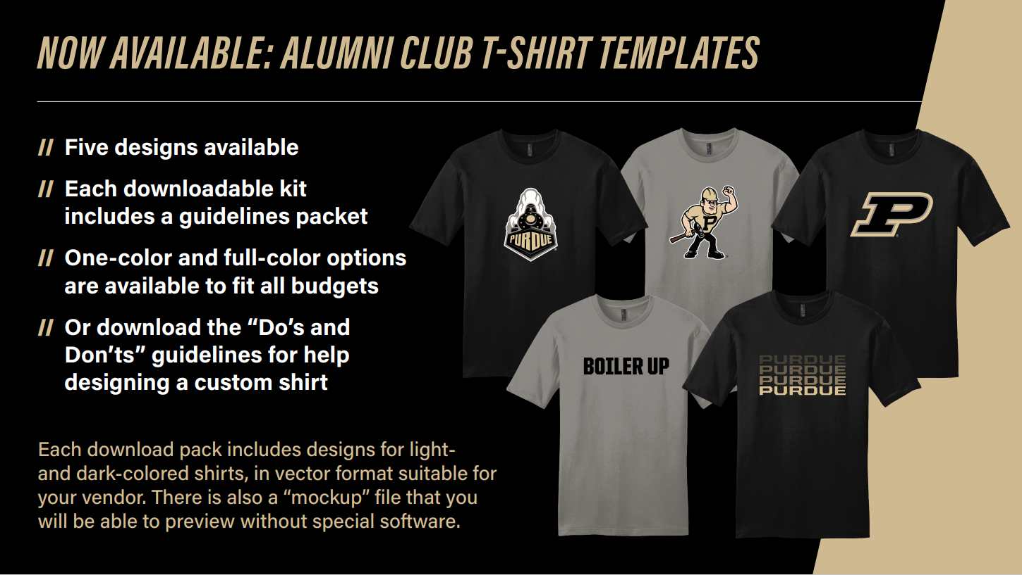
Social Media
Notes:
https://forms.office.com/Pages/ResponsePage.aspx?id=7UBb4sj5uUSUIP4chmQYVJAryX-3njNFhtAyci0RbKtUMjYzNUdPVUs1WjRHRktFVERBVFJWMkMwWS4u
May we will discuss great events, strategic planning for end of year.

Slide 35
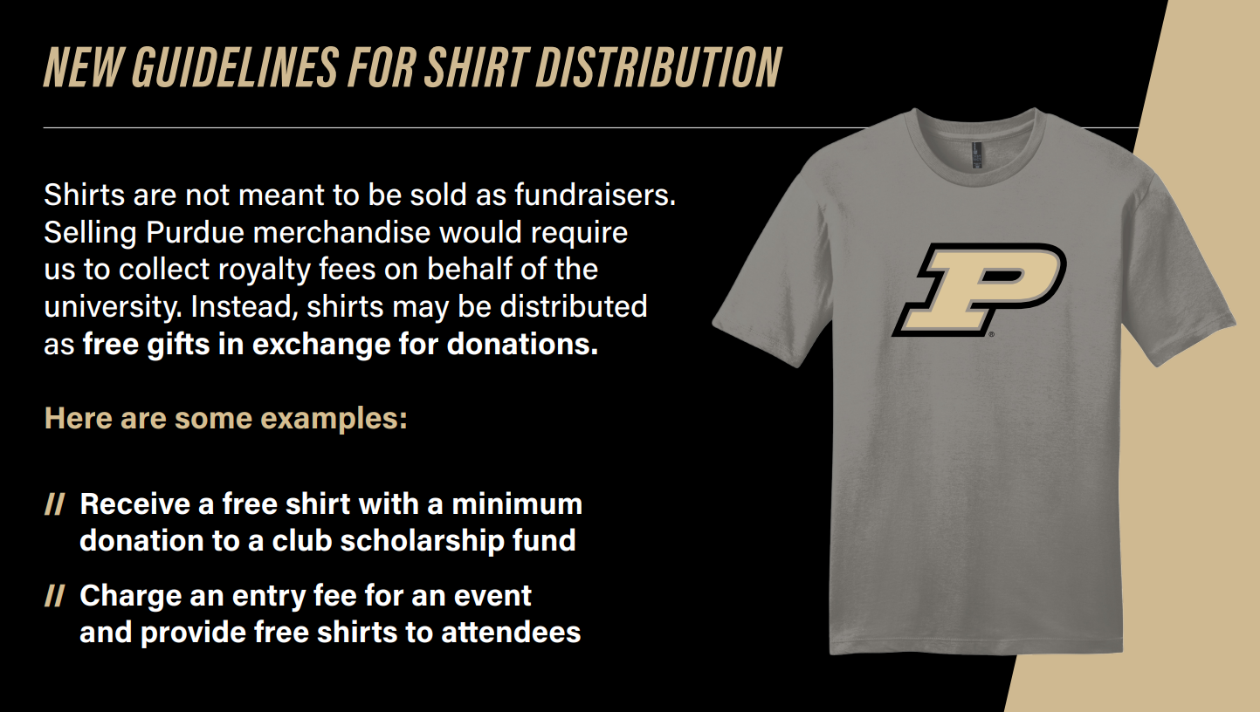
Notes:
Do NOT use the term FUNDRAISING

Slide 36

Notes:
https://link.us-1.lytho.us/i/1781553929078b6565430-aebb-4482-a4e1-fd2dd92c2d5a#alumni-club-t-shirt-templates

Slide 37

Brand Guidelines
Best Practice: Leverage this guide and work with a Purdue-approved vendor
Guide Overview
Consistent representation of Purdue’s brand
Proper use of logos, colors, and trademarks
Compliance with licensing and vendor rules
How to become a Purdue-licensed vendor
In a nutshell, Clubs can:
Create custom designs within guidelines but need to work with a Purdue-licensed vendor. Leverage pre-approved templates for a smoother, stress-free process
Do / Don’t Summary checklist:
✅ Use brand colors, fonts, landmarks
❌ Modify logos, claim official university status, misuse marks
❌ No outside logos or implied partnerships
❌ Avoid state shapes other than Indiana when paired with marks (e.g., Purdue Pete, university seal, etc.)
Bottom line:
Templates = safest route
Custom designs = more scrutiny

Slide 38







Five Designs Available
Boiler Up
Purdue Pete
Motion P
Purdue Text
Train Logo
Attachments included with each design:
Branded Guidelines document
Files ready to share with a Purdue licensed Vendor
  Options for full color or one color for designs based on budget

Slide 39
Reminders

Slide 40
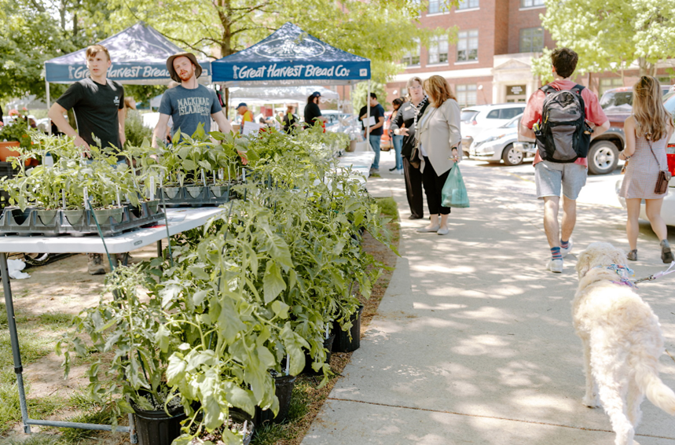
Final Reminders
Quarterly Bank Statements
  Due July 15. Include explanations of transactions: https://www.purdueforlife.org/alumni-leaders/clubs/alumni-club-quarterly-financial-report/
Join the Facebook page!
  Search for “Purdue Alumni Club Leaders”
  Click on “Join Group”

Slide 41
Coming Up Next
June
July
Board Transitions
ACES Prep
August
ACES
Board Elections Finalized
ACES Award Nominations
Election results submitted to Alumni Clubs Team due May 31, 2026
Work on you board transitions, student send-offs, family friendly events, young alumni/GOLD networking events, hiking events, ice cream social, etc.
PFLF Foundation closes from July 1-6.
Please be advised of the following deadlines to submit email requests:
Emails going out before the closure should be requested by end of day Friday, June 19.
Emails going out during the closure should be requested by end of day Monday, June 22.
ACES Awards Nominations are due June 30 – Nominate to reward board members and volunteers!
Boilermaker Pride Award Nomination: https://purdue.ca1.qualtrics.com/jfe/form/SV_3rNBcxPTnG8tibc
ACES Awards Nominees: https://purdue.ca1.qualtrics.com/jfe/form/SV_e2uGFdPpDqHtdHM
June 15 – Club leadership rosters are due
June 25 – Statement of Integrity submitted by all board members
The Alumni Clubs Team will be at:
PWN Annual Conference (Indy)
  June 24-25
Grandparents U
  July 16–17
  July 23–24
ACES Prep for your 2026-2027 Club Strategy Discussions. Forms will be sent by
mid July
Top 3 annual goals for your club
Calendar of event ideas, etc.
Event in a Box example to submit
ACES August 5-6!
In person
Ability to attend virtually

Slide 42
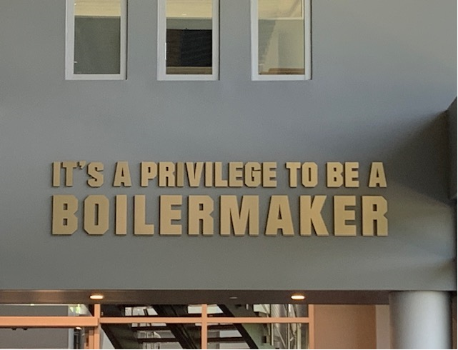
Thank you!
The next forum will be Wednesday, July 15, 2026 at 7:30 pm ET
  Theme: Getting Ready for ACES - Prep and Strategic Planning
Recordings of past forums are available on the Alumni Club Resource Library website: https://www.purdueforlife.org/alumni-leaders/clubs/resource-library/

