Slide 1
Alumni Club Leaders Forum
July 15, 2026

Slide 2
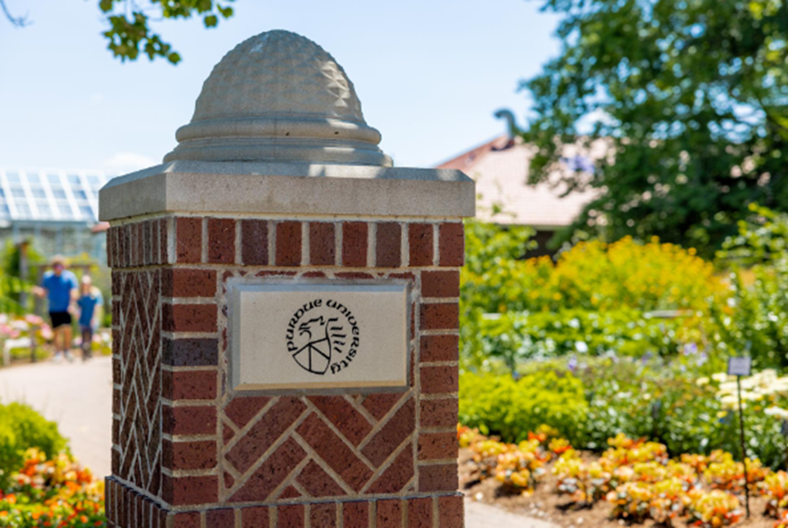
Purdue Alumni Clubs Forum
Reminders & Instructions
This forum is being recorded to share along with slides and chat content
Participants will be muted
Questions should be submitted using the chat function

Slide 3
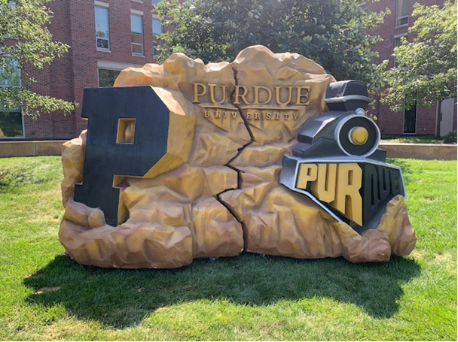
Purdue Alumni Clubs Forum
Agenda
University Updates
Purdue for Life Updates
Alumni Clubs:
ACES
  Detailed Agenda Preview
  Logistic
  Pre – Aces Work: Strategic Goals
Game Watches
Darien’s Corner - Social Media Best Practices
Students Send-Offs Talking points and Resources

Slide 4
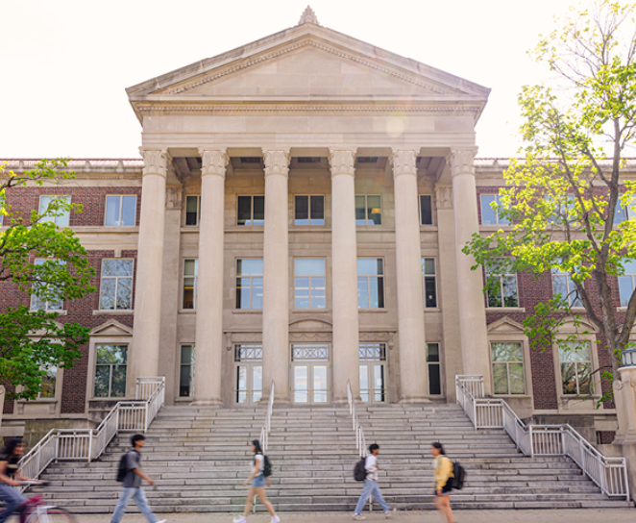
Purdue University Updates
Input in search for Next President
  Purdue University is seeking input as it searches for its 14th president.
  The Board of Trustees invites feedback on the experience, leadership qualities, and characteristics that should define Purdue’s next leader, along with suggestions for potential candidates.
  Share your perspective:
  🔗 https://lnkd.in/euRWvdRy
Notes:
Impact: Reinforces Purdue’s strength in career readiness and workforce alignment, enhancing its global competitiveness and reputation.

Slide 5

Purdue University Updates
#4 Globally and #1 Public in US!
the latest American Caldwell Global University Visibility (GUV) Rankings were released today, and Purdue has moved up two spots to No. 4 globally while retaining its position as the No. 1 public university in the United States.
The rankings measure university visibility based on publicly available indicators, including news coverage, search interest, website traffic, social media reach and video engagement.

Slide 6

Purdue for Life Updates
Key Dates
Purdue University's 2026 Homecoming will take place November 5–7. The main celebration features the Boilermakers facing off against the Maryland Terrapins
For more info: https://www.purdueforlife.org/homecoming/

Slide 7
Purdue for Life Updates
Looking for Club Stories - Featuring Clubs in PFLF Social Media
We’re interested in stories about our Club Communities, their leaders or volunteers doing fun, meaningful, or unexpected things that connect back to their Purdue experience.
Examples:
A student send-off event on its own may not be a story, but a connection made at that event—such as an alum inspiring a student to give back, pursue a unique career path, or seize an unexpected opportunity—could be.
A club that played a significant role in helping its community recover after a natural disaster may have a compelling story to tell.
Not every story needs to be serious, lighter but engaging stories are also okay. Think Purdue-themed mailboxes, friendly alumni rivalries and any creative expressions of Boilermaker pride.
Have a story to share? Please email us your idea at alumniclubs@purdueforlife.org

Slide 8
Alumni Clubs
Notes:
Leanne lastd section

Slide 9
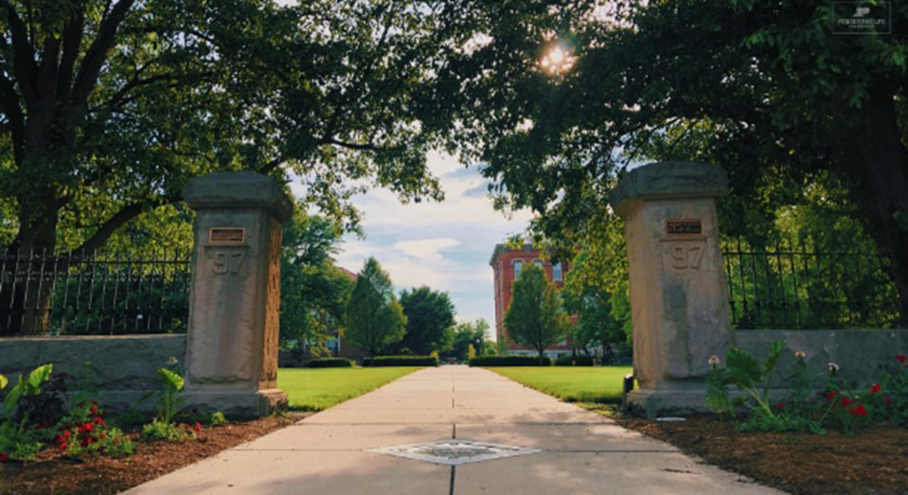
Management of Board Member Transitions
Reminders
Submit the Alumni Club Leadership Roster
All board members need to sign the Statement of Integrity and Volunteer Conduct form
  https://www.purdueforlife.org/alumni-leaders/clubs/alumni-leader-integrity-conduct-expectations/
Board transitions. Remove outgoing board members and add new:
  Club Email
  Bank Accounts
  Social Media Accounts
Notes:
https://www.purdueforlife.org/alumni-leaders/clubs/alumni-club-leadership-roster/

Slide 10
Club Agreement Highlights
Undergoing Final review
  Updates on Data Privacy.
  Denise will send via Docusign to the president and treasurer. Please sign and return promptly.
Other Operational Reminders
Board members are expected to be active PAA members (annual or lifetime)
Hold a minimum of 3 events during the fiscal year (July 1-June 30)
Submit all email communications and event registrations though our system
Have at least one club leader attended the monthly forum
Timely submission of quarterly bank statements and financial reports
  Transferring your account to Purdue Federal Credit Union could make this process easier for your club. Reach out to alumniclubs@purdueforlife.org to receive the packet materials.

Slide 11
Engagement Funds
Clubs who receive Gold, Silver, or Bronze status will receive the first engagement fund payment in August (50%)
  All forms need to be submitted to receive funds
    Updated alumni club leadership roster
    Signed Club Agreement by the president and treasurer
    All board members signed the Statement of Integrity
    Quarterly bank statements from the previous fiscal year
      4th Quarter due July 15: https://www.purdueforlife.org/alumni-leaders/clubs/alumni-club-quarterly-financial-report/

Slide 12
Game Watches

Slide 13
Game Watches: Mock Up
Clubs hosting game(s) will fill out the same event form: https://purdueuniversity.my.site.com/community/s/eventrequest
Alumni Clubs Team will create:
  1 registration page for all clubs for both football/basketball with the following fields required:
    Name
    Email
    Drop down list of clubs
    Zip code
    Game Watch(es) they are attending
      Each week we will update the "Session" (game) with the clubs hosting

Slide 14
Game Watches (Cont'd)
Each club hosting will receive:
  QR code for this registration site.
  An attendee report if anyone registered for their game watch
  Clubs can also request 1 game watch swag box for every 4 game watches they host. Engagement funds can be used to purchase additional swag for these events.
Monday noon for deadline to be included on Game Watch Map & Emails that go out monthly
Clubs who follow process will be entered to win a signed ball at the end of the season​
Game Times/TV​ https://www.espn.com/college-football/team/schedule/_/id/2509/purdue-boilermakers​

Slide 15
Student Send-Offs

Slide 16
Student Send-Offs: Best Practices
Make the Event About Building Community
The primary goal should be helping incoming students meet:
Other new Purdue students from their area
Current Purdue students
Local Purdue alumni
Purdue parents
Top Questions
Housing/Move-in
Student organizations/Greek life
Academic workload
Internship and co-op opportunities
Campus traditions
Shuttles to and from Campus
Food Plan
Create a strong panel with a mix of:
Current student (s)
One recent graduate
One experienced alumnus
Notes:
https://forms.office.com/Pages/ResponsePage.aspx?id=7UBb4sj5uUSUIP4chmQYVJAryX-3njNFhtAyci0RbKtUMjYzNUdPVUs1WjRHRktFVERBVFJWMkMwWS4u
May we will discuss great events, strategic planning for end of year.

Slide 17

Student Send-Offs: Best Practices
Create Opportunities for Students to Connect With One Another.
Potential icebreakers include:
Major-based groups
Residence hall matching
County/high school introductions
Purdue trivia
"Find someone who..." networking activities
Showcase Purdue Spirit
Successful send-offs often include:
Purdue swag, photos and banners
"Hail Purdue"
Club scholarship presentations
Purdue trivia and prizes
Photo opportunities
Notes:
Darien – Does everyone know what FOMO is?

Slide 18
Student Send-Offs: Best Practices
Engage Parents Intentionally
Parents often attend with different concerns than students:
Safety
Academic support
Career outcomes
Homesickness
Move-in logistics
Consider:
A dedicated parent Q&A
A Purdue parent volunteer available for conversations
Contact information for local alumni club leaders
Create Opportunities for Students to Connect With One Another.
Potential icebreakers include:
Major-based groups
Residence hall matching
County/high school introductions
Purdue trivia
"Find someone who..." networking activities
Showcase Purdue Spirit
Successful send-offs often include:
Purdue swag, photos and banners
"Hail Purdue"
Club scholarship presentations
Purdue trivia and prizes
Photo opportunities
These traditions help students begin identifying as part of the Purdue community before they arrive on campus.
Notes:
Darien – Does everyone know what FOMO is?

Slide 19
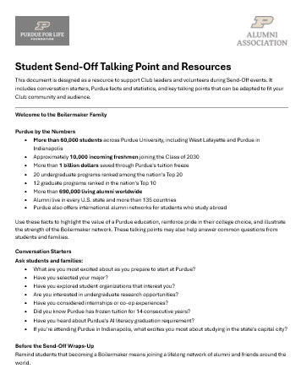
Student Send-Offs: Best Practices
Highlight Local Club Engagement Beyond the Send-Off
Use the event to introduce:
Game watch parties
Networking events
Community service activities
Internship and mentoring opportunities
Young alumni programs
This helps students see the alumni club as a lifelong Purdue connection rather than a one-time event.
Notes:
Link to the File: 2026 Student Send-Off Talking Points.docx

Slide 20
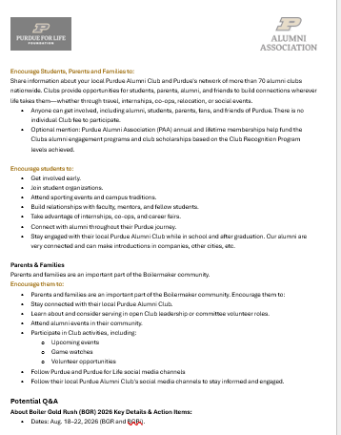

Student Send-Offs Talking Points
The document is for optional use.
Benefits:
Handy Talking points for the welcome, closing during the Q&A.
You have the convenience select highlights to share with Students, Parents, Alumni and Friends

Slide 21
Social Media & Communication Updates

Slide 22
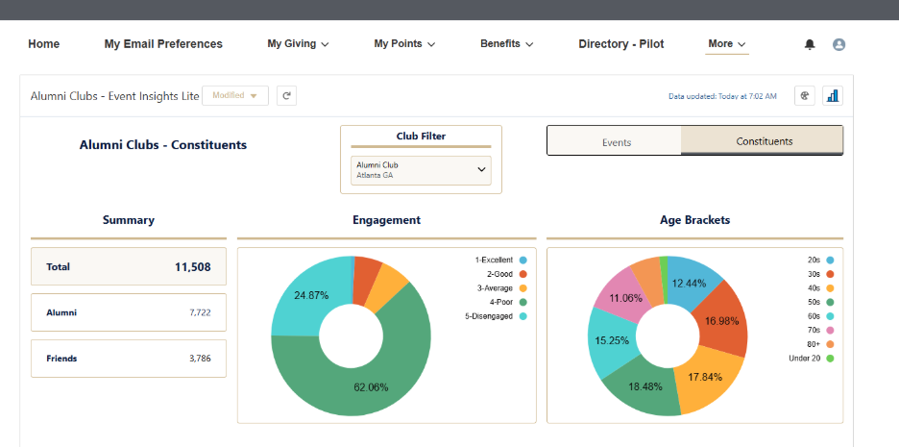
Know Your Audience: How Alumni Find Events
Notes:
Darien - Add Link to the dashboard. Each club using is average age, who is attending, which College
May we will discuss great events, strategic planning for end of year.
Constituents and their engagements
Percentage by demorgraphic - engagement
City list in club area with most attendings.
Explain the metrics and send to club leaders
Event and registrations – Don’t call attention to Emails – stress considerate of data privacy

Slide 23

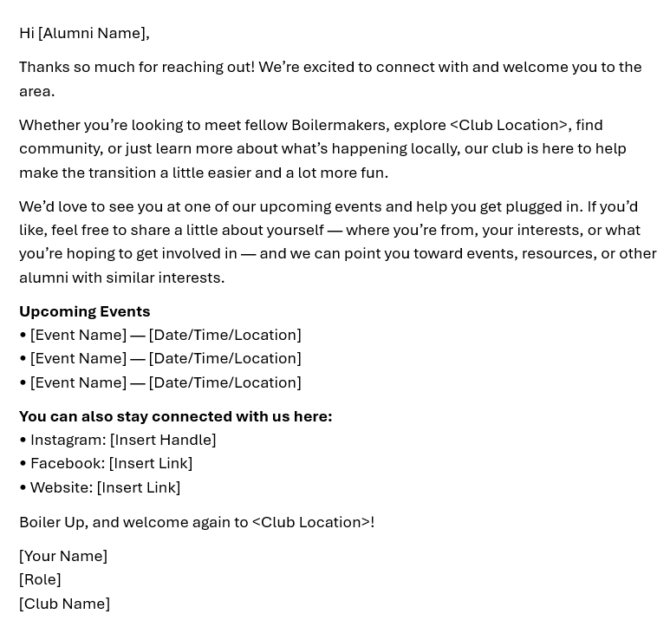
Update: “Welcome to the Club” Emails
PASE Collaboration
12 Clubs provided local Community Info
Email update: Will be sent approximately July 15

Slide 24
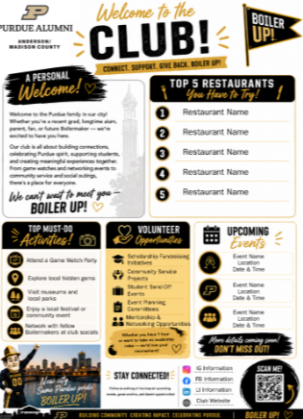
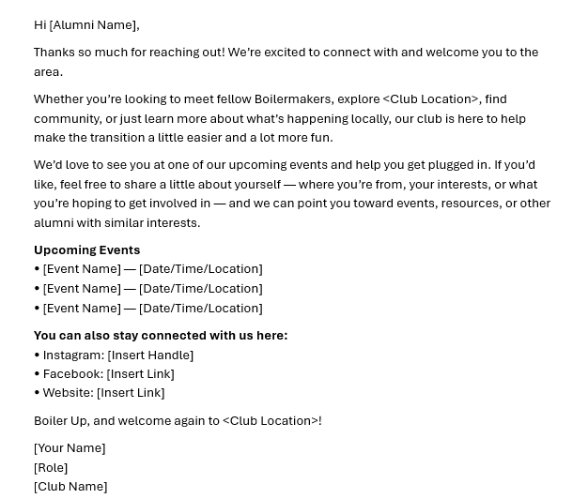
“Welcome to the Club”: Next Step Reminders
Resources Reminder
Call to Action: As you recent graduates contact you following the “Welcome to the Club,” please leverage these resources (Shared on the May 2026) Forum Email but will be re-send on this month’s post-forum email)

Slide 25
2026 ACES (Advancing Club Engagement and Strategy)

Slide 26
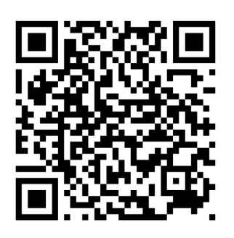
ACES Schedule
📅 Schedule:
Wednesday, August 5
  Sessions: 1:00–5:00 PM*
  Social Hour: 5:30–6:30 PM
Thursday, August 6
  Sessions: 8:30 AM–1:30 PM*
  Networking Session: 1:30–2:30 PM
Registration:
You can register for:
In-Person (Day 1, Day 2, Both)
Virtual
Wednesday Night Social Hour
1:1 Meeting with Team Member
UDPATE – FOR CATERING PURPOSES: Deadline to register: Friday, July 24
Notes:
https://forms.office.com/Pages/ResponsePage.aspx?id=7UBb4sj5uUSUIP4chmQYVJAryX-3njNFhtAyci0RbKtUMjYzNUdPVUs1WjRHRktFVERBVFJWMkMwWS4u

Slide 27
ACES
🍽️ Included with your free Registration
Wednesday: Afternoon snacks
Social Hour: Hors d'oeuvres & beverages
Thursday: Breakfast & lunch
🤝 1:1 Meetings* with the Alumni Clubs Team:
Morning of August 5
Afternoon of August 6
*Virtual meetings can also be scheduled
Travel Support: Engagement funds may be used to help subsidize conference-related travel expenses, including hotel, meals, and transportation (please note: alcohol is not eligible).
Up to $150 per in-state traveler
Up to $300 per out-of-state traveler
Itemized receipts must be uploaded through the bank statement portal to document how funds are used.
Notes:
https://forms.office.com/Pages/ResponsePage.aspx?id=7UBb4sj5uUSUIP4chmQYVJAryX-3njNFhtAyci0RbKtUMjYzNUdPVUs1WjRHRktFVERBVFJWMkMwWS4u

Slide 28
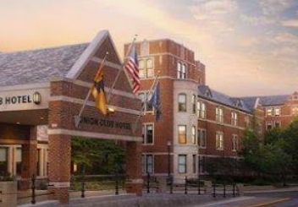
ACES Logistics
The Union Club Hotel at Purdue University – Time Sensitive!
  A discounted room rate of $199 per night is available for guests arriving on August 5, 2026, and departing on August 6, 2026.
  Reservations must be made through this reservation link by July 22, 2026, to receive the discounted rate.
  A courtesy room block of five (5) rooms has been secured initially. We will work closely with the hotel to monitor demand and, if needed, explore opportunities to increase the number of rooms available within the block.
Notes:
The last date to book at the discounted rate is 7/22.
Reservation-Link
https://www.marriott.com/event-reservations/reservation-link.mi?id=1784059264529&key=GRP&app=resvlink&_branch_match_id=1605686985392603963&_branch_referrer=H4sIAAAAAAAAA8soKSkottLXTywo0MtNLCrKzC8p0UvOz9UvSi0uy0wtN7IHytiCODmZedlqmSm2huYWJgamlkZmJqZGlmrZqZW27kEBanVFqWmpQO156fFJRfnlxalFtq4p6akA73tzzl8AAAA%3D

Slide 29
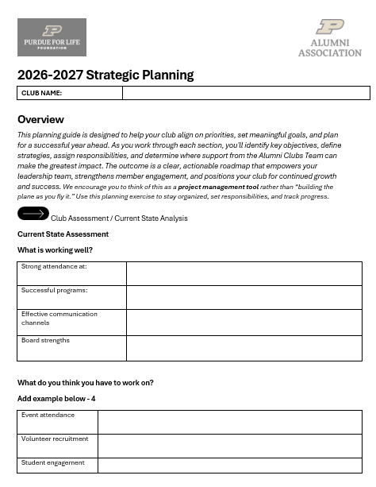
ACES PREP
These items will be sent your way here shortly with the goal of helping you be ACES ready!
Survey Submission Due
  Due Thursday, July 31
2026- 2027 Strategic Plan
This document serves as a guide to support your Club's growth, planning, and success throughout the year.

Slide 30
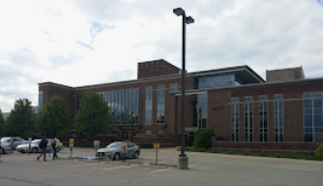
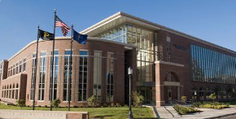
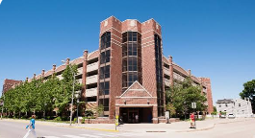
ACES Location
Dauch Alumni Center - 403 W Wood St., West Lafayette, IN
The Dick and Sandy Dauch Alumni Center is a vibrant, welcoming hub that celebrates Purdue’s rich history, traditions, and global impact. Through interactive exhibits showcasing achievements in athletics, space, and innovation—along with beautiful gathering spaces and the iconic Boilermaker Special replica—the center beautifully connects visitors to the enduring spirit and proud legacy of Purdue.
Parking - Grant Street Parking Garage
Due to construction on multiple garages, we strongly encourage the use of Grant Street Garage.
The daily Parking Fee is $5.
  If your club has sufficient funds in addition to the ACES-allocated travel expense amount, club leaders may pay for parking directly at the garage and seek reimbursement from the club. Itemized receipts must be uploaded through the bank statement portal to document how funds are used.
  If you are a guest of the Union Club Hotel, parking is free at the Grand Street Garage.

Slide 31
ACES Agenda
Wednesday, August 5
1:1s with PACT
Available from 2:30pm through 5:05pm ET with 45-minute appointments.
Your key topics and Time availability to be submitted in the Pre-ACES Survey. We will match you with a PACT Team based on that.
Schedule
2:30 PM – 3:15 PM | Appointment 1
3:25 PM – 4:10 PM | Appointment 2
4:20 PM – 5:05 PM | Appointment 3
Room Opens at Noon ET
Noon – 1:00 Arrivals and Social Time
1:00-1:30 – Welcome, Intros, Agenda, Goals
1:30-2:20: 3 Goals & Calendar of events
2:30-3:20: Student & GOLD Constituents
3:30-4:20: (Jordan Exercise)
4:30-4:45: 1st day wrap-up; 2nd day agenda/expectations
5:30–6:30 PM Social Hour

Slide 32
ACES Agenda
Thursday, August 6
1:1s with PACT
Doors open @7:30am
8:30-9:45: Breakfast, Social Time & Recognition/Awards
10:00-10:50: Increasing Engagement
11:00-11:50: Operations/Tools & Resources (new templates, dashboard, new for the year)
12:00-1:30: Lunch & Speaker/Presentation – Social Media & Fundraising w/ Q & A session
1:30-2:30: Social/Networking
Available from 2:30pm through 5:05pm ET with 45-minute appointments.
Your key topics and Time availability to be submitted in the Pre-ACES Survey. We will match you with a PACT Team based on that.
Schedule
2:30 PM – 3:15 PM | Appointment 1
3:25 PM – 4:10 PM | Appointment 2
4:20 PM – 5:05 PM | Appointment 3

Slide 33

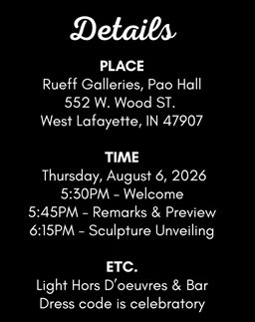
Optional Activity
Thursday, August 6
For those interested, here’s an optional event happening on campus. It’s one of our Team’s favorites: The Purdue Galleries annual preview event at 5:30PM on Thursday, August 6 in Rueff Galleries, Pao Hall – One block away from Dauch.
In addition to introducing the 2026-27 exhibitions and celebrating some recent achievements, they will be unveiling two new sculptures in the permanent cases outside of the Rueff Galleries. To register: https://purdue.ca1.qualtrics.com/jfe/form/SV_cCu59qboqHqMAfQ
Notes:
https://purdue.ca1.qualtrics.com/jfe/form/SV_cCu59qboqHqMAfQ

Slide 34
Reminders

Slide 35
Coming Up Next
July
August
Maximizing ACES
Task Force Returns
September
Football Season!
Board Transitions
ACES Prep
Work on you board transitions, student send-offs, family friendly events, young alumni/GOLD networking events, hiking events, ice cream social, etc.
The Alumni Clubs Team will be at:
Grandparents U
  July 16–17
  July 23–24
You can now Submit your Game Watches!
ACES Prep –
2026-2027 Club Strategy Discussions.
ACES August 5-6!
In person and virtual
PACT Awards
Aug. 18–22, 2026 Boiler Gold Rush
West Lafayette, Indianapolis campuses
Task Force
Restart/Meetings
Recognition Program
August funds processing will begin
September 19 PFLF Tailgate at the Rose Bowl (Purdue vs. UCLA). Clubs supporting:
LA/OC, San Francisco, San Diego, Las Vegas
Oregon/SW Washington, Phoenix, Puget Sound
Dauch Football Tailgates
September 26: Alumni Clubs Saturday
2 hours prior to game time

Slide 36
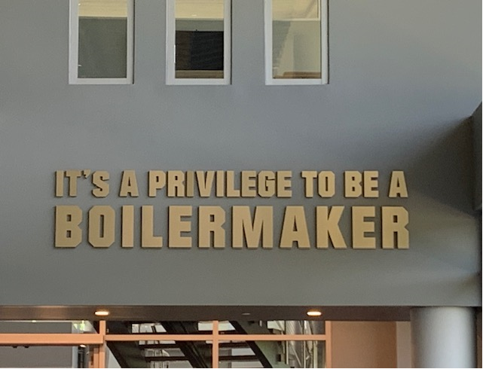
Thank you!
We’ll send a newsletter recapping ACES and any additional information requested during the week of August 17, 2026
The next forum will be Wednesday, September 16, 2026 at 7:30 pm ET
  Theme: Follow-Up and Questions from ACES
Recordings of past forums are available on the Alumni Club Resource Library website: https://www.purdueforlife.org/alumni-leaders/clubs/resource-library/

