Slide 1
Alumni Club Leaders Forum
April 22, 2026

Slide 2
Purdue Alumni Clubs Forum
Reminders & Instructions
This forum is being recorded to share along with slides and chat content
Participants will be muted
Questions should be submitted using the chat function

Slide 3
Purdue Alumni Clubs Forum
Agenda
University Updates
Purdue for Life Updates
Alumni Clubs Updates
PDoG – Latest Updates
Lifelong Learning Offerings/ Featuring: Leslie Fernung - Sr Director, Lifelong Learning • Engagement (LeAnne)
Student Pathways to Clubs / Featuring Carol Smith - Director, Student Engagement & Welcome Center (Darien)
ACES – Updates and What to Expect
Scholarship Process – Results and Appreciation (Denise/Darien)
Tournament Appreciation.

Slide 4
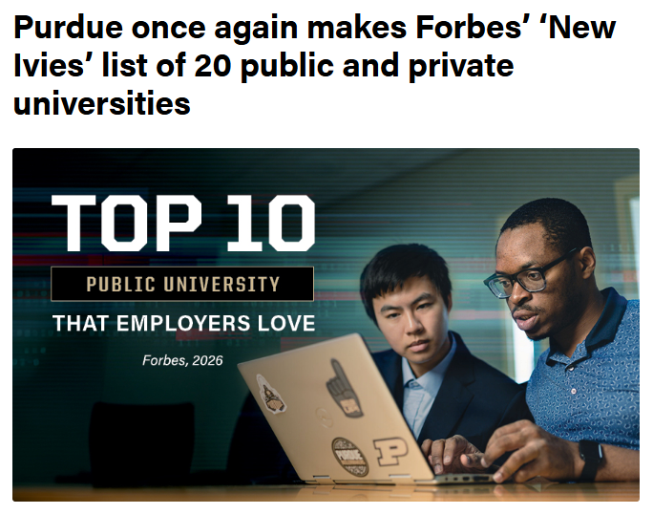
Purdue Alumni Clubs Forum
Purdue University Updates to Share
Purdue on Forbes' ‘New Ivies’ list of 20 public and private universities (Third Year) – Based on feedback from over 100 C-suite and hiring executives, indicating that Purdue alumni are highly valued for their technical adaptability.
Purdue is the 1st major university to mandate a comprehensive AI working competency for all undergraduates. The requirement is designed with "continual input" from industry leaders to ensure academic training aligns with real-world hiring needs.
Within the top five civilian, public universities nationwide.
The only public university in Indiana
One of the only three of Big Ten institutions
As the 2nd largest institution on the list - Purdue is producing a high volume of graduates prepared for the modern economy.
In the top 10 public and top 10 private universities best equipping students for AI-driven workforce needs.
Notes:
50 Purdue free courses: https://www.purdue.edu/newsroom/2026/Q1/purdue-expands-lifelong-learning-portfolio-to-50-free-online-courses-for-alumni/
PWN registration: https://www.purdueforlife.org/womens-conference/
Purdue Day of Service: https://events.blackthorn.io/en/3ktO526/2026-spring-day-of-service-4a9GQp1lhd/overview
GPU

Slide 5


Purdue Alumni Clubs Forum
Purdue University Updates to Share
Daniels - #1 Business school of Indiana - Based on Times Higher Education global rankings.
Investment in the Indianapolis Campus Continue to Grow - The Board of Trustees on Friday (April 10) approved the purchase of properties in downtown Indianapolis as part of the university’s efforts to enhance students’ urban experience.
All-Boilermaker Crew Set for ‘Purdue 1’ Space Mission - Purdue University has a five-member, all-Boilermaker crew (5) for the “Purdue 1” space mission. Arvind Raman, John A. Edwardson Dean of the College of Engineering at Purdue University, called the mission “historic” and one that has not been attempted by any university in the world ever.
Notes:
50 Purdue free courses: https://www.purdue.edu/newsroom/2026/Q1/purdue-expands-lifelong-learning-portfolio-to-50-free-online-courses-for-alumni/
PWN registration: https://www.purdueforlife.org/womens-conference/
Purdue Day of Service: https://events.blackthorn.io/en/3ktO526/2026-spring-day-of-service-4a9GQp1lhd/overview
GPU
Standing out through its strategy to more deeply integrate business education with STEM fields, the Daniels School is drawing on Purdue’s powerhouse programs in engineering, data science and technology to bolster learning and scholarship for students in business analytics, supply chain management, quantitative analysis and tech-driven entrepreneurship.

Slide 6


Purdue Alumni Clubs Forum
Purdue for Life – Upcoming Events
Purdue Day of Service - Wednesday, April 24, 2026 (9am – noon ET) Sign up => Here
Indianapolis
The Purdue Alumni Travel Showcase, May 7 - Explore programs, meet other travelers and check out the 2027 travel schedule — Learn more and register here.
Purdue Women’s Conference, June 24-25 – Register Here
Purdue Travel – Annual Young Alumni Trips
August 8-16, 2026 - Flavors of Ireland - https://www.aesu.com/trip/26irw-purdue/
July 3-10, 2027 - Treasures of Scotland - https://www.aesu.com/trip/27sct-purdue/
Notes:
50 Purdue free courses: https://www.purdue.edu/newsroom/2026/Q1/purdue-expands-lifelong-learning-portfolio-to-50-free-online-courses-for-alumni/
PWN registration: https://www.purdueforlife.org/womens-conference/
Purdue Day of Service: https://events.blackthorn.io/en/3ktO526/2026-spring-day-of-service-4a9GQp1lhd/overview
GPU

Slide 7
Lifelong Learning Offerings
Featuring: Leslie Fernung
Sr. Director, Lifelong Learning

Slide 8

Visit the Lifelong Learning Page
Purdue expands lifelong learning portfolio to 50 free online courses for alumni
Growth reflects the expanding scope of skills required in today’s economy: from AI and technology to business essentials and urban agriculture
Google Career Certificate
Purdue University Online YouTube channel

Slide 9
Student Pathways to Clubs
Carol Smith Director, Student Engagement & Welcome Center
Bennett Coffey PASE VP, Engagement & Volunteerism

Slide 10


Graduate Gateway

Slide 11
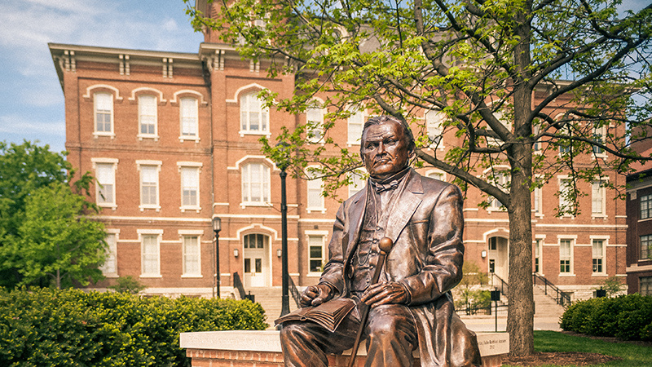
Journey from Student to Alum
01
Orientation, also known as BGR--> Discovery of all that Purdue has to offer.
Student Engagement connects students to the ethos of Purdue and find their place in community.
02
03
Graduate Gateway, the next steps of being an engaged alumni through the pillars of engagement and philanthropy to get involved, stay connected, and give back.

Slide 12
The Transition Year: Navigating Adulthood
Relationships
Finances
Wellness
Rest
Navigating friendships, dating, family, and meeting new people
Learning how to manage budgets, paying bills, paying off debt, and savings
Discovering ways to stay fit, handle doctor appointments, and health insurance
Working full-time and recovering from college life
Entertainment
Hangouts
Side Projects
Work
Going to concerts, gaming events, eating out, and sporting events
Finding places to hangout after work and on the weekends
Finding a way to keep passions alive or make more money
Working full-time or still looking for work, finding ways to network

Slide 13


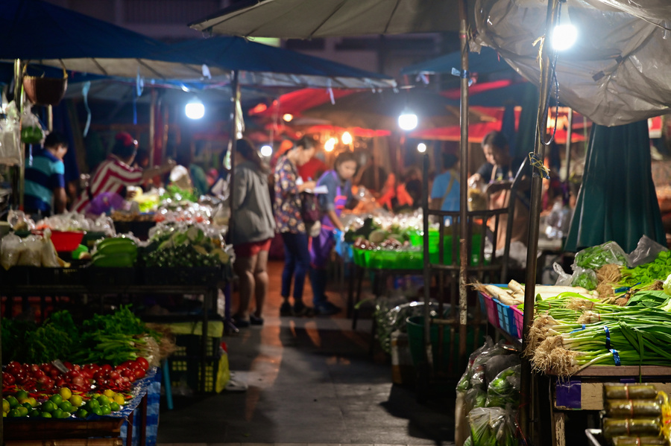
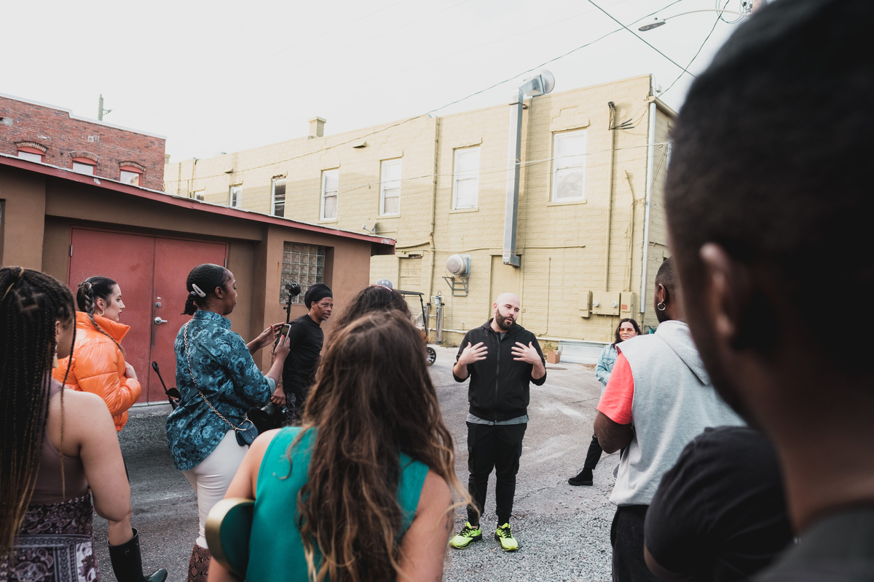
Welcome Message
Craft a personal message from the club to recent grads.
“WELCOME TO THE CLUB”
Everyone needs to eat
List 5 must try resturants in the area thinking through different price points.
We have created a way for you to communicate to recent grads in your area specifially for clubs.
Think through the following components for us to create a crafted email for you.
Entertainment
Create a list Must do’s in the area like markets, theaters, festivals, and races.
Serve your community
Provide a list of places to volunteer in the area like food banks and shelters.

Slide 14

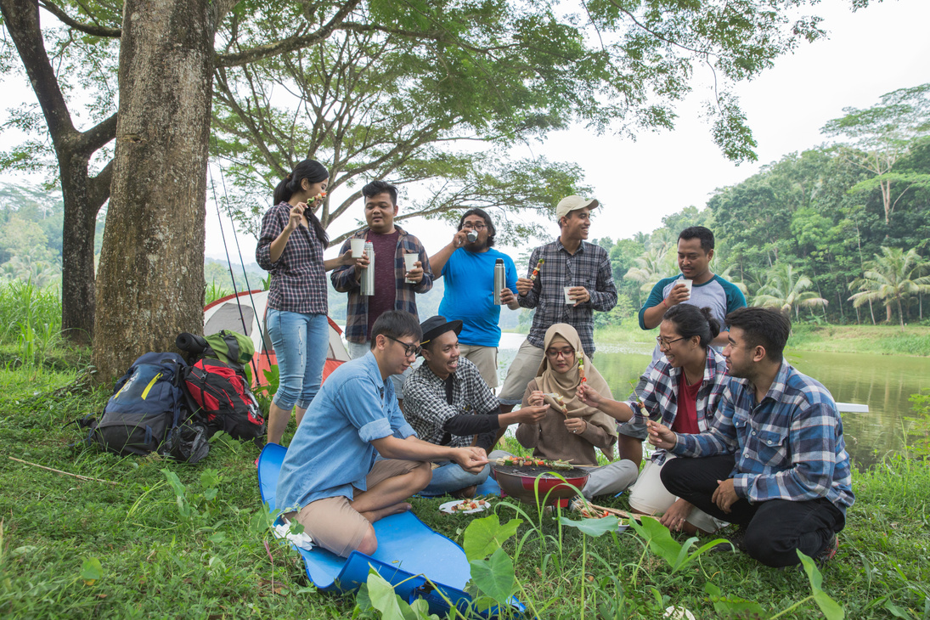
Let’s be social
“WELCOME TO THE CLUB”
List your socials, consider getting Instagram!
Club Events
Create club events around the months after graduation.

Slide 15
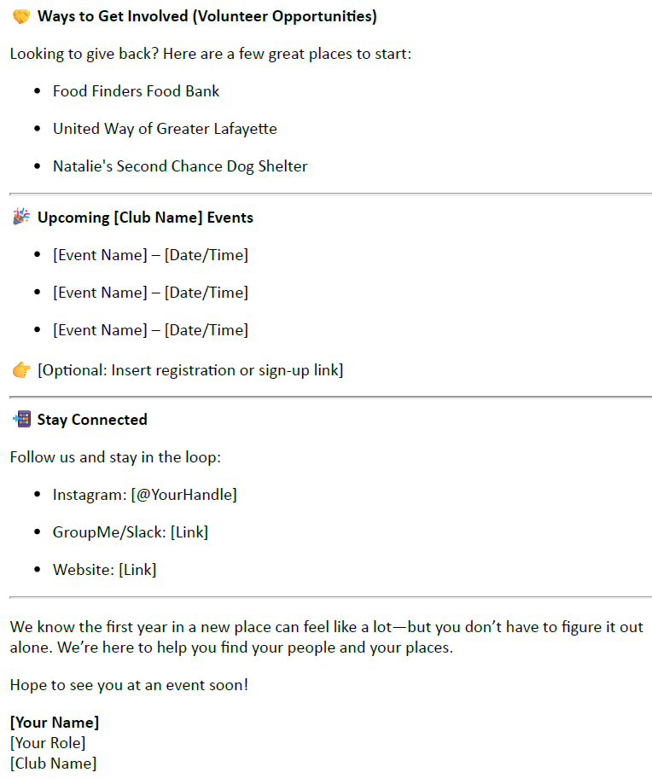
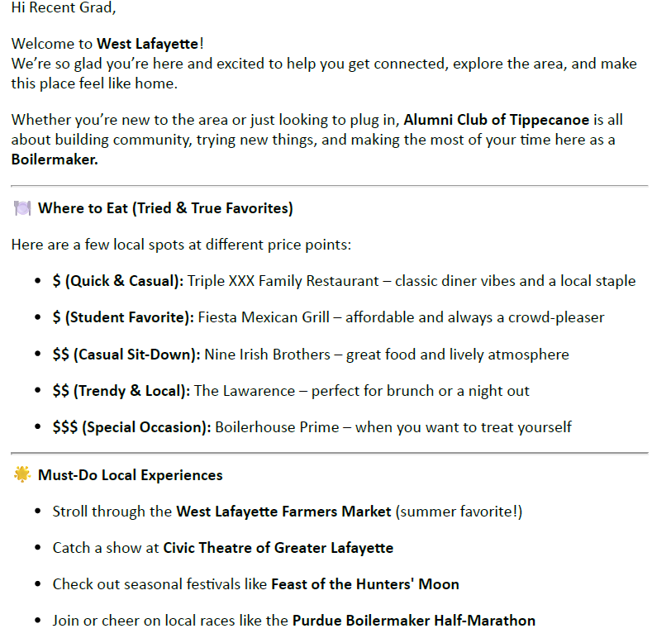
Email Example
3/3

Slide 16
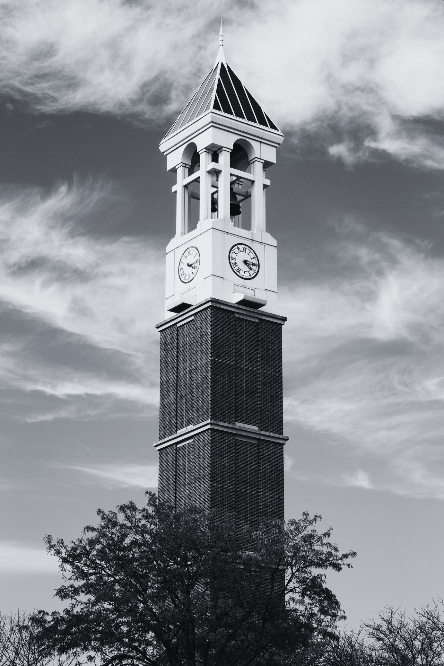


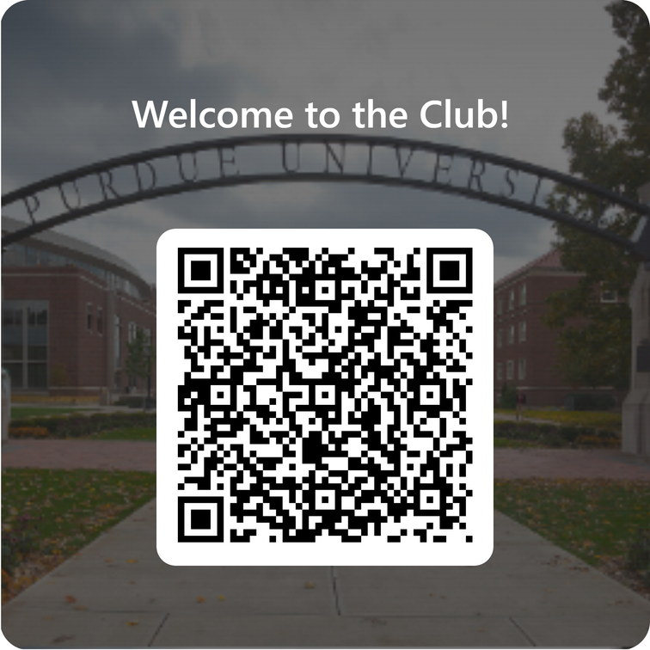
Events
WHAT’S NEXT?
Create events with recent grads in mind.
This is your opportunity to encourage recent grads into your club.
Forms
Fill out the form provided to create a “Welcome to the Club” newsletter.

Slide 17
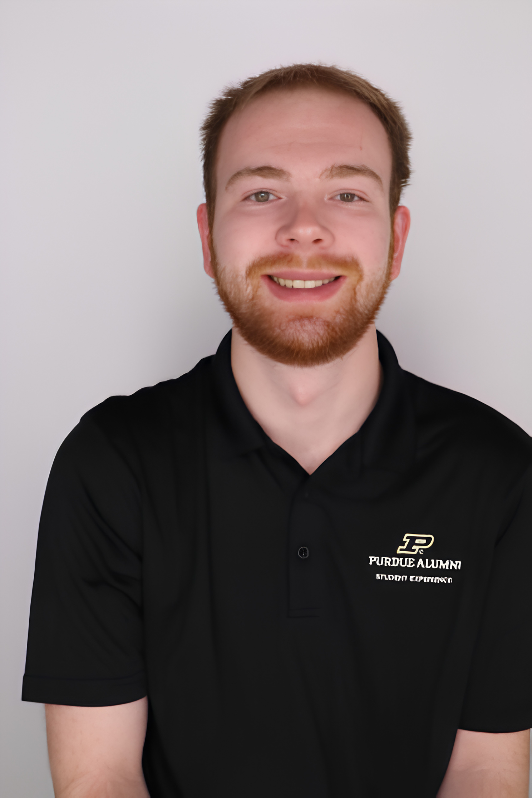
The Student Perspective
Vice President, Bennett Coffey, shares his perspective as a student and an executive board of director of PASE.

Slide 18

Purdue Alumni Student Experience
Largest student organization on campus with 9,000+ members
Connecting student with alumni through professional development, networking, and campus traditions
Lead by a student board

Slide 19




Golden PASE 5K Color Run
Alumni Networking Night
Online Events
Ways to Engage
The top goals for student engagement are focused on mentorship, professional development, traditions and the gateway from student to alumni. We aim to create an experience as students that is meaningful and impactful that encourages them to stay engaged as alumni.

Slide 20
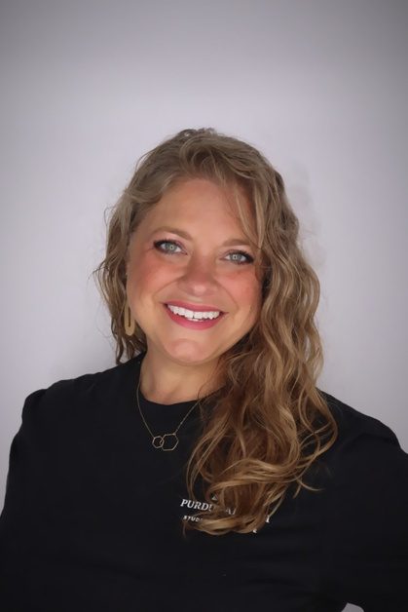

Contact Information
Carol Smith
Bennett Coffey
Director Student Engagement/
Welcome Center
Vice President Engagement & Volunteerism
cesmith@purdueforlife.org
Master, Educational Psychology ‘22
Bachelor, Special Education, ‘00
coffey39@purdue.edu
Finance and Political Science ‘27

Slide 21
Purdue Day of Giving (PDoG): Latest Updates

Slide 22
Purdue Day of Giving (PDoG) – Resources
Reminders:
The Purdue Day of Giving Website is live! https://dayofgiving.purdue.edu/
Access Toolkit => Here
The toolkit has access to:
Logos
Social Media Content
Impact One Pager
Email Graphics/Footer
Print Advertisements
Save the Date Cards
QR Codes & Links are on their way!
Purdue Alumni Clubs Video: Share out on your social media!
Notes:
DROP LINK IN CHAT: https://link.us-1.lytho.us/i/1763761219221c75c61ac-44ab-45cd-96e1-60558f04713c#purdue-day-of-giving-2026-toolkit
Note: Alyssa's email about PDoG pages.

Slide 23


Purdue Day of Giving (PDoG) – Resources
Social Media Post Cards: https://canva.link/pdogqrcodes
Notes:
DROP LINK IN CHAT: https://link.us-1.lytho.us/i/1763761219221c75c61ac-44ab-45cd-96e1-60558f04713c#purdue-day-of-giving-2026-toolkit
Note: Alyssa's email about PDoG pages.

Slide 24
Purdue Day of Giving (PDoG) – Alumni Club Ambassadors – “Xtra Special Boilermakers”
All club leaders are encouraged to create an Ambassador page—more donations through your efforts will help boost your club’s standing on the overall leaderboards, including both total dollars raised and number of gifts received.
Here’s how it works:
Sign up as an Xtra Special Boilermaker using this link: https://purdue.tfaforms.net/f/PDOG-Ambassador-2026
After signing up, Alyssa will send a follow-up email (via GiveGab, the Purdue Day of Giving platform) to help you set up your custom fundraising page
Personalize your page with photos and a message about why you’re supporting your club or community
Share your page with your network to encourage participation
Incentives for Participation: You can earn exclusive Purdue Day of Giving items—we encourage club leader(s) o use them as scholarship fundraising incentives (i.e., door prizes, silent auction items, trivia night prizes, etc.):
3 donors → Purdue Day of Giving sticker
5 donors → Purdue socks + sticker
10 donors → Purdue Day of Giving mug + socks + sticker
Notes:
DROP LINK IN CHAT: https://link.us-1.lytho.us/i/1763761219221c75c61ac-44ab-45cd-96e1-60558f04713c#purdue-day-of-giving-2026-toolkit
Note: Alyssa's email about PDoG pages.

Slide 25

Purdue Day of Giving (PDoG) – Leadership Board
By # of Donations: | Scholarship Bonus Funds
Club #1 | $1,000
Club #2 | $700
Club #3 | $500
Club #4 | $200
By $ Amount Raised:
Club #1 | $1,200
Club #2 | $800
Club #3 | $600
Club #4 | $500
Notes:
DROP LINK IN CHAT: https://link.us-1.lytho.us/i/1763761219221c75c61ac-44ab-45cd-96e1-60558f04713c#purdue-day-of-giving-2026-toolkit
Note: Alyssa's email about PDoG pages.

Slide 26
Purdue Day of Giving (PDoG)
Purdue Day of Giving Weekend – Share the “Why”
Goal: Help clubs tell the story behind their scholarship fund and inspire participation.
Focus on Impact
Share why your club’s scholarship matters to local students
Highlight how gifts make an immediate impact on future Boilermakers
Encourage participation at every level — every gift counts
Ways Clubs Can Engage Alumni
Host a Purdue Day of Giving Weekend event to connect with local alumni
Share stories about students supported by your scholarship
Use email and social media to spread the message
Promote the club giving link and QR codes when available
Key Message to Alumni
Your gift supports students from your region
Together we can open doors for the next generation of Boilermakers

Slide 27
Purdue Day of Giving (PDoG)
Activating Alumni & Building Momentum
Before & During PDoG
Promote the scholarship fund through emails, newsletters, and social media
Encourage alumni to give and share with fellow Boilermakers
Recognize donors and celebrate participation – Share at event & on social media (if they approve)
Brief remarks highlighting the club’s scholarship impact
Encourage real-time giving and social sharing – Share the "Why"
After Purdue Day of Giving
Thank donors and participants
Share results and impact stories
Invite alumni to stay connected with the club
The Bigger Impact
Strengthens club engagement
Elevates local Purdue pride
Supports future Purdue students through scholarships

Slide 28
PDoG – Check Handling Process
Deadline for Counting Toward PDoG
Check Deadline: Checks must be delivered to Dauch by 5:00 p.m. ET on Wednesday, April 22 to be counted toward PDoG.
Advanced Coordination: If your club anticipates delivering a large number many provide advance notice via @alumniclubs@purdueforlife.org prior to April 22nd so we can coordinate with Gift Processing and plan accordingly.
Collection Timeline: Checks should not be collected or dropped off prior to April 15.
Important Considerations
To preserve the integrity and energy of PDoG, we strongly encourage use of official PDoG Giving Links.
While we are willing to work with clubs that collect checks, this is not the preferred or advertised method, as it increases operational complexity.
Our goal: Support clubs while maintaining a streamlined, consistent process for everyone.
Notes:
Our preferred approach is to lean into what we’ve established for Club events: hosting events April 24–26 and utilizing a PDoG giving link that we provide. This keeps the experience aligned, simplifies processing, and ensures gifts are counted digitally.

Slide 29
Planning for ACES 2026

Slide 30
Advancing Club Engagement and Strategy (ACES) Conference - End of Summer 2026
(Due April 24) - Please hare your availability and preferences : HERE
Proposed dates include:
July 29 & July 30
August 5 & August 6 (Awareness: JPC Annual Golf outing August 6)
If you can’t come to West Lafayette, preferences for virtual attendance
Plans: Include a social/happy hour as part of the experience, and 1:1 meeting with the Alumni Clubs Team & your club.
Awards & Nominations (Due June 30): Recognize your outstanding volunteers and clubs
Boilermaker Pride Award Nomination: https://purdue.ca1.qualtrics.com/jfe/form/SV_3rNBcxPTnG8tibc
ACES Awards Nominees: https://purdue.ca1.qualtrics.com/jfe/form/SV_e2uGFdPpDqHtdHM
Travel Support –Engagement funds may be used to help subsidize conference-related travel expenses, including hotel, meals, and transportation (please note: alcohol is not eligible).
Up to $150 per in-state traveler
Up to $300 per out-of-state traveler
Itemized receipts must be uploaded through the bank statement portal to document how funds are used.
Notes:
https://forms.office.com/Pages/ResponsePage.aspx?id=7UBb4sj5uUSUIP4chmQYVJAryX-3njNFhtAyci0RbKtUMjYzNUdPVUs1WjRHRktFVERBVFJWMkMwWS4u

Slide 31
Scholarship Program Results and Appreciation

Slide 32
Alumni Clubs – Q3 Successes: Scholarships
Delivered a DFA-compliant, end-to-end scholarship process
Enhancements in tracking and reporting through dashboard
Improvements in scholarship marketing and in support of long-term sustainability.
Incoming Freshmen
Applications
2025-26
434 applications
74 awarded
$114,500 awarded
2026-27
1,515 applications
101 awarded (pending commitment)
$144,640 awarded (pending commitment)
Current Student
Applications
2025-26
375 applications
45 awarded
$80,850 awarded
2026-27
518 applications
54 awarded
$97,690 awarded
Total
Applications
2025-26
809 applications
119 awarded
$193,350 awarded
2026-27
2,033
155
$242,330

Slide 33
Event Planning May through Summer Ideas

Slide 34

Let’s Finish the Year Strong with a Great Calendar of Events
Planning Events:
Spring:
Annual Golf Outings, Dinners
Volunteer Focused – Park clean up, food banks, highway clean up
Family-Focused
Student Send-Offs
Coffee Meet-Ups: Bring a Friend, Meet the Board, New Members
Summer:
Annual Golf Outings
Family Focused
Student Send-Offs
Reminders:
Students are usually home 1st 1-2 weeks after semester, or right before the Fall semester starts.
We need up to 2 weeks to request student/parent data for emails
Recognition Program
3rd Quarter FY '25-26
Gold = 37
Silver = 9
Bronze = 12
FY '24-25 Final Results:
Gold = 37
Silver = 6
Bronze = 11
Recognition Numbers have been updated through 3rd quarter, reach out to LeAnne if you want to know your club's status.
Notes:
https://forms.office.com/Pages/ResponsePage.aspx?id=7UBb4sj5uUSUIP4chmQYVJAryX-3njNFhtAyci0RbKtUMjYzNUdPVUs1WjRHRktFVERBVFJWMkMwWS4u
May we will discuss great events, strategic planning for end of year.

Slide 35
Reminders & Updates: Operations

Slide 36
Operational Reminders & Updates:
W-9 & Federal Tax ID Clarification
We've identified a past miscommunication regarding W-9s and Federal Tax ID numbers.
All alumni clubs use the Purdue Alumni Association (PAA) Federal Tax ID – not the Purdue for Life Foundation (PFLF) or Purdue Research Foundation (PRF) ID.
If a venue, sponsor, employer, or vendor requests a W-9 or Federal ID, contact alumniclubs@purdueforlife.org.
Ilenia or Denise will provide the correct documentation.
We apologize for the confusion caused by prior communication indicating otherwise.
Notes:
We recently reviewed our processes and discovered there has been some confusion around W‑9s and Federal Tax ID numbers. To clarify, all alumni clubs operate under the Purdue Alumni Association, not the Purdue for Life Foundation or Purdue Research Foundation. Because of this, clubs must use the PAA Federal ID. If anyone requests a W‑9 or tax ID, please reach out to alumniclubs@purdueforlife.org, and Ilenia or Denise will provide the appropriate documentation. We recognize that different information was shared in the past and sincerely apologize for the confusion.

Slide 37

Emergency & After Hours Support
This process is intended for urgent, time-sensitive situations that require immediate communication to attendees before they travel to an event.
How to Submit an Emergency:
Email alumniclubs@purdueforlife.org – Please CC LeAnne Williams
Submit at least 3 hours prior to the event start time
Clearly describe the emergency and specify the action(s) needed
Option for those who have completed the Data Privacy Training: they will have the contact info to alert event registrants. Please reference the Volunteer Data Training Slide Deck
Examples of Emergencies:
Weather-related changes
Venue or location changes
Parking or arrival updates
Event cancellation or rescheduling
Sample Language:
“Due to the weather, we will be moving the picnic into Shelter 3, located near the west parking lot.”
“Due to an incident at the venue, we will be rescheduling this event to a future date.”

Slide 38
Events & Email Updates:
Emails: We are back on track for emails to go out within 4 business days of submission.
Newsletters:
New Templates are in the works
Old Newsletter: Header needs to be updated
Photos available here: https://link.us-1.lytho.us/i/1726749883194a66cc55e-764f-4b96-a440-f377f9098b5a#purdue-for-life-foundation-photos
Boilermaker Special Images: Please discontinue use of these images for social media, emails, newsletters
Notes:
We recently reviewed our processes and discovered there has been some confusion around W‑9s and Federal Tax ID numbers. To clarify, all alumni clubs operate under the Purdue Alumni Association, not the Purdue for Life Foundation or Purdue Research Foundation. Because of this, clubs must use the PAA Federal ID. If anyone requests a W‑9 or tax ID, please reach out to alumniclubs@purdueforlife.org, and Ilenia or Denise will provide the appropriate documentation. We recognize that different information was shared in the past and sincerely apologize for the confusion.

Slide 39
Coming Up Next
April
May
June
Board
Transitions
July
ACES Prep
Elections & Board Planning
PDOG
Board Elections Finalized / Send-Off and Student Event Planning
April 22 Forum – 2:30pm Time changed due to speakers' availability
Agenda
Latest updates on PDOG
Election
Readiness Recognition Program Status
Board Call outs sessions (zoom and/or in person)
Purdue Day of Service Options
April 24-26 PDOG weekend events (More to come!)
April 29– Purdue Day of Giving (PDOG)
Plan for the rest of Spring and Summer Calendar of Events
4/27-4/29 The Alumni Clubs Team will be attending the annual CASE Conference. We will continue to monitor messages during this time; however, responses may be delayed.
Board Call outs sessions (zoom and/or in person)
Start planning your board transitions, student send-offs,
family friendly events!
Might be a good time to host an event welcoming back students – volunteer activity
Forum – 5/27 7:30pm
Election results submitted to Alumni Clubs Team by May 31, 2026
June 15 – Club leadership roster due
June 25 – Statement of Integrity submitted by all board members
The Alumni Clubs Team will be at:
PWN Annual Conference (Indy)
June 24-25
4th of July PFLF shut down (June 29-July 3)
ACES Prep: Your Club Strategy for 2026-2027, calendar of event ideas, etc.
The Alumni Clubs Team will be at:
4th of July PFLF shut down (June 29 - July 3)
Grandparents University
July 16–17
July 23–24

Slide 40
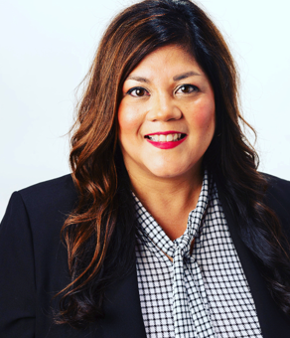
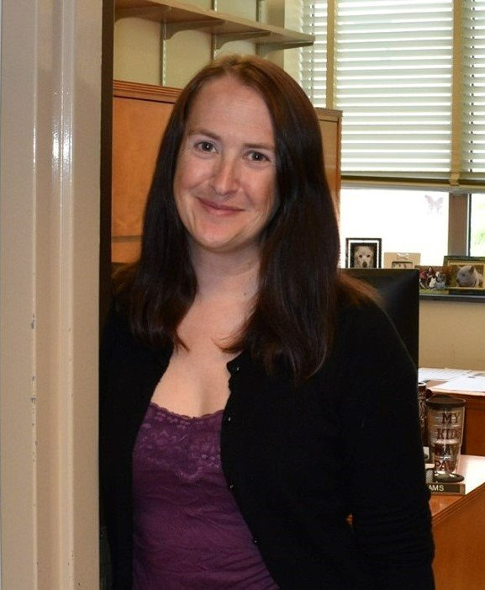
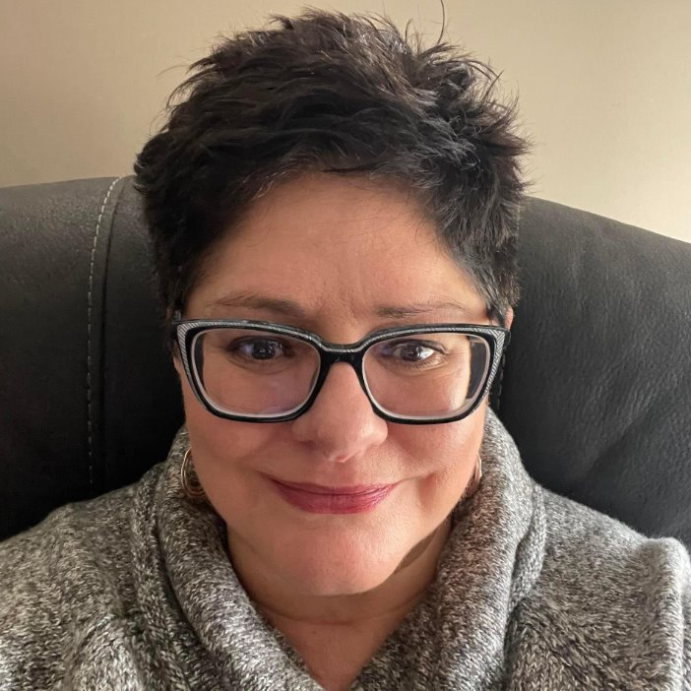


Alumni Clubs Team: Points of Contact and Areas of Support
Ilenia Herrera Lutz
Senior Director of Alumni Clubs
Focus: Alumni Clubs and Alumni Team Strategy & Vision, Special Projects & National Events, Stewardship
LeAnne Williams
Alumni Clubs Senior Specialist
Focus: Established Clubs, Event Execution & Communications, Recognition Strategy
Denise Jernagan
Alumni Clubs Specialist
Focus: Operational Optimization (Processes, Data, and Reporting), Financials, Scholarship Administration & Compliance (DFA)
Darien Thompson
Alumni Clubs Senior Specialist
Focus: Launching and Revitalizing Clubs, Digital & Social Engagement, Young Alumni Integration into Clubs
When team members may be out of the office—whether due to holidays, regular PTO, or other absences—please always include alumniclubs@purdueforlife.org on your communications to help ensure your request is addressed in a timely manner

Slide 41
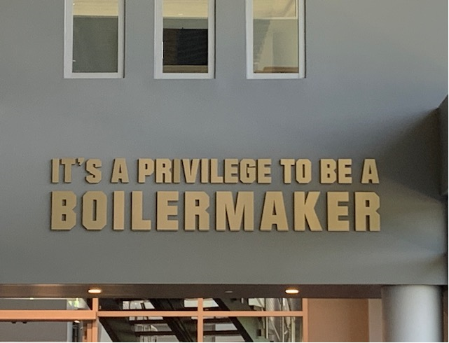
Thank you!
The next forum will be Wednesday, May 27, 2026 at 7:30pm ET.
Recordings of past forums are available on the Alumni Club Resource Library website: https://www.purdueforlife.org/alumni-leaders/clubs/resource-library/

