Slide 1
Alumni Club Leaders Forum
February 18, 2026

Slide 2
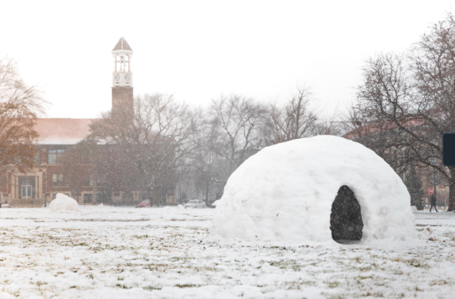
Purdue Alumni Clubs Forum
Reminders & Instructions
This forum is being recorded to share along with slides and chat content
Participants will be muted
Questions should be submitted using the chat function

Slide 3
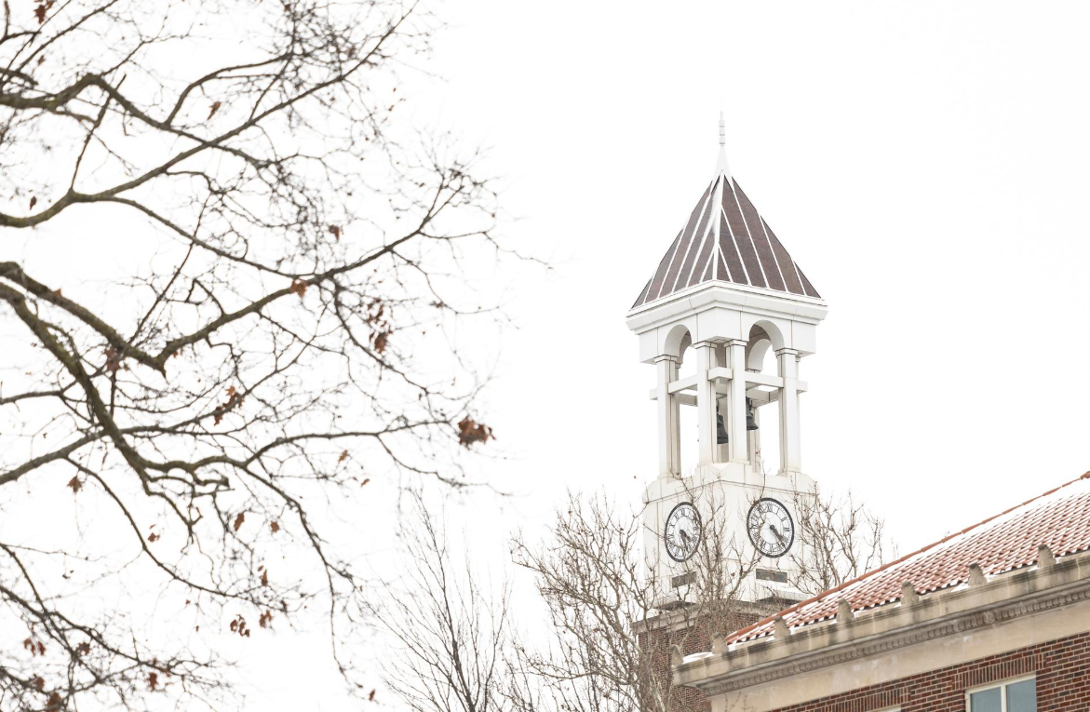
Purdue Alumni Clubs Forum
Agenda
University Updates
Purdue for Life Updates
  Purdue Day of Giving – Presenters:
    Angela Buckles, Vice President, Broad-Based Campaigns and Engagement.
    Bailey Daily, Executive Director, Broad-Based Campaigns and Strategic Engagement
Alumni Clubs Updates
  Board Elections
  Reminders
  Coming Up Next

Slide 4

Purdue Alumni Clubs Forum
University Updates
New Dean of the College of Liberal Arts - Dr. Christopher Yeomans
Purdue is once again the No. 1 public university in Indiana - Maintain high, consistent rankings, including U.S. News & World Report 2026.
Spring Presidential Lectures Series Announced
  CEOs of AMD and Adobe, writer, tech investor (Feb 26 – April 30)
  Tickets https://am.ticketmaster.com/purdue/buy/pls0226
Purdue Football Schedule 2026 Announced - Spring Game announcement pending

Slide 5

Purdue Alumni Clubs Forum
Purdue for Life Updates
Boilermaker Ball
  Saturday, February 28 from 5:30-11:00 pm - Indianapolis Marriott Downtown
Purdue Day of Service - Wednesday, April 24, 2026 (9am – noon ET)
  Sign up to go live Mid-March
  Not in West Lafayette? – Opportunity for a philanthropic or Volunteering event during April

Slide 6
Purdue Day of Giving 2026
Bailey Dailey, Executive Director of Broad-Based Campaigns and Strategic Engagement

Slide 7
Purdue day of giving & alumni clubs

Slide 8
WHAT IS PURDUE DAY OF GIVING?

Slide 9
PURDUE DAY OF GIVING IS A 24-HOUR
ONLINE-BASED FUNDRAISING EFFORT.
(PLUS A MONTH-LONG RAMP-UP)
PURDUE ALUMNI, FRIENDS, FACULTY, STAFF, RETIREES, STUDENTS, PARENTS, AND FANS ARE ENCOURAGED TO GIVE BACK TO THE UNIVERSITY—AND SMALL
DONATIONS CAN MAKE A BIG IMPACT IN HELPING PURDUE
TRANSFORM LIVES AND CHANGE THE WORLD.

Slide 10
CAMPAIGN RESULTS
 | 2014 | 2015 | 2016 | 2017 | 2018 | 2019 | 2020 | 2021 | 2022 | 2023 | 2024 | 2025 | COMPOUND ANNUAL GROWTH RATE | CUMULATIVE TOTALS
Dollars Raised ($ millions) | $7.5 | $13.6 | $18.3 | $28.2 | $37.6 | $41.6 | $42.2 | $52.5 | $68.2 | $110.8 | $76.5 | $105.1 | 24.6% | $602.1
# of Gifts | 6,600 | 9,592 | 12,872 | 15,181 | 18,663 | 21,420 | 20,224 | 25,219 | 26,726 | 27,855 | 32,054 | 36,875 | 15.4% | 253,281
Class Year with the Most Gifts | 2013 | 2014 | 2015 | 2015 | 2017 | 2018 | 1980 | 1980 | 2015 | 2022 | 2023 | 2024
Notes:
This year’s push emphasizes the importance of participating through the impact of each individual gift - every member of the Purdue community can have a lasting impact on the University by contributing the larger goal of Purdue Day of Giving!

Slide 11
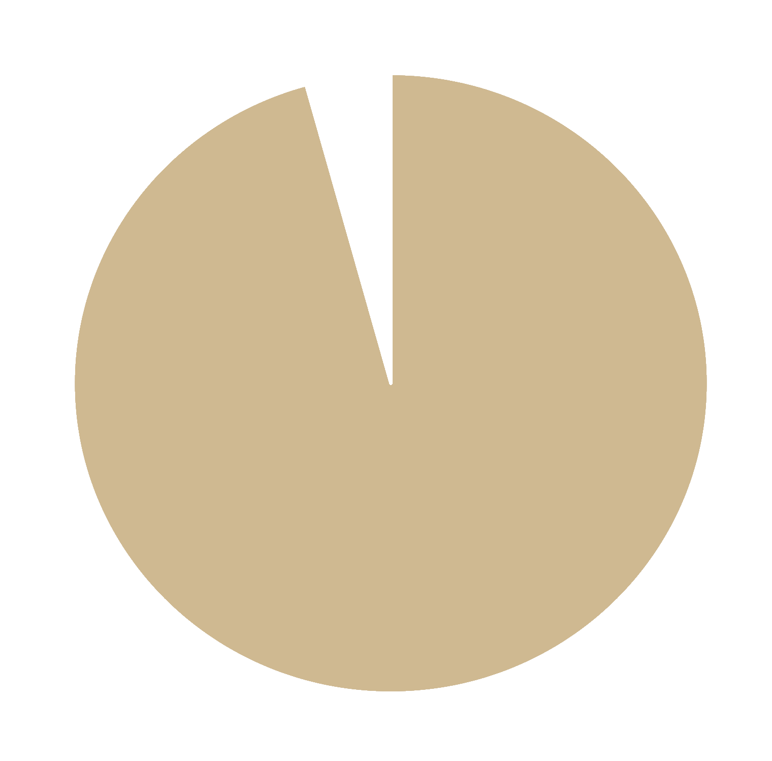



GIFTS
DOLLARS
4%
7%
96%
93%
ONLINE
OFFLINE
Notes:
KAP

Slide 12
WHAT MAKES A PROGRAM LIKE THIS WORK?
// Activating the power of social media to capture widespread
attention through peer networks
// Using elements of game theory to motivate participation
// Sparking fun competition between school, program,
and student organization affinity groups
// Appealing to nostalgia with campus-related content
// Emphasizing the impact of each individual donation—no matter the size
Notes:
AKT

Slide 13

TIMELINE
LATE
MARCH
APRIL 1–14
APRIL 15–28
APRIL 29
THE BIG DAY!
MAY 1–ON
CREATE AWARENESS
START A MOVEMENT
CREATE ANTICIPATION
DRIVE DONATIONS
GIVE
THANKS
Plant the seed
Start creating buzz
Share impact stories
Create hype/
begin countdown
to the day
Share the video
UGC challenges
Strong CTAs
“Give today”
Leverage digital assets
Thank donors
Recap results
Establish ongoing social stewardship

Slide 14
CHALLENGES & LEADERBOARDS

Slide 15
CHALLENGES: BEFORE THE DAY
$3,275
Introductory Video Sharing
Challenge (April 15–22)
User-generated Content (UGC) Challenge
DATE
CHALLENGE
PARTICIPATION
BONUS
UNIT
PARTICIPATION
RANK
BONUS
APRIL 24 |  | MOST CREATIVE POST |  | $225
APRIL 25 |  | MOST CREATIVE POST |  | $225
APRIL 26 |  | MOST CREATIVE POST |  | $225
APRIL 27 |  | MOST CREATIVE POST |  | $225
 |  | MOST SHARES |  | $750
 |  | 2ND PLACE |  | $500
 |  | 3RD PLACE |  | $400
 |  | 4TH PLACE |  | $300
 |  | 5TH PLACE |  | $200

Slide 16
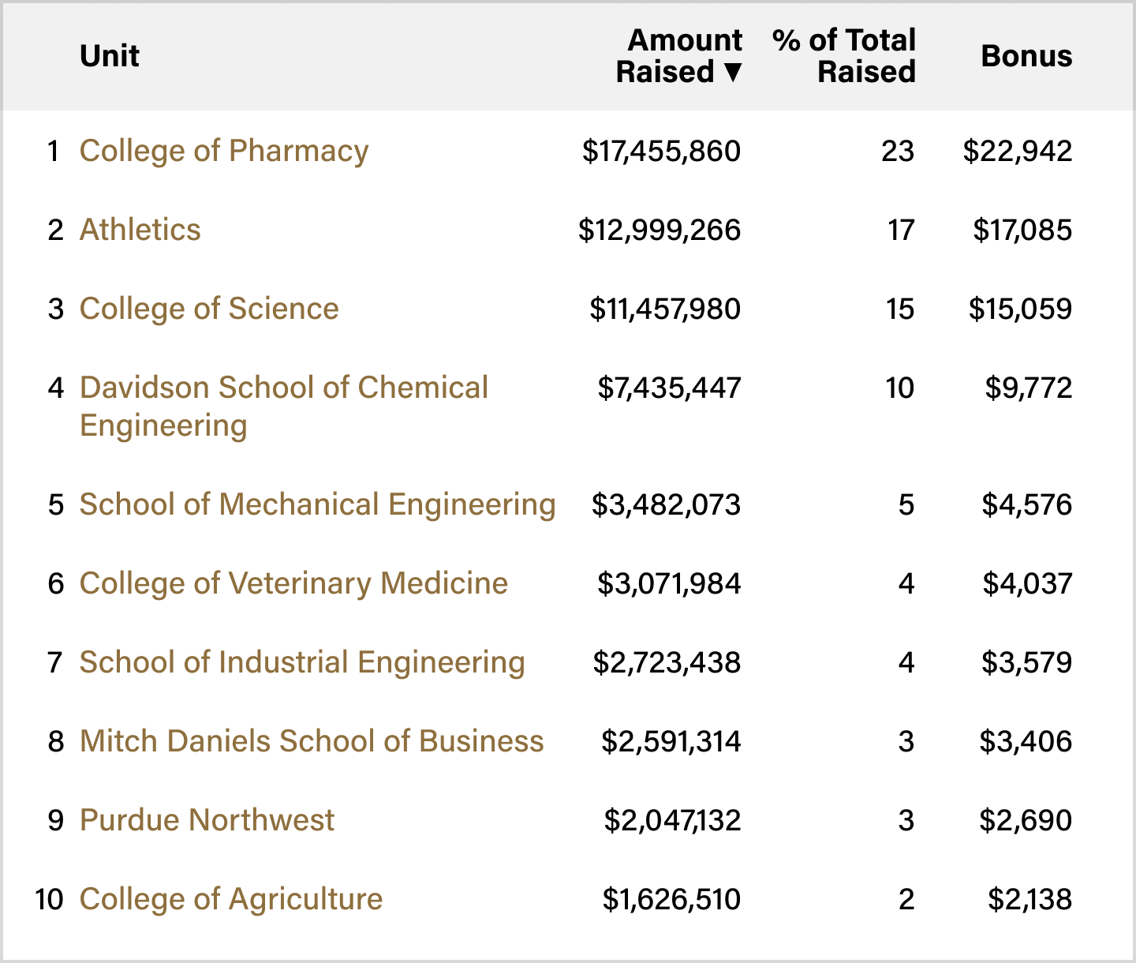
CHALLENGES:
DONATION
LEADERBOARD
$100,000

Slide 17
CHALLENGES: PARTICIPATION LEADERBOARD
$72,000
UNIT
PARTICIPATION RANK
BONUS
UNIT C |  | 1 |  | $12,000
UNIT A |  | 2 |  | $10,000
UNIT F |  | 3 |  | $9,000
UNIT T |  | 4 |  | $8,000
UNIT V |  | 5 |  | $7,000
UNIT W |  | 6 |  | $6,000
UNIT Z |  | 7 |  | $5,000
UNIT H |  | 8 |  | $4,000
UNIT B |  | 9 |  | $3,500
UNIT K |  | 10 |  | $3,000
UNIT P |  | 11 |  | $2,500
UNIT Q |  | 12 |  | $2,000

Slide 18
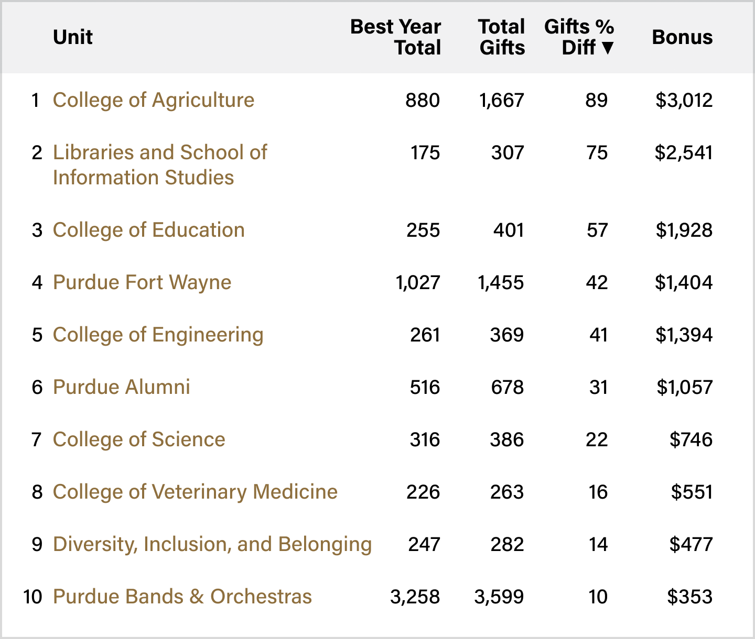
CHALLENGES:
BEAT YOUR LAST
LEADERBOARD 1
$30,000
($15,000 EACH)
Help your favorite unit take their next giant leap by surpassing your gift total from last year’s Purdue Day of Giving!
Units are split into two leaderboards based on their 2025 gift totals, with $15,000 available in each. Every unit’s share is determined by its percentage
of the total increase within its group.

Slide 19
RESOURCES

Slide 20
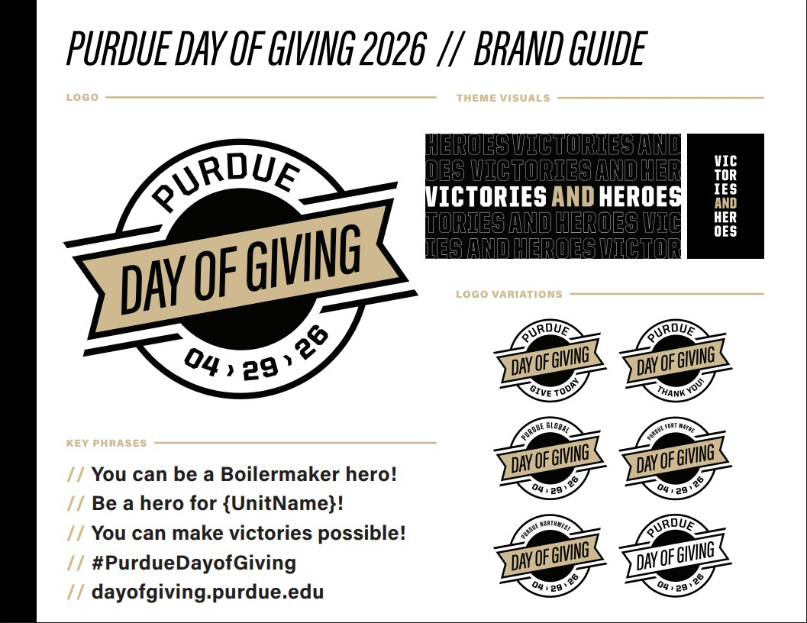

Slide 21
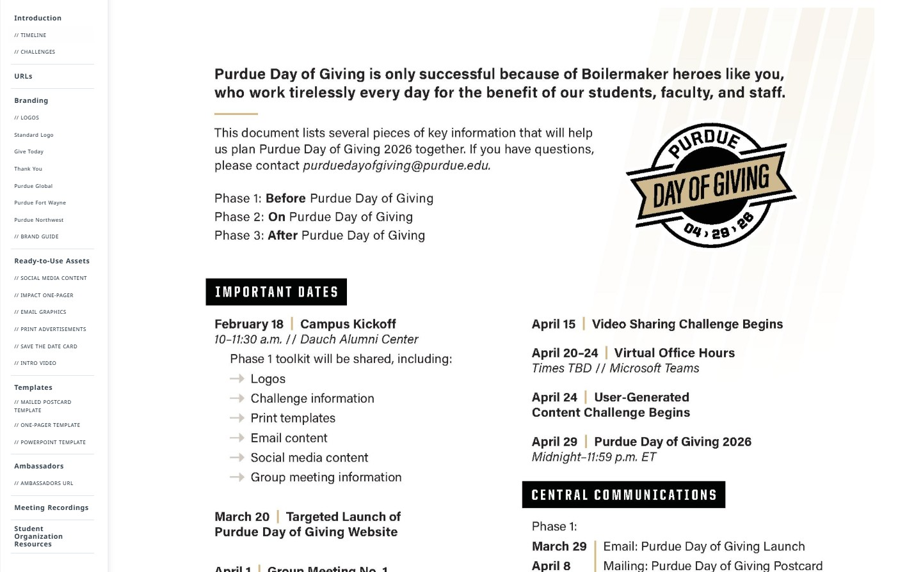
PURDUE DAY OF GIVING TOOLKIT
Phase 1 content available now!
Phase 2 content available 4/1
Phase 3 content available 4/15
ACCESS THE TOOLKIT
PURDUE.UNIVERSITY/
PDOGTOOLKIT

Slide 22

SOCIAL MEDIA CONTENT
Each phase includes date - specific content and evergreen content.
Date-Specific = must be posted on the date included in the toolkit
Evergreen = can be posted whenever works for you!
Phase 2 includes hourly challenge promotion, as well as templates to promote efforts specific to your club. Examples from 2025 included below!

Slide 23
ALUMNI CLUB SPECIFIC CONTENT

Slide 24
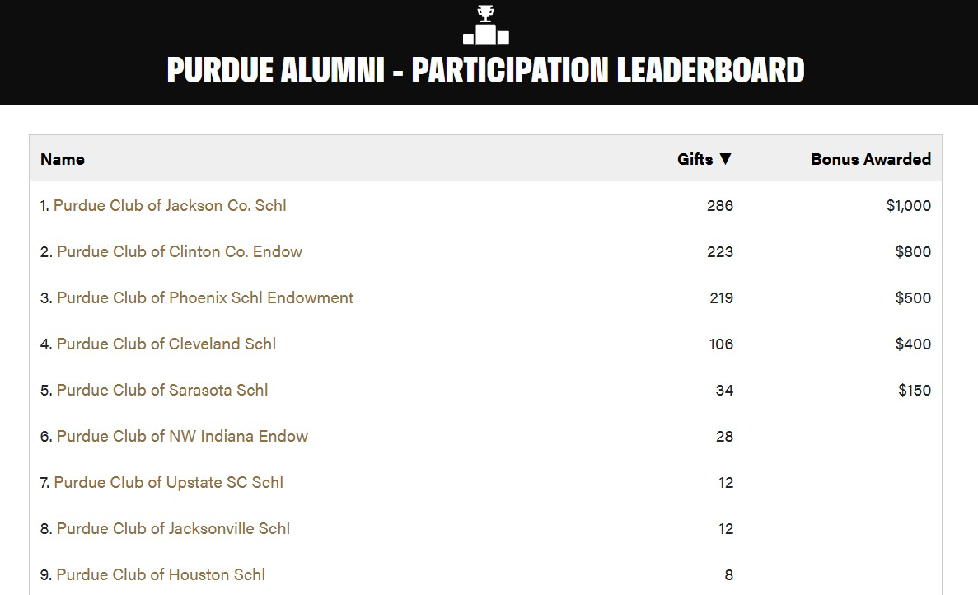
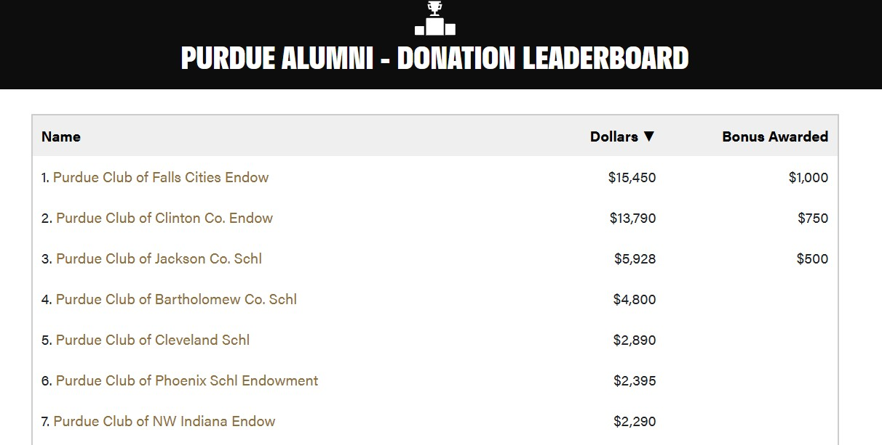
ALUMNI CLUB LEADERBOARDS
Win bonus funds for your club! Leaderboards are based on participation (number of gifts) and dollars raised.

Slide 25
Weekend Prior Events — New This Year!
Units may now choose to host an event the weekend prior to Purdue Day of Giving to begin engaging donors early.
What this means:
  Events may take place Friday, April 25 – Sunday, April 26, 2026
  Giving during these events will be supported through Purdue Day of Giving early-access links (provided by PFL)
  Events should also encourage giving on Purdue Day of Giving (April 29) to participate in hourly challenges and honor the spirit of PDOG
Additional details:
  Early-access giving links will be distributed no later than April 22, 2026
  Note: Purdue Day of Giving leaderboards will go live on April 29, 2026

Slide 26
PDoG – Check Handling Process
Deadline for Counting Toward PDoG
Check Deadline: Checks must be delivered to Dauch by 5:00 p.m. ET on Wednesday, April 22 to be counted toward PDoG.
Advanced Coordination: If your club anticipates delivering a large number many provide advance notice via @alumniclubs@purdueforlife.org prior to April 22nd so we can coordinate with Gift Processing and plan accordingly.
Collection Timeline: Checks should not be collected or dropped off prior to April 15.
Important Considerations
To preserve the integrity and energy of PDoG, we strongly encourage use of official PDoG Giving Links.
While we are willing to work with clubs that collect checks, this is not the preferred or advertised method, as it increases operational complexity.
Our goal: Support clubs while maintaining a streamlined, consistent process for everyone.
Notes:
Our preferred approach is to lean into what we’ve established for Club events: hosting events April 24–26 and utilizing a PDoG giving link that we provide. This keeps the experience aligned, simplifies processing, and ensures gifts are counted digitally.

Slide 27
RESOURCES
SOCIAL MEDIA
TOOLKIT
PURDUE.UNIVERSITY/
PDOGTOOLKIT
PURDUE DAY
OF GIVING QUESTIONS
PURDUEDAYOFGIVING
@PURDUE.EDU

Slide 28
Club Specific Incentives – Participation Leaderboard
As clubs raise money, they can compete for these Scholarship Bonus Funds:
By # of Donations: | Scholarship Bonus Funds
Club #1 | $1,000
Club #2 | $700
Club #3 | $500
Club #4 | $200
By $ Amount Raised:
Club #1 | $1,200
Club #2 | $800
Club #3 | $600
Club #4 | $500

Slide 29
Elections:
Time to Start Planning & Strategizing

Slide 30
It’s Time to Start Thinking about Elections
High Level Timeline
March and April– Call outs
  Complete by April 15, 2026
  Decision on the type of election for the club
May – Election Process
  Submit survey request by April 30, 2026
  Election results submitted to Alumni Clubs Team by May 31, 2026
June/July– Leadership Transition
  June 15 – Club leadership roster due
  June 25 – Statement of Integrity submitted by all board members
  July 15 – Bank statements for the final quarter of FY25/26 due
  July 25 – Club Agreement signed by President and Treasurer (sent via Docusign)
6–8weeks out
4–6 weeks out: Promotion + call-outs + outreach
2 weeks out: Finalize slate + open voting
Post-election (within 2 weeks): Onboarding + transition
  June 15 - Club Leadership roster is due
Notes:
6–8 weeks out: Assess needs + confirm roles open
☐ 4–6 weeks out: Promotion + call-outs + outreach
☐ 2 weeks out: Finalize slate + open voting
☐ Post-election (within 2 weeks): Onboarding + transition

Slide 31

Recruitment and Election Checklist
Phase 1: Needs & Strategy (The Foundation)
Define the Scope: Decide if you are doing a total board "refresh" or just filling specific vacancies.
Identify Gaps: Pinpoint where you’re thin (e.g., Do you have enough hands for events? Who is actually posting to Instagram?).
Set the Rules: Review your Board Role Descriptions and confirm that all officer candidates are official PAA members.
Build the Pipeline: Use your interest survey (Qualtrics) to track demographics and specific areas of interest.

Slide 32
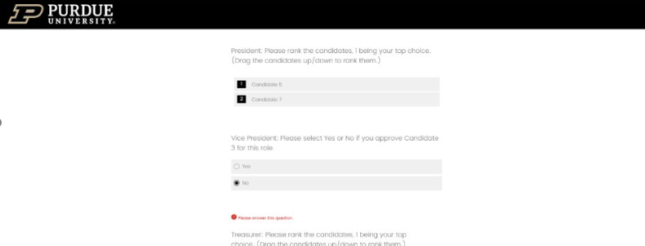
Survey Request
A Qualtrics survey can be created by PFL for the elections
  Email the request to LeAnne (lewilliams@purdueforlife.org) and CC Alumni Clubs (alumniclubs@purdueforlife.org)
Include the following
  Candidate bios (150 word maximum)
  List of all nominees for Leadership, Board, and Committee roles
  Closing Date (recommend the voting period be two weeks)

Slide 33

Recruitment and Election Checklist
Phase 2: Humanized Recruitment (The Outreach)
Go High-Touch: Move beyond emails. Text strong candidates, grab coffee, or do a quick 1-on-1 check-in after a game watch.
Host a Call-Out: Run a virtual or in-person "Meet the Board" night so prospects can see the human side of the roles.
Be Transparent: Share a "Year in the Life" document. People are more likely to commit when they know exactly how many hours/meetings are expected.

Slide 34

Election Process Checklist
Phase 3: The Election Process (The Logistics)
Finalize the Ballot: Ensure the "Big Three" are covered: President, Treasurer, and Secretary.
Pick Your Format: Choose between an anonymous virtual survey (best for reach) or an in-person vote.
The Two-Week Window: Keep voting open for 14 days to maximize participation across your newsletter and social channels.
Review

Slide 35
General Election Voting Options
1
Voting Type:
  Anonymous
  Open or In-person
  Virtual (survey)
Any constituent member can express interest for a position
Who Votes: All Members Vote
All Constituents in Club Mailing list are invited vote for
Leadership
General board members
Committees
2
Two Step Vote
Vote #1: All Constituents in Club Mailing list are invited vote for general board members
Vote #2: Elected Board Members vote for:
  Leadership
  Committees
3
Who Votes: Current Board
All positions are voted in by current Board

Slide 36
Reminders

Slide 37

Shoutout: Thank you to All of our Club Leaders!
Admitted Freshmen Scholarships Applications
1,690 total submitted applications
We are grateful for:
Promotion of the scholarships
Outreach to High Schools
Support of Recruiting Fairs
Club leaders who were helping other clubs with promotion
Your time and overall support of phase 1
Coming Up Next: Current student deadline is March 1.

Slide 38
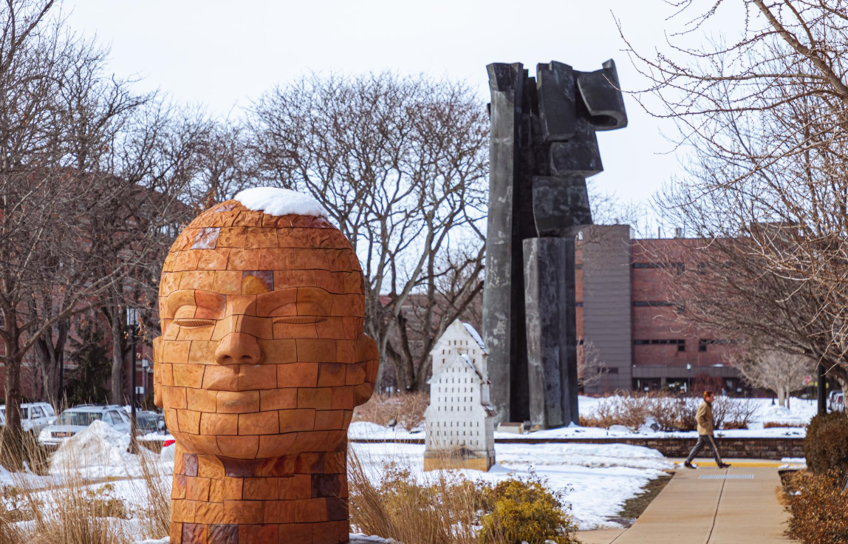
Operational Updates: Scholarships
Upcoming Dates
  March 1st – Deadline for current students to submit the scholarship application
  March 15th – Deadline for scholarship committee chair to submit current student awardees
  DFA will begin sending out award notifications to incoming freshmen – typically early to mid-March

Slide 39

Operational Updates - Basketball Tournaments
Big Ten – March 10-15, 2026
United Center, Chicago, IL
Chicago venue is being confirmed
Free event – Partnering with the Chicago Clubs
No event registrations
Prize Package QR Code
Alumni Clubs Staff – LeAnne & Darien
March Madness - March 17 - April 6, 2026
Fan HQs expected for every game
  Locations TBD based on seedCban
  Engagement Staff Support
  Rounds 1 & 2 – LeAnne & Darien
  Sweet 16 & Elite Eight – Denise & Ilenia
  Final 4 (Lucas Oil Stadium, Indianapolis, IN) - Alumni Clubs & Volunteerism Team Members
Next Steps:
February 22 - Tournament Handbook will be emailed to Club Leaders
February 25 - Final regular season Game Watch email
ASK - Please start confirming your Tourney game watch venue due to the fast turnaround after Selection Sunday. *Email schedule will be posted when we know Purdue’s playing times.
Notes:
Kick-Off
Promotion Digital Final Four Watch Party Kit (graphics, signage, chants, trivia)
Registration for tracking & follow-up
Hosts Provide:
Location (home, bar, office)
Invite list + Purdue spirit
Photos & highlights
This isn’t just a watch party.
It’s a shared Purdue moment — nationwide.
Spirit Club" may also refer to a general group for alumni to show support

Slide 40
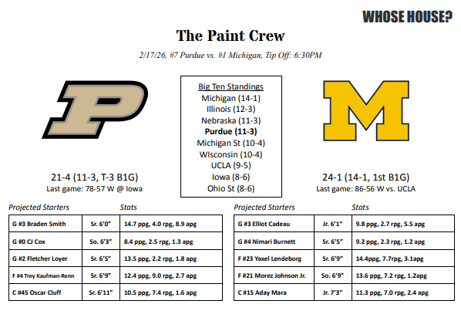
Paint Crew Intel for Clubs: Mackey Game Day Sheets
The Paint Crew is delivering something special for our Alumni Clubs
We’re incredibly grateful to the Paint Crew for sharing this with our alumni network. This is meant to be a Boilermaker-only advantage — a way to strengthen our community while keeping it out of the hands of opposing teams and the general public. To honor their generosity, please follow these sharing guidelines:
Sharing Etiquette & Guidelines
✅ Print and use at watch parties to amplify the energy. This is very special and it’s only for our Club Leaders to hand out/print at in person game watches. Please be sure collect any remaining sheets after the game watch.
🚫 Do not forward and do not distribute widely
🚫 Do not share only within your club’s private channels
🚫 Do not post publicly on Facebook, Instagram, X, websites, or other fully public platforms.
Through March 7, the Paint Crew is Sharing their official Mackey Gameday Sheet with us — the real deal. The chants. The insider energy. This is your chance to bring the electricity of Mackey Arena straight to your watch parties!

Slide 41
Operational Updates - Handbook, Events & Emails
Email submissions
  Digital Team is short-staffed — please submit email requests at least 6 days in advance when possible.
  Standard turnaround: ~4 days from submission if all information is complete and accurate.
  Best practice: Ensure your email request is fully complete and correct to avoid delays from follow-up questions.
Reminder: Event forms submitted fewer than two weeks before the event date do not allow enough time to properly plan, execute, and communicate the event to alumni, friends, and family.
Game Watch Requests: Please submit by 12:00pm (noon, ET) on Mondays if you want your game watch(es) included on the Game Watch website update that week.

Slide 42
Operational Updates - Handbook, Events & Emails
Alumni Clubs Resources:
https://www.purdueforlife.org/alumni-leaders/alumni-clubs/leaders-resources/
Club Leaders Handbook overview
  https://www.purdueforlife.org/app/uploads/Purdue-Alumni-Clubs-Handbook-Final-v1_226.pdf
Purdue Images for Emails, Newsletters, and Social Media:
  https://link.us-1.lytho.us/i/1726749883194a66cc55e-764f-4b96-a440-f377f9098b5a#purdue-for-life-foundation-photos
Data Privacy Training:
  Any club leader handling event need to:
    Watch the video
    Review the slides
    Fill out the agreement.

Slide 43
Operational Updates: Use of Attendee Lists with Contact Information
DOs
What to Avoid
Restrict Access: Ensure data is handled only by individuals who have completed Volunteer Data training.
Limit Scope: Use information strictly for the specific event registered for—including communications before, during, and up to 30 days after the date of the event.
Protect Privacy: Always use the BCC field for group emails to keep recipient addresses confidential.
Ask for Help: Contact alumniclubs@purdueforlife.org for any communication or technical support.
If in doubt, complete the training:
  Volunteer Data Training Slide Deck
  Volunteer Data Training Video
Unauthorized Sharing: Do not share lists with anyone (board members or volunteers) who hasn't completed mandatory training.
Irrelevant Outreach: Never contact registrants about programs or events unrelated to their original registration.
"Ghost" Databases: Do not store data in separate, unofficial, or offline spreadsheets.
Expired Usage: Stop using registration lists 30 days after the event concludes.
Stale Data: Do not use old lists for ongoing outreach; they lack real-time updates on unsubscribes and contact changes.
Best practice: Send post-event email thanking attendees and sharing information about upcoming events

Slide 44
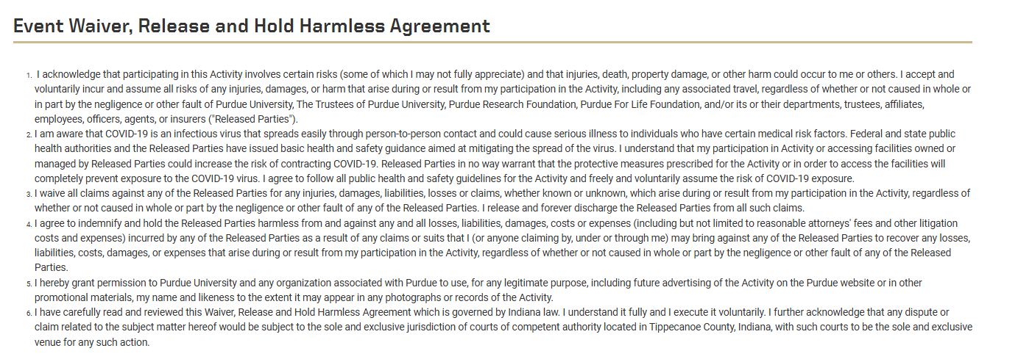
Operational Updates - New Event Waiver for All Events
New organizational-wide policy we've been asked to include on all events: https://connect.purdue.edu/portal/s/event-waiver.

Slide 45
Coming Up Next
February
Scholarships Promotion!
March
April
PDOG
Elections & Board Transition Planning
May
Elections & Board Transition Planning
Current Student Scholarships
BB Tournament
BB Tournament
PDOG Planning
April 22 Forum @ 7:30pm ET – PDOG – last updates, Election Readiness, Recognition Program Status
Purdue Day of Service Options
April 24-26 PDOG weekend events (More to come!)
April 29– Purdue Day of Giving (PDOG)
Board Call outs sessions (zoom and/or in person)
Board Call outs sessions (zoom and/or in person)
Start planning your board transitions, student send-offs, family friendly events!
Forum – 5/27 7:30pm
Clubs promote current student applications on social media
Feb. 22 – Tournament Handbook distribution
Wednesday. Feb. 25 -
Final regular season Game Watch email
Confirm your Tourney game watch venue: a fast turnaround will be required after Selection Sunday (3/15/26)
March 1 - current student applications due
Clubs Plan for:
- B1G/March Madness Prep – Identify game watch locations & engagement strategy (Retaining new attendees, board/young alumni committee prospects, etc.)
Purdue Day of Giving (PDOG) options
Weekend prior to PDOG event?
Strategy
March 15 – March Madness Selection Sunday
March 16 – March Madness Game watch Info Due
March 18 Forum @ 7:30pm ET – PDOG Readiness, Events Showcase
March 15 –Current Student Selection deadline

Slide 46
Lifelong Learning Updates
Event Idea or Speaker Identification: Lifelong Learning Purdue YouTube channel videos
Great place to seek out club speakers or leverage for an event (video could be shown and then go into a discussion) https://www.youtube.com/@LifeAtPurdueOnline/videos
Free Certificate Courses for Alumni
Alumni can now take a handful of online certificate courses for free through Purdue’s online programs, as part of a partnership with Purdue for Life. The offerings include Purdue’s ABET-recognized AI microcredential course “Demystifying AI, Understanding Risks, and Shaping the Future” and Google Career Certificates in cybersecurity, data analytics, digital marketing and e-commerce, IT support, and project management. Alumni will receive a certificate upon completion of any eligible course.
To access these courses, you must be an alumnus and have an account on the Purdue for Life portal. Set up your account now if you haven’t already done so. New accounts may take 24 hours to create.

Slide 47

PASE Upcoming Events – Volunteers Needed
Alumni Networking Night
Dauch Alumni Center
March 5th, 2026 - 6-8:30pm
Registration: https://events.blackthorn.io/en/3ktO526/pase-alumni-networking-night-3a9GQpUXZ/overview
Volunteers: The registration is the catch all for that event. sign up the will select the "alumni ticket" option.
Career Readiness Night 2026
2nd Floor Stewart Center
April 15th, 2026 - 6-9pm
Volunteer Form - PASE Career Readiness Night 2026 - Volunteer Form – Fill out form

Slide 48
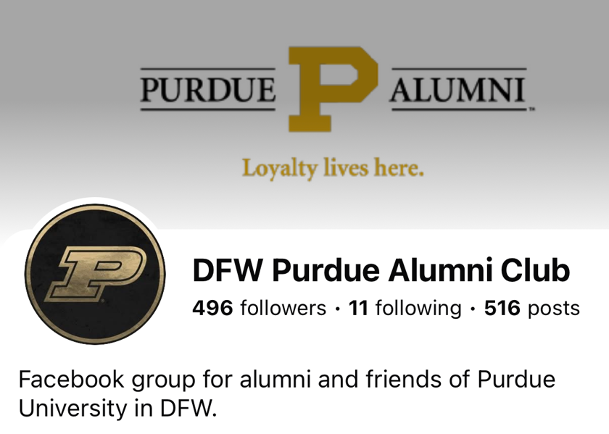
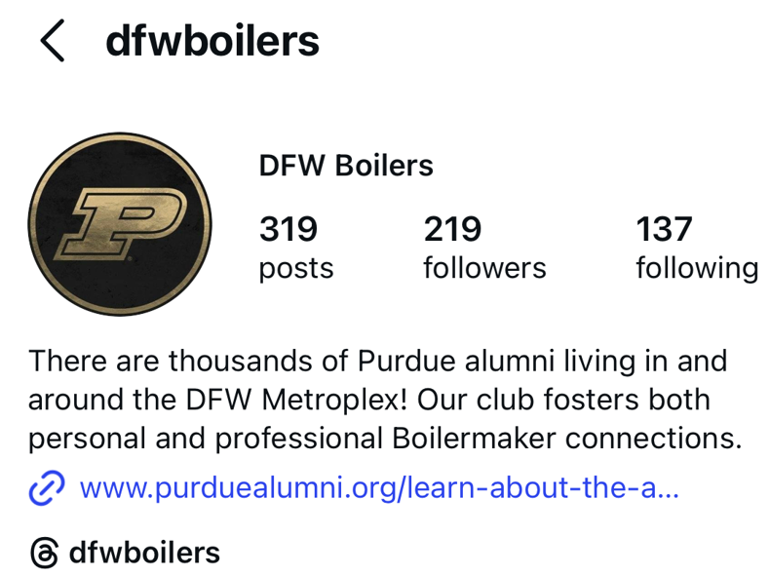
Shoutout: Dallas Best Practice
Great Auto-Reply Message
Thanks for reaching out. We're glad you are here! Did you know there are over 7000 Boilermakers in the DFW Metroplex and our mission is to foster both personal and professional relationships while also contributing to our community.
Stay connected
The best way to connect with us is through our closed Facebook group Here is where we post most of our events that include watch parties for both football and basketball. We are also on Twitter and Instagram @DFWBoilers and our events are posted on our web page http://www.purduealumni.org/dallas .
Feel free join us there and introduce yourself! We hope to see you in person soon!

Slide 49
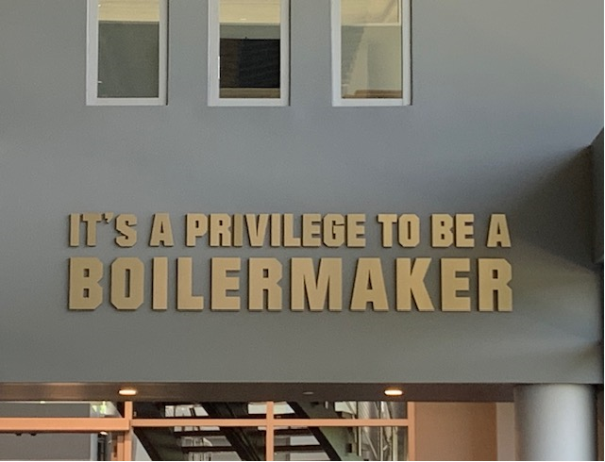
Thank you!
The next forum will be Wednesday, March 18, 2026 at 7:30pm ET.
Recordings of past forums are available on the Alumni Club Resource Library website: https://www.purdueforlife.org/alumni-leaders/clubs/resource-library/

