Slide 1
Alumni clubs Brain share
Theme: Amplify your Impact
October 15, 2025

Slide 2
Welcome to our very first BrainShare!
Concept
Example Format
Welcome, Agenda overview and Club Updates (10 min)
Topic #1 (10 min)
  Cohort Discussion (10 min)
  Cohort debrief + Quick Takeaways (5 min)
Topic #2 (10 min)
Open Discussion (10 min)
Reminders (5 min)
Opportunity for Club Leaders to . strategize and learn by discussing ideas and best practices
Topics relevant to the club cycle will be presented and after, we’ll break into group discussions and discuss take aways.
You take the ideas that work for you and your club!

Slide 3
Today’s Agenda
Welcome (8 min)
Social Media (10 min)
  Cohort Discussion (10 min)
  Cohort Debrief +Quick Takeaways
    Each Group designates a speaker (5 min)
Club Pulse
    Discussion: Event Planning through Feb 2026 (10 min)
    Event in a Box (10 min)
    Reminders (5 min)

Slide 4
Social Media
Audit Results

Slide 5


Social Media Audit
What’s Working
Patterns and Trends
Consistency: Most clubs post regularly (at least once monthly).
Commitment: Clubs maintain pages and show willingness to improve.
Structure Emerging: Some clubs using templates or branded visuals (Canva) correctly.
Facebook Activity: Active community interaction where groups remain public or semi-public.
Branding ASK:–Clubs consistently use their Club Brand Logos
Content Variety: Clubs content often lacks strategic variety and creativity.
Maximize LinkedIn: The platform is currently underutilized for professional networking and deeper engagement.
Improve Reach: Consistently tag relevant partners or accounts for organic reach
Training Needed: Volunteer could use more support and training on social media best practices.

Slide 6
What’s Not Working
Category | Audit Findings | Impact
Content Quality | Over-reliance on reshares; minimal original voice | Feels generic; low engagement
Engagement | Likes/comments/shares are minimal | Missed community-building
Tagging & Cross-Promotion | Club admins rarely tag official pages or each other | Low visibility; stagnant follower growth
Admin Oversight | Non-board members managing pages | Accountability risk
Platform Focus | Too many pages with limited management | Diluted effort and quality
Private Pages | Many pages set to private | Severely restricts organic reach
Follower Metrics | <20% of potential alumni audiences reached | Underperforming presence

Slide 7
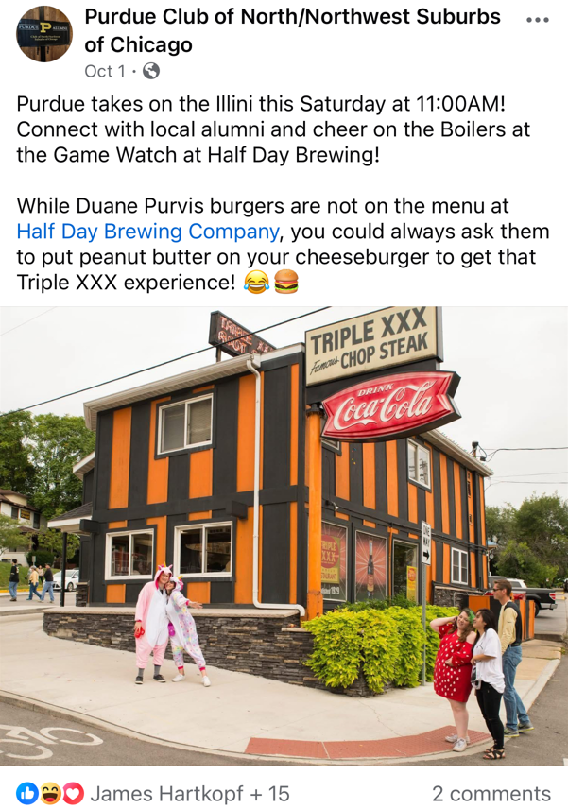
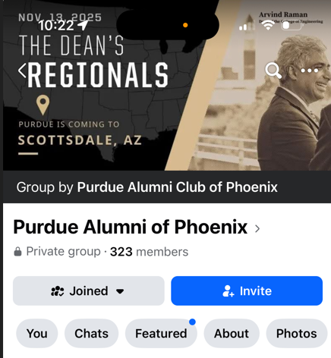
Social Media Audit
USE THE FACEBOOK BANNER TO PROMOTE UPCOMING EVENT
NOSTALGIA AND HUMOR TO ELICIT ENGAGEMENTS
Activity | Phoenix, Nashville, LA/OC
Content | Phoenix, Atlanta, Nashville, Chicago, Central Ohio
Creativity | Atlanta
Presence | Nashville, Chicago N/NW, Chicago
Community | Area of Improvement for All Clubs

Slide 8
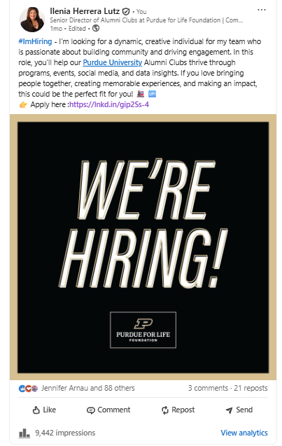
What’s Good
Tagging & Cross-Promotion
Tags increase visibility, allowing both your existing network and new, targeted audiences to see and share your posts. Example: @PurdueforLife
Purdue University, Purdue for Life, College
Tag fellow clubs
Club Leaders, Alumni Teams Staff
Ask others to share your post
Avoid tagging President Mung and PFLF CEO

Slide 9
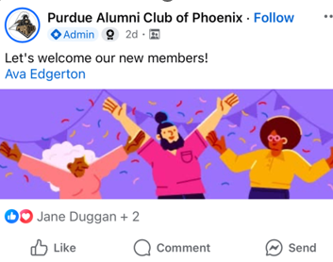
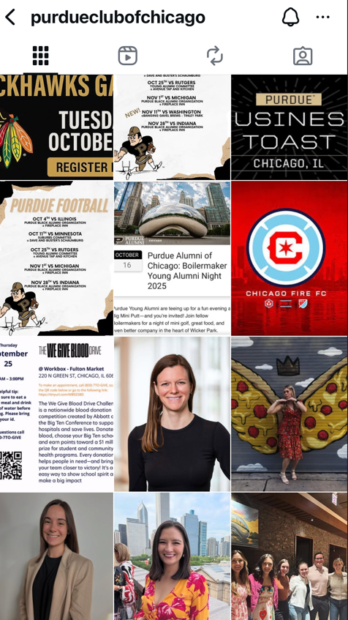
What’s Good
FACEBOOK: Public pages is best
Welcoming New Members
Frequency of Posts
Posts show Active
Photos show Fun & Pride
Personalized Content: Board introductions
Notes:
Mikaela’s training

Slide 10
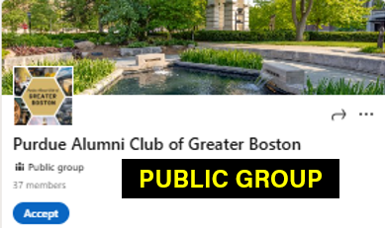
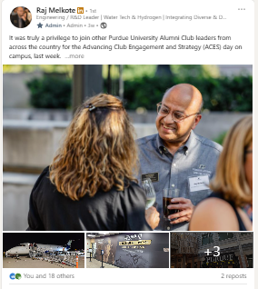
What’s Good: LinkedIn
Make it Public!
Makes the club discoverable by alumni searching on Google, not just within LinkedIn
Non-members can find and view the Page/Group
Promotional Power: posts, events, and job announcements can be shared outside the immediate membership circle
Visibility to all, demonstrating the club's positive impact and strengthening partnership opportunities.
Students are focusing on LinkedIn usage

Slide 11
10 MINUTES
Notes:
CLUB narrative
Goal: Be seen as a fun, active, and vibrant alumni community — one that celebrates Purdue pride, builds connections, and inspires participation.
In short:
Fun. Engaging and welcoming.
Active. Consistent and involved.
Vibrant. Full of life, purpose, and Boilermaker spirit.
Goal: Use photos that reflect a dynamic, welcoming, and high-energy alumni community.
If your photos look boring, your events will feel boring — even if they aren’t.
Show Energy. Smiles, movement, interaction.
Show Connection. Alumni engaging with each other and students.
Show Pride. Purdue spirit, traditions, and memorable moments.

Slide 12
Club Pulse
10 minutes
Events through February 2026
Are you planning holiday events, volunteering, student events over break, game watches or anything new?

Slide 13
Event in a Box
Our Library for Events
Event in a Box Template
  St. Joe Valley’s Super fun Trivia – Make it your own fun – Rebecca Lindenman
  Boone County Pi Day – A Family Fun Day - Jill Winkelman
Pay it Forward Club Leaders! - We’ll be sharing the template so you can submit a successful event for other club leaders to replicate
  Send back to Alumniclubs@purdueforlife.org
  We’re reviewing the Resources Section and we’ll alert you when we are posting them there

Slide 14
What’s Coming Up Next
Fall Check-Ins
(October-Nov)
Nov. Forum
Nov 19
2:30pm ET
Dec. Student Events
Event Forms due
Nov 1 – Nov 20
Thanksgiving
- Early Dec.
December
Brain Share
January 21
7:30pm
BB & Winter
Check-Ins
March
Finalize goals, calendar of events and discuss support needed
In State Clubs: In Person – Groups
Out of State: Individual Zoom Calls
Scholarship process, timelines and actions
Winter Recess Readiness – Submitting your events, planning payments, reimbursements
Submit Event Forms 45 days prior – Why?
Student Email Data needs to be requested to Purdue which adds 2 weeks to the Process
Maximize your 3 emails
PFLF Closed Nov. 27-28
Scholarship Applications go-live: Dec. 4
No Forum: The Alumni Clubs Team Newsletter (mid-month)
PFLF Foundation closes from Dec. 24th to January 2nd. - Submit your events requests by December 12 5PM
JANUARY 2026
Brain Share #2
Wed. January 21

Slide 15
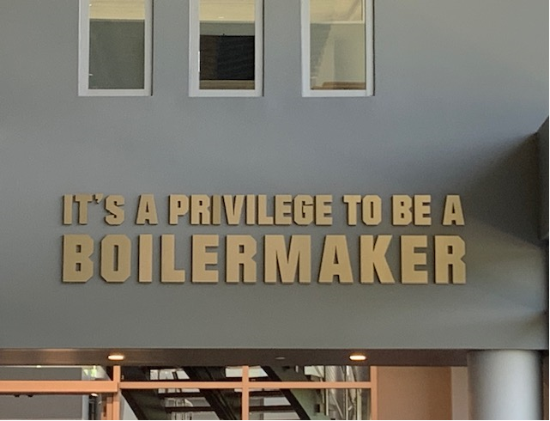
Thank you!
The next forum will be Wednesday, November 19 at 2:30 pm ET
  General Fall Meetings Updates
  Investments and Endowments – How they work
  Scholarships – review timeline, application process, scholarship committees
  Recognition Program – update on where clubs are
Recordings of past forums are available on the Alumni Club Resource Library website (NEW) - https://www.purdueforlife.org/alumni-leaders/alumni-clubs/leaders-resources/

