Slide 1
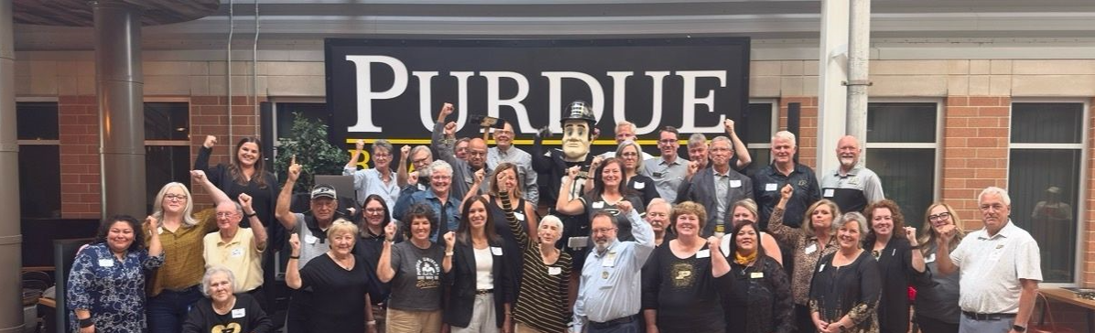
2026 Alumni Clubs Engagement and Strategy Session
Thursday, August 5
Dauch Alumni Center
Prusiecki Ball Room

Slide 2
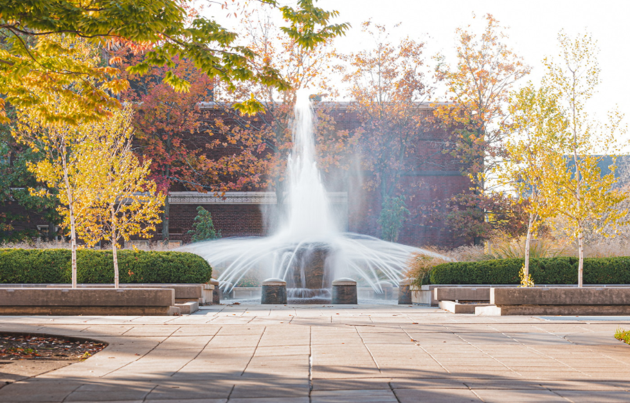
Agenda
Noon – 1:00 Arrivals and Networking Time
1:00-1:30 – Welcome (I.Lutz, Jillian Henry). Introductions and Agenda
1:30-2:20: Goals and Events Discussion
2:30-3:20: Engagement Best Practices. Focus: Young Alumni & GOLD
3:30-4:20: High Performing Clubs: Opportunities & Problem-Solving Session
4:30-4:45: Wrap-up; Day 2 agenda/expectations
5:30–6:30 PM Social Hour (Dauch Patio)

Slide 3
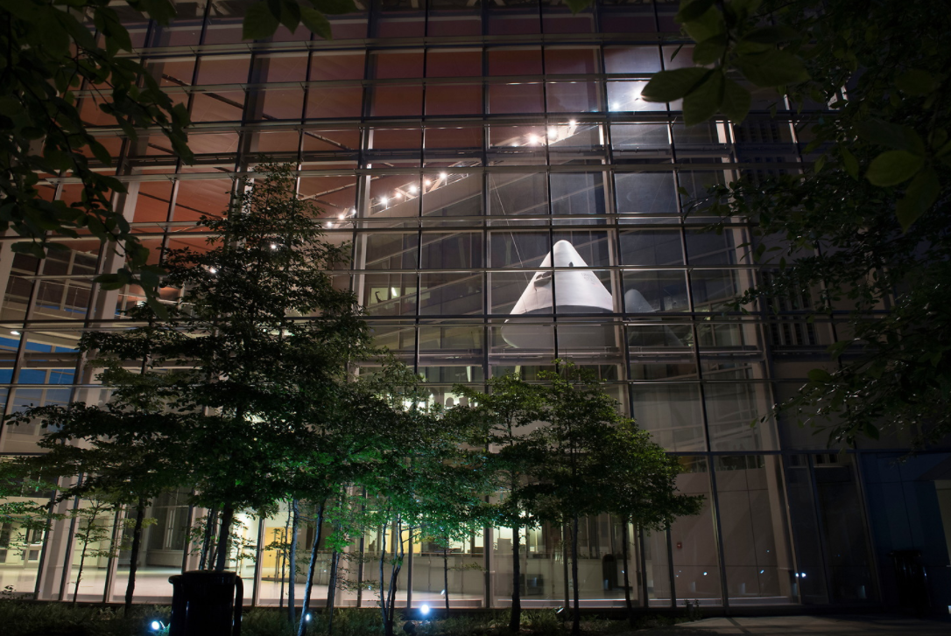
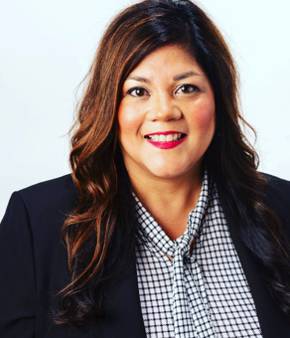
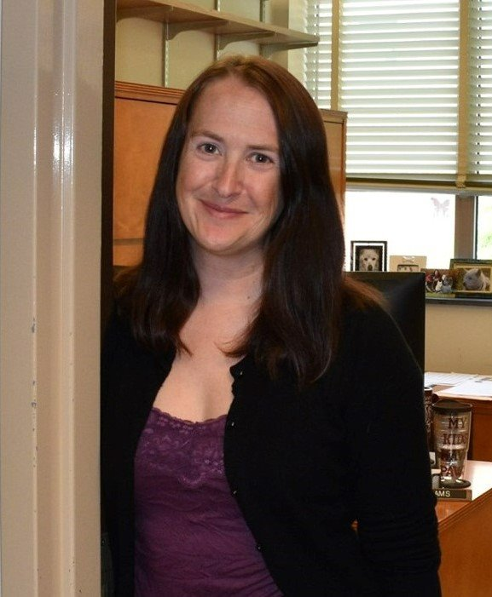
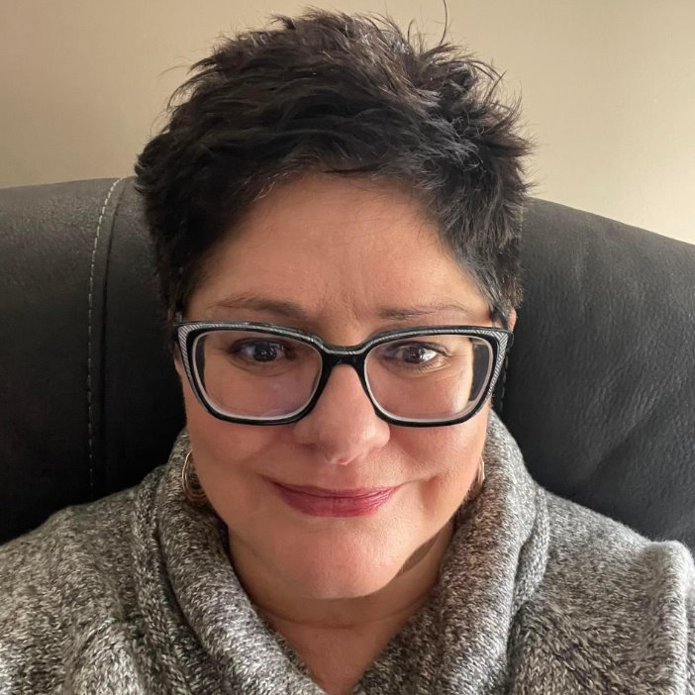
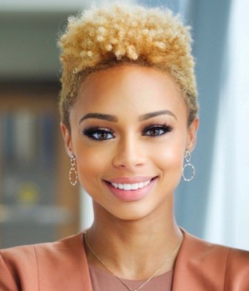
The Alumni Clubs Team
Ilenia Herrera Lutz
Senior Director of Alumni Clubs
Focus: Club and Team Strategy & Vision • Relationship Building and Stewardship
Strengths: Relationship Building, Stakeholder Management, Tenacity, Future‑Focused Leadership
LeAnne Williams
Alumni Clubs Senior Specialist
Focus: Established Clubs • Event Execution & Communications • Recognition Strategy
Strengths: People‑Centered Approach, Persistence, High‑Touch Support, Deep Institutional Knowledge
Denise Jernagan
Alumni Clubs Specialist
Focus: Operational Optimization (Processes, Data, and Reporting) • Financials • Scholarship Administration & Compliance
Strengths: Process Optimization, Data‑Focused Decision‑Making, Persistence, High Responsiveness
Darien Thompson
Alumni Clubs Senior Specialist
Focus: Launching and Revitalizing Clubs • Digital & Social Engagement • Young Alumni Integration into Clubs
Strengths: Relationship‑Driven, Inspires Momentum, Community‑Focused, Technology‑Savvy

Slide 4
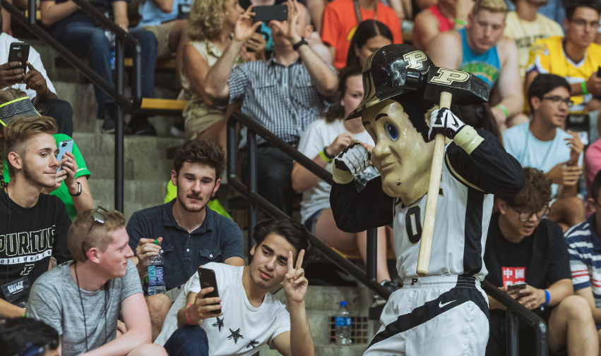
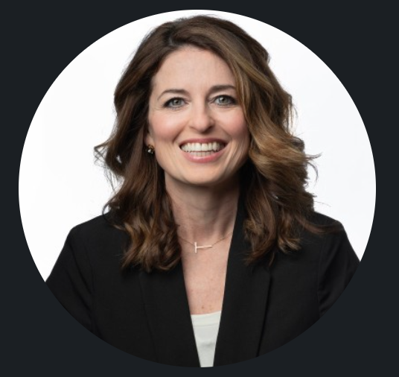
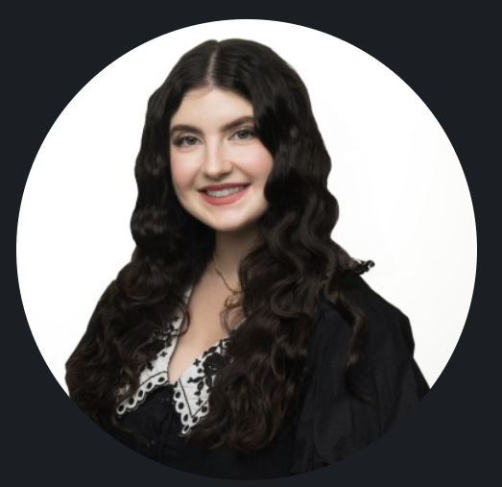
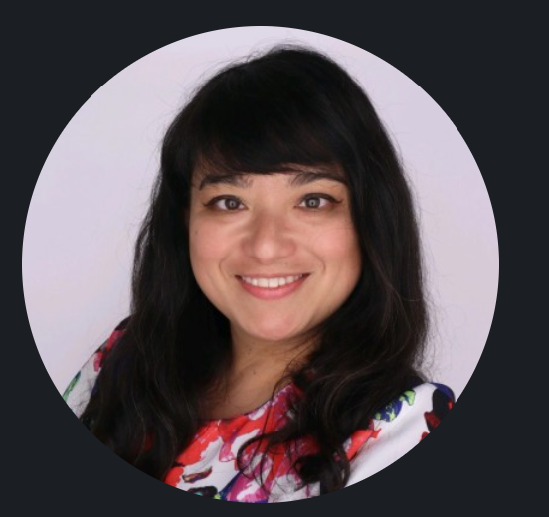
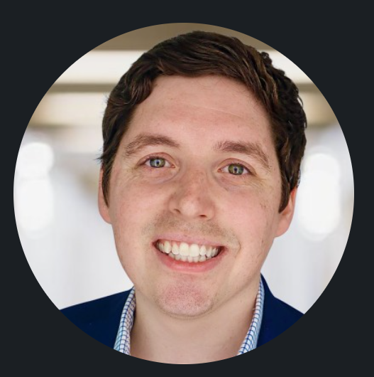
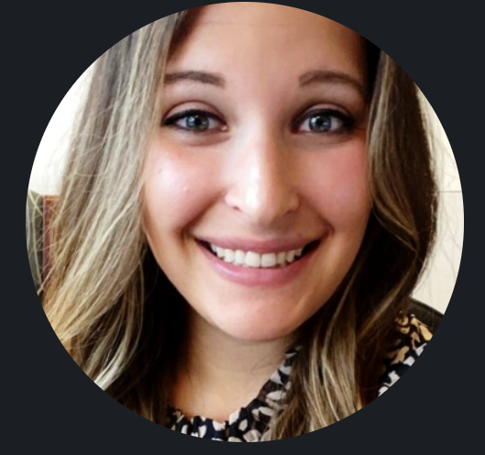
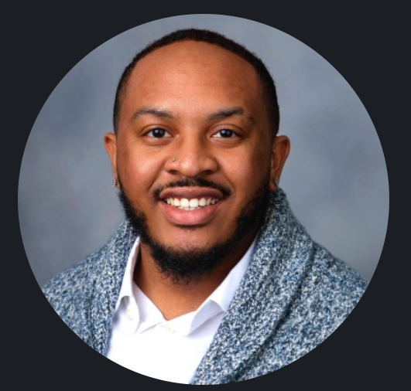
Who’s Joining Us
Engagement Staff
Presenters: The Purdue Brand Studio
Almira “Sugar” Yllana
Alumni Engagement Officer
PFLF Engagement
Teresa Walker
Lead Marketing Strategist
Kolby Lybarger
Social Media Specialist
Braden Vorhees
Alumni Engagement Specialist
PFLF Engagement
Presenter: Broad Based Campaigns
Joshua Ford
Alumni Engagement Officer
PFLF Engagement
Alyssa Collevechio Crawford
Campaign Strategy Advisor
PFLF Engagement

Slide 5
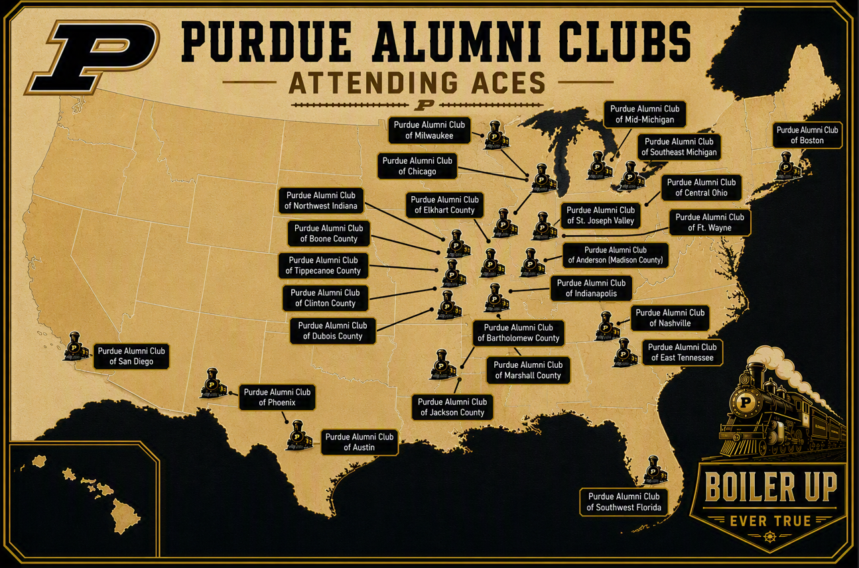
26 Clubs

Slide 6
In Attendance
  Anderson/Madison County: Michael Sheward (Vice President)
  Austin: Cindy Chen Derkacz (President)
  Bartholomew County: Jeffrey Daiker (Co-President), Lora Miller (Co-President)
  Boone County: Ken Kitts (President), Matt Watkins (Events Coordinator, Attending Virtually)
  Boston: Raj Melkote (Scholarship Chair)
  Central Ohio: Jackie Grimm (Vice President)
  Chicago: Meagan Pluckebaum (Secretary)
  Clinton County: Baylee Neff (Secretary, Attending Virtually), Bob Thorley (Board Member)
  DuBois County: Craig Knies (President)
  East Tennessee: Kim Bonczek (President), Richard Bonczek (VP/Scholarship)
  Elkhart: Mike Tomko (President)
  Fort Wayne: Wayne Funk
  Indianapolis: Kendra Lewis (President), Missy Lewis Deeter (Treasurer, Attending Virtually)
  Jackson County: Cary Bell (Co-President), Mary Lou Siefker (Co-President), Dale Siekfer (Board Member)
  Marshall County: Melissa Christiansen (Treasurer)
  Mid Michigan: Marie Hernandez (Scholarship Chair)
  Milwaukee: Allen Gillette (Scholarship Chair)
  Nashville: Shawn Sullivan (President), Lauren Price (Vice President), Anne Shields (Philanthropy/Scholarship Chair, Attending Virtually), Brian Shields (Philanthropy/Scholarship Chair, Attending Virtually)
  Northwest Indiana: Adam Hamernik (Vice President)
  Phoenix: Lauren Handwerk (President, Attending Virtually)
  Putnam County: Duane Huge (Volunteer), Jane Huge (Treasurer)
  San Diego: Doug Evans (Board Member, Attending Virtually)
  Southeast Michigan: Bob Feldmaier (Board Member)
  Southwest Florida: Beth Stickles-McDaniel (President)
  St. Joseph Valley: Nan Pinter McCartney (VP/Scholarship, Attending Virtually), Rebecca Lindenman (President, Attending Virtually)
  Tippecanoe County: Alison Stoddart (President), Susie Saberniak (Board Member), Logan Marshall (Social Media Chair)

Slide 7

Making the Most of Today’s Conversations
Think boldly, share openly: Explore ideas and envision new possibilities.
Learn from one another: Welcome diverse perspectives and contribute authentically.
Engage with purpose: Stay focused, participate actively, and make space for all voices. Be mindful not to dominate discussions.
Connect and collaborate: Exchange ideas, build relationships, and identify solutions to shared challenges.
Be respectful of the group: Keep comments concise, raise your hand to speak, and step outside for phone calls.
Build lasting connections – Before you leave, exchange contact information with leaders you'd like to collaborate with or learn from.
Thank you!
Notes:
Restroom locations

Slide 8
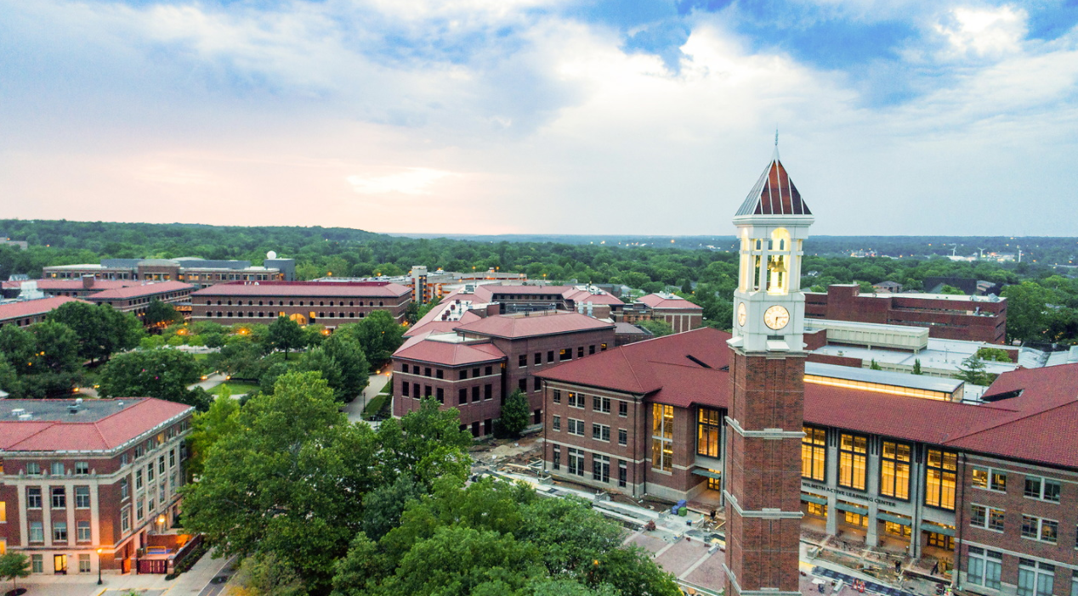
Strategic Session – 1:30 am - 2:20 pm
SESSION HOST: LeAnne Williams
Strategic Plan Discussion: Goals and Events
  Survey Results
    Clubs Goals and Events
  Strategic Planning Document
  Group Discussion

Slide 9
Survey Results - Alumni Clubs
Overall, how would you describe the current health of your club?
Thriving = 4
Stable = 4
Growing = 0
Rebuilding = 2
General:
10 clubs submitted the online survey.
How do you prefer to hear from us?
  Emails
  Forum
  Club Leaders Facebook Group
  Newsletters
What are your board's top 3 priorities this year?
Recruit and onboard volunteers = 5
Communications and social media = 3
Membership engagement = 3
Young Alumni/GOLD engagement = 2
Scholarship fundraising = 2
Board development and succession = 2
Increase event attendance = 1
Increase Purdue for Life engagement = 1
Community partnerships = 0

Slide 10
Survey Results - Alumni Clubs
What is your club experiencing its strongest momentum?
Board collaboration = 6
Student send-offs and scholarship events = 6
General event attendance = 5
Athletic events and game watches = 5
Communications (email, newsletters, social media) = 2
Community partnerships = 1
Young alumni engagement = 1
Signature fundraising events = 0
Volunteer recruitment = 0
Where is your club experiencing its strongest momentum?
Dinner with speakers
Student Send-offs

Slide 11
Survey Results - Alumni Clubs
What is one thing your club does especially well that you think other clubs could adopt?
Monthly board meetings to maintain momentum and keep focus
Partnering with other alumni groups
Silent Auction fundraising
Annual dinner with Purdue speaker
Scholarship fundraising dinner
Invite former scholarship winner to sit on selection committee, represent club at awards ceremonies
Quarterly newsletter: upcoming events and club news.
Started a young alumni club
Event planning and ability to coordinate events.

Slide 12
Survey Results - Alumni Clubs
Looking at the goals, your board has set for this year, where do you feel the biggest gap in resources lie? What specific assets or training from the Alumni Clubs Team would help you close the gap?
Event planning & management
Boards: Recruiting, onboarding new volunteers, setting up subcommittees.
Communications
Time management: emails, social media, event pages
Help create positive impact of emails, events, social media
Highlighting Volunteerism
Visibility of Club operations – recruiting new board members and alumni support/engagement
Reaching alumni in area
Targeting GOLD audience

Slide 13
Survey Results - Alumni Clubs
What are your best practices for your board to recruit and retain volunteers?
Work on getting to know event participants outside usual cycle
Notifications through social media and event reminders to reach Alumni
Sending out emails, mentioning at events
Seeking volunteers at any opportunity availability
Hosting board meetings every 6-8 weeks via Zoom
Overall, everyone is expressing struggles with this process
What specific initiatives or new ideas are you most excited to implement this year & how do you plan to do this?
Trying new location for events
Adding a new communications coordinator to improve social media presence
Adding business networking events showcasing Alumni start ups
More collaborations with other schools
Streamlined game watch planning and attendance
More family friendly events

Slide 14
Survey Results - Alumni Clubs
Which annual events are you planning on hosting per quarter? (August-September)
Student Send-offs
Farmers Market
Outreach Events
Beer garden
Symphony on the Prairie
Tickets for basketball games
Which annual events are you planning on hosting per quarter? (October-December)
Football game watch
Community events
Annual Holiday Party
Basketball game watch
Parades
Volunteer opportunities (Bell Ringing, Gift Wrapping)
Alumni luncheon
Wreath making
Dinners

Slide 15
Survey Results - Alumni Clubs
Which annual events are you planning on hosting per quarter? (January-March)
Call-out
Basketball game watch
Annual fundraising dinners
Tickets to professional sports events
Which annual events are you planning on hosting per quarter? (April-June)
Scholarship awards
Volunteer/Community events
Dinners with guest speakers
Annual meetings
Scholarship fundraising dinners
Family focused events (picnic, bowling, zoos, Connor Prairie)
Student send-offs
Symphony on the Prairie
Marathons

Slide 16
Survey Results - Alumni Clubs
Social Media:
What platform(s) does your club currently use:
  Facebook
  LinkedIn
  Instagram
  WhatsApp
Which social media platform would your club like to start using?
  Instagram
  LinkedIn
Which social media training topics would be most helpful?
  Reaching young Alumni = 6
  Meta/Facebook Tools = 4
  Engagement = 4
  Content planning = 4
  Analytics = 3
  Instagram Best Practices = 3
  LinkedIn = 2
  WhatsApp/Messenger Communities = 0
Request: Be provided with Social Media templates throughout the year.

Slide 17
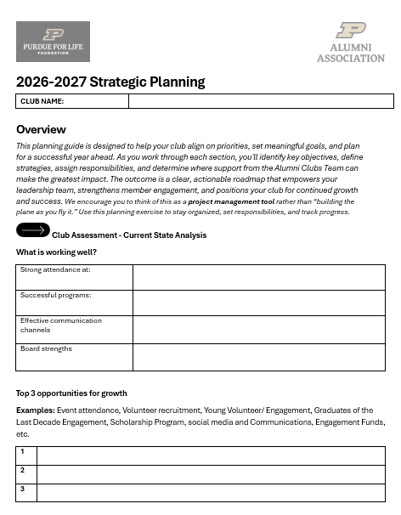
Strategic Planning Document
Recommended Approach
Document: Record goals, opportunities, events, challenges, assign responsibilities and action items throughout the year
Track Progress: Update regularly with notes, accomplishments, and next steps.
Collaborate: Leverage board and member expertise to refine ideas and solve challenges.
Review & Update: Revisit the plan throughout the year to keep efforts aligned and on track.
Benefits
✅ Creates strategic focus and accountability
✅ Improves member engagement and club growth
✅ Strengthens event planning and execution
✅ Supports leadership continuity and succession planning
✅ Simplifies onboarding for new board members
✅ Maintains both short-term priorities and long-term vision
Outcome: A clear, actionable roadmap that helps your club stay organized, aligned, and positioned for sustained success.

Slide 18
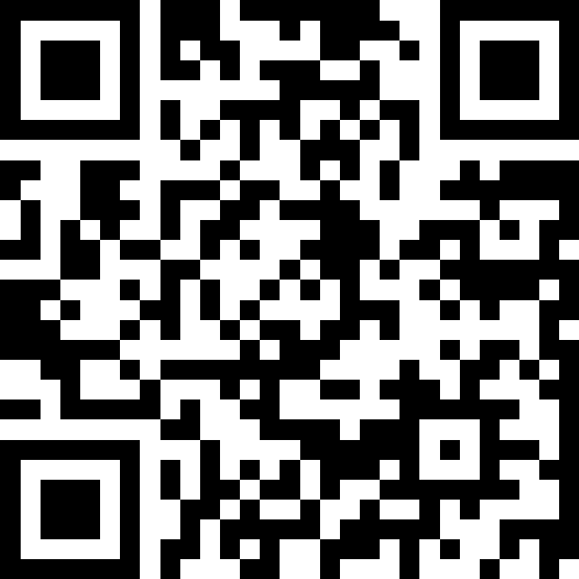
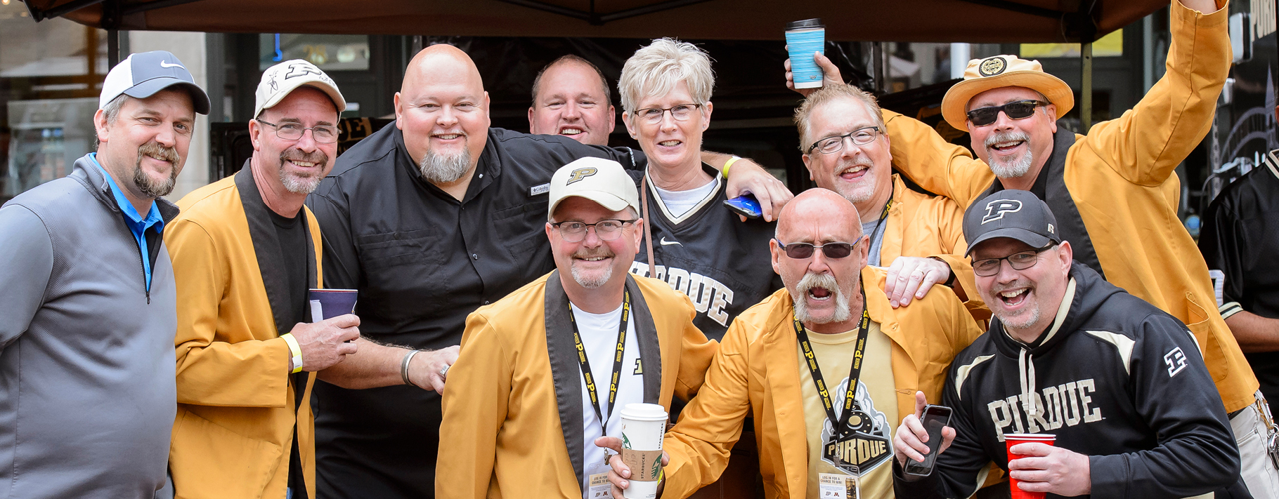
Goals and Events: Survey Says

Slide 19
Alumni Clubs
Group Discussion
What is one successful strategy your club uses that others could adopt?
What is your biggest opportunity for growth this year?
How do you identify what alumni want, and what has helped increase attendance?
What challenges could prevent you from reaching your goals?
What are your top three action items for the next 90 days?
All - How can the Alumni Clubs Team best support your success?
Notes:
BREAKOUT THE TIME – PRESENTATION/DISCUSSION
What is one successful strategy your club uses that other clubs could replicate?
Where do you see the greatest opportunity to build momentum over the next 12 months?
How do you determine what events alumni want? What strategies have increased attendance or participation?
What barriers could prevent you from achieving these goals?
What are the next three actions you will take within the next 90 days?
How can the Alumni Clubs Team help accelerate progress?

Slide 20
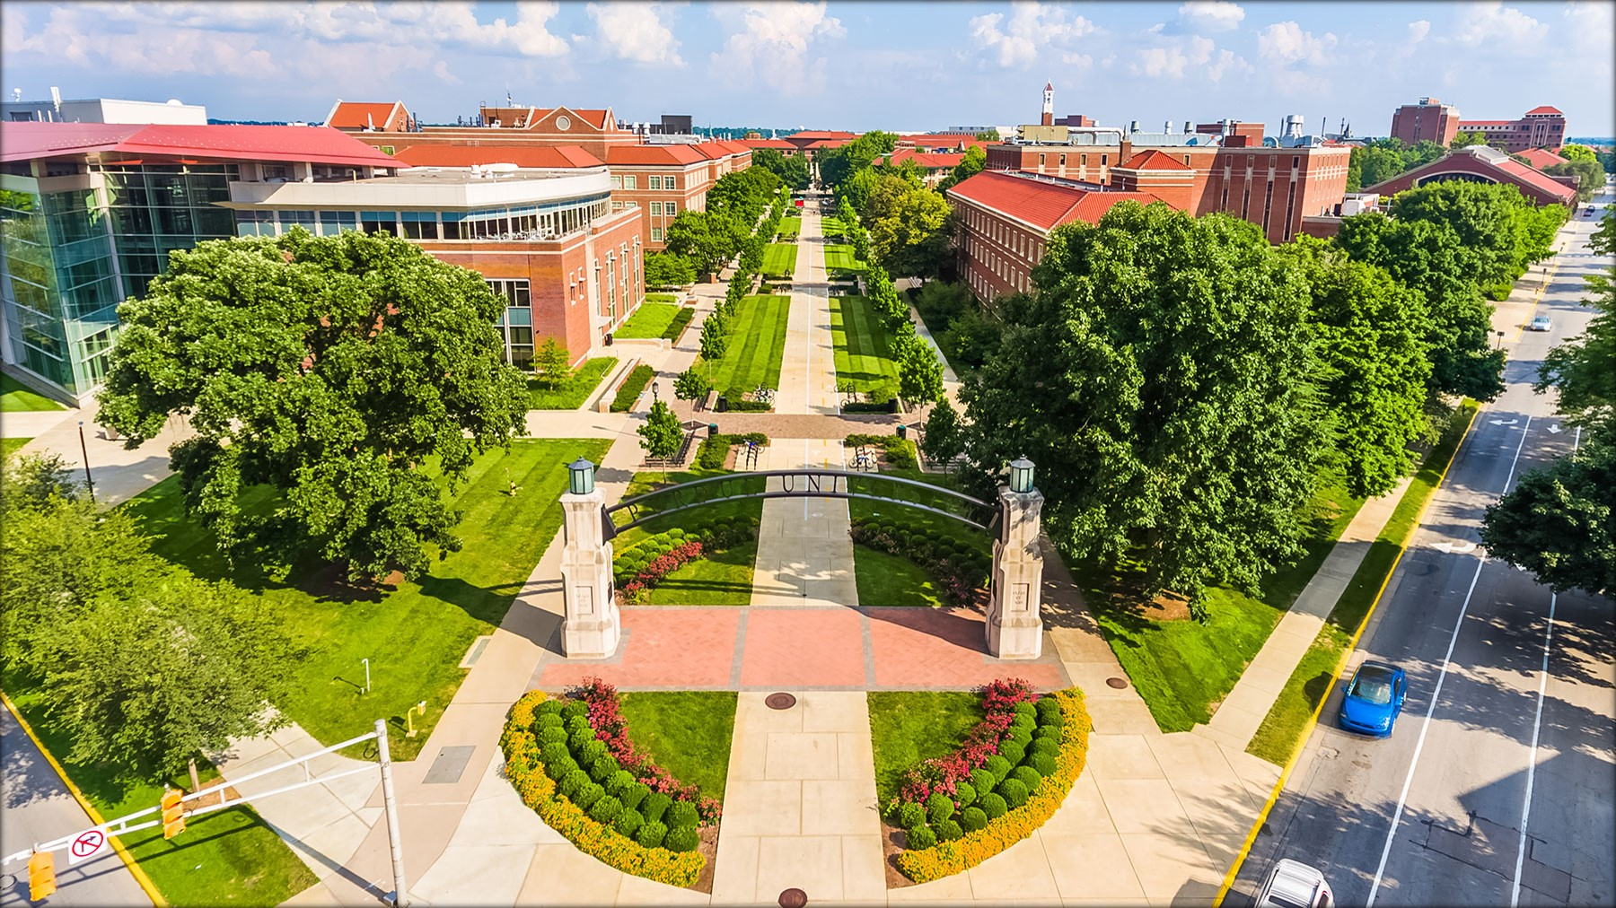
Break – 2:20pm - 2:30 pm

Slide 21
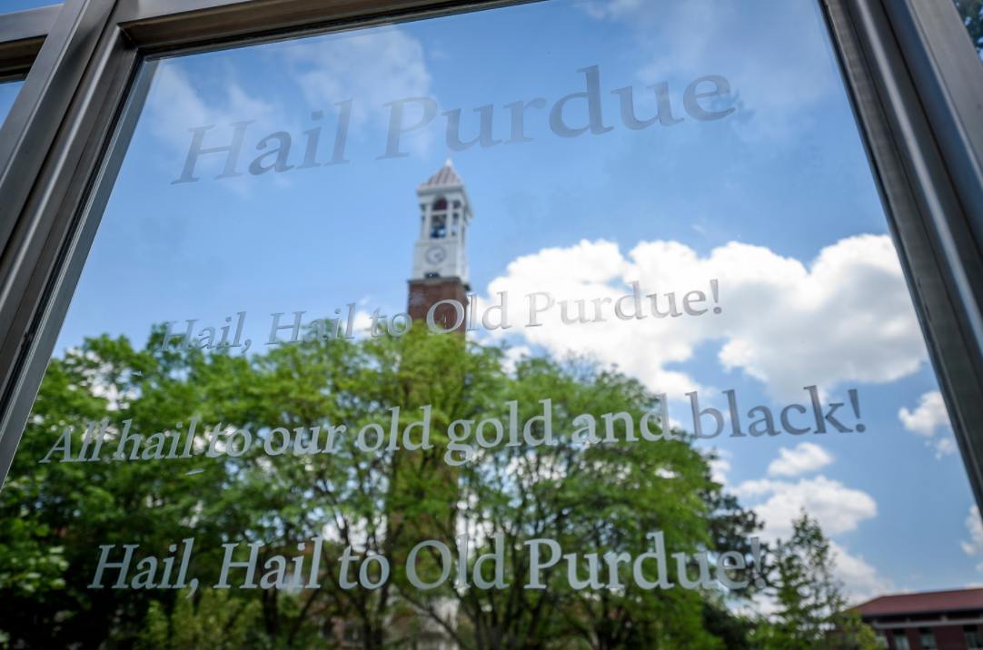
Strategic Session – 2:30 pm-3:20 pm
SESSION HOST: Ilenia and Darien
Engagement - Attracting Young Alumni & Graduates of the Last Decade (GOLD) Constituents
  Survey
    Student & GOLD – What’s their priorities
  Student, Young Alumni and GOLD Stats and Best Practices
  Group Discussion

Slide 22
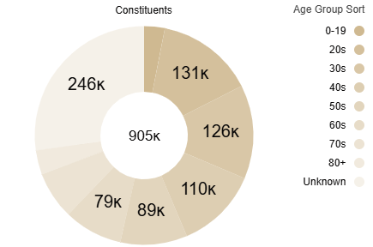
Alumni, Fans and Friends Statistics by Age
Opportunity: 257K Young Alumni and GOLD

Slide 23
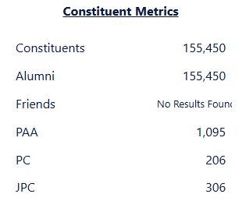
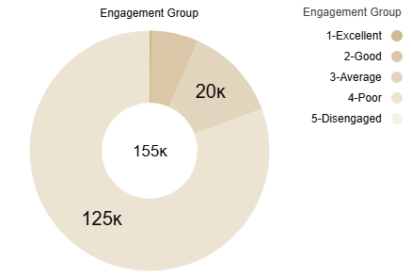
Graduates of the Last Decade Statistics
60+ - # Alumni Clubs in the USA and Puerto Rico (7/30/26)

Slide 24
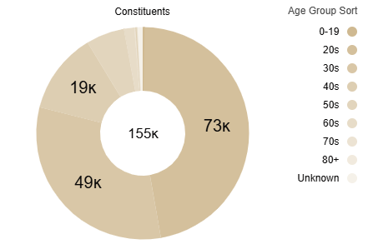
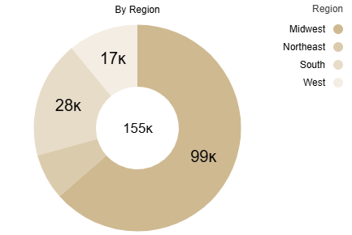
Graduates of the Last Decade Statistics
60+ - # Alumni Clubs in the USA and Puerto Rico (7/30/26)
Notes:
63 Clubs

Slide 25
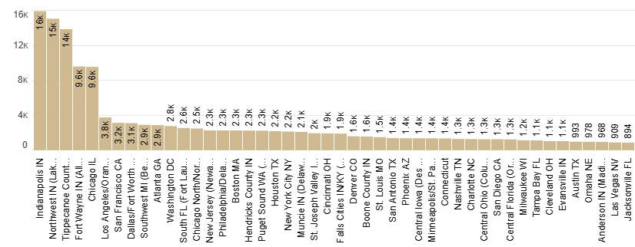
GOLD Stats – Constituents by Alumni Club
60+ - # Alumni Clubs in the USA and Puerto Rico (7/30/26)

Slide 26
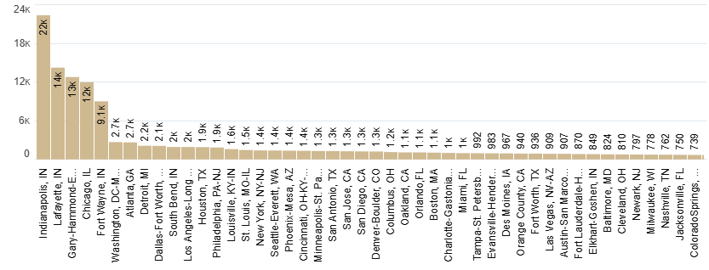
GOLD Stats – Count by City (7/30/26)

Slide 27
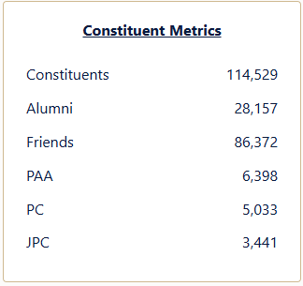
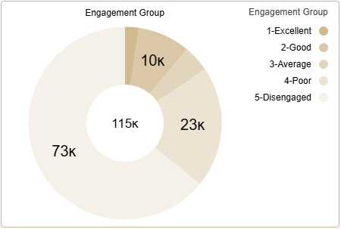
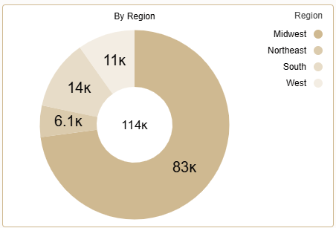
Don’t Forget about Parents and Purdue Friends
By the Numbers
The Opportunity
Where are They?
Note: Data from current students only, not admitted students
Benefits
Potential Board Members
Scholarship Fundraising and Promotion
Increase attendance to events

Slide 28
Engagement Best Practices
.
Shift from transactional networking to relationship building. Foster genuine, personable interactions between alumni, fans, parents, friends and students
  ✅ Designate Board “Connectors”
✅ Make People Feel Seen
and Valued
✅ Facilitate Deeper Connections
  During club events, assign 1–2 board members to engage attendees and build connections
  Don’t ask them to join the Board immediately
Take time to get to know attendees as a person, what they value in their Purdue experience. Relationships, and associations
Don’t make assumptions about people
Make meaningful introductions.
Identify shared interests, experiences, or connections among attendees.
Encourage conversations that go beyond small talk and foster lasting relationships.

Slide 29

Once You’ve Met Attendees – Push Forward
Keeping in Touch:
✅ Once you've established rapport and had genuine conversations, ask for their email or phone number. Safer Option: Send a LinkedIn Connect request rather than "Follow" to ensure they receive a notification with your name.
✅ Critical: Follow up promptly with a personalized message to continue the connection.
    Message Example
    Great to meet today at <Club Event Name>. I see we have mutual connections/You are in LinkedIn. Please accept this invite to stay connected. Hail Purdue!
✅ After the connection is accepted, check-in on occasion. You can mention upcoming events and ask if they are coming.
Notes:
Micro-Volunteerism – NYC Club/Brooklyn plant a garden on a weekend – # attendees?

Slide 30
Engagement Best Practices: Keeping it Simple
Calls to Action
Events
  ✅ Ask them to follow the Club on Social Media and follow them back
  ✅ Add them to messaging app (WhatsApp, Slack). Add them to your personal social media
  ✅ Discuss upcoming events and see what interest them
  ✅ Offer to connect them with others based on discussions
Go back to Basics: Host “Bring a Friend” Mixer or “New Member” Coffee Chat
Coffee & Tee Meet-Ups: Perfect for the weekends
Leverage Local Community Educational Free Programming
    Lectures, field trips, book clubs, and recreational activities. Check your local libraries!
Hikes (GOLD and Family Friendly)
      Local Forest Preserves often have free hikes
Notes:
Micro-Volunteerism – NYC Club/Brooklyn plant a garden on a weekend – # attendees?

Slide 31
Engagement Best Practices
Micro-Volunteerism
Volunteering is one of the strongest indicators of alumni connection, commitment, and giving:
82% of alumni are philanthropic
  Only 36% have ever volunteered for their alma mater
  10% have volunteered within the past year.
Alumni who volunteer are 8 times more likely to report feeling very connected to their institution.
The future volunteer pipeline is strong:
  1 in 5 alumni indicate they are likely to volunteer
  74% of recent volunteers want to volunteer again.
They seek volunteer experiences that:
  Leverage their expertise, demonstrate measurable impact, and respect the realities of their time.
  Are high-impact opportunities such as mentoring students, serving as career advisors, or contributing specialized skills create stronger connections and greater satisfaction
Source: CASE 2026 National Alumni Survey
✅ 1.5 to 2 Hours: ideal time window people are willing to dedicate to a meaningful cause or interest
✅ Host a Local Day of Service: Organized community volunteer projects that allow alumni to give back locally while representing Yale values
✅ Include Post-Event Socializing: Host and promote an informal social gathering (e.g., pizza or sandwiches) immediately after volunteering.
Notes:
Micro-Volunteerism – NYC Club/Brooklyn plant a garden on a weekend – # attendees?
CASE – Council for the advancement and support of education

Slide 32
Engagement Best Practices
✅ Partner with Existing Groups
✅ Tips for Parents
Joint programming with peer institutions for critical mass and broader networks
Big Ten Partnerships: Host joint events or friendly rivalries with peer B1G clubs (watch parties, food drives, fundraising challenges).
Tradition Networks: Engage alumni tied to lifelong student organizations (Greek life, band, student government, honor societies).
Partner with Affinity Networks
Engage Parents on Social Media
Campus Events: Share traditional and signature campus happenings
Academic & Student Cycle Reminders: Feature timely info like housing deadlines, transit options, and care packages
  Inclusive Messaging: Use official communications (newsletters, emails) to explicitly welcome parents—especially to Game Watches.

Slide 33
Students, Young Alumni & Gold Engagement
Highlight the value of alumni connection through targeted programs and messaging.
Event Ideas
Host networking sessions, coffee meet ups or dinners s for young alumni and current students to encourage participation and networking (Club could ask for alumni/friends to sponsor the dinner to minimize costs)
Invite interns or local students (email comms/social media) with a purpose – Summer Intern Mixer, Focus Group to ideate, Jr. Board members for the Summer, etc.
Engage with local high schools to recognize outstanding students, creating recruitment pipelines, promote scholarships and community relationships.
Priorities
✅ Health and Wellness - Host a Yoga class, rally a group for a local 5K, etc.
✅ Career Advancement – Connect Alumni by industry, affinity or career stage,

Slide 34
Ways to Attract Young Alumni & Gold
Conversation → Connection → Trust → Attendance → Membership → Volunteer Leadership
Lead with Conversations, Not Recruitment
❌ Instead of Saying...
"Would you like to become a member?"
"Can I tell you about membership?"
"Here's everything our club does."
"We need volunteers."
✅ Try Saying...
"What brought you out today?"
"When did you graduate?"
"What have you been up to since Purdue?"
"What kind of events would actually interest you?"

Slide 35
Group Discussion
What are some early engagement programming, resources or messaging that would introduce students to see the value of engaging alumni communities?
Why do you think some young alumni hesitate to get involved, and how can a genuine conversation help overcome those barriers?
What are your top three action items for the next 90 days?

Slide 36
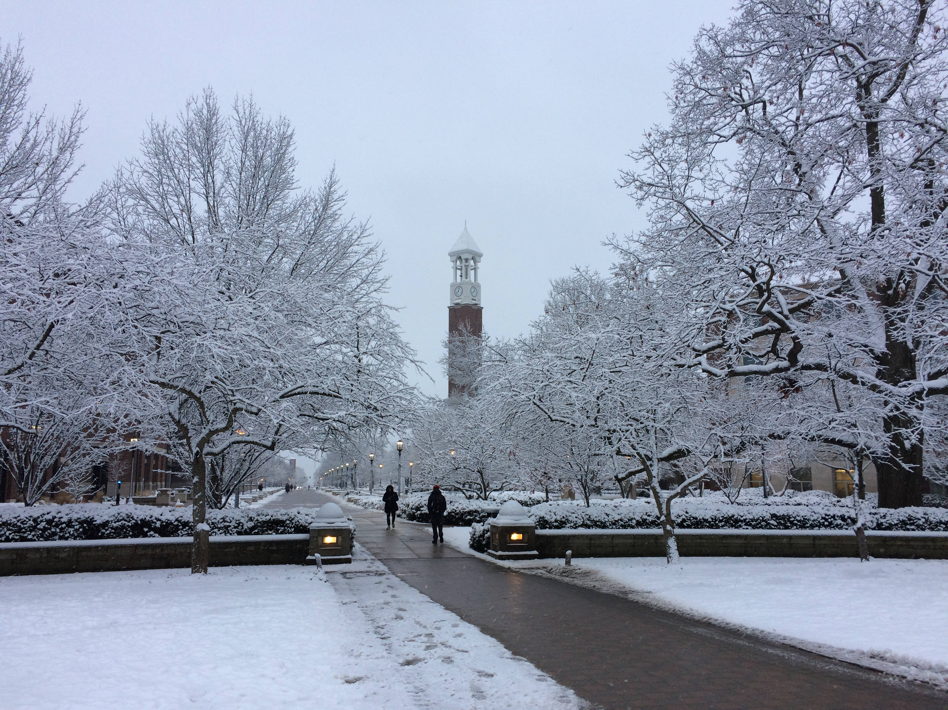
Break – 3:20pm - 3:30pm

Slide 37
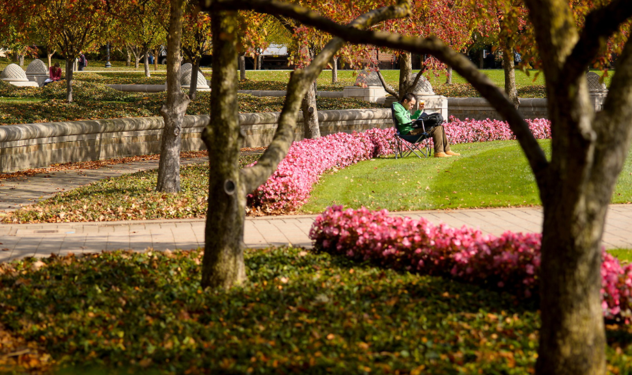
Strategic Session – 3:30 pm - 4:20 pm
High Performing Clubs: Opportunities & Problem-Solving Session
SESSION HOST: LeAnne
Harness the collective knowledge, experience, and creativity of the group to generate practical solutions to a shared challenge.

Slide 38
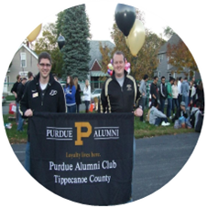
High Performing Clubs: Problem-Solving Session
Overview
Participants will work in small groups to tackle a shared challenge. Teams will discuss the problem, generate ideas, and capture their solutions on Post-it notes for collective review and discussion.
Process
Review the problem statement on your table.
Brainstorm solutions in small groups.
Write one idea per Post-it note.
Post and review ideas from all groups.
Identify common themes and top recommendations.
Virtual Participants: will receive their own problem statement (all in 1 group)
Outcome
A collection of actionable ideas generated through diverse perspectives and collaborative thinking.
How it Works
Notes:
LeAnne to come up with topics and print
Increasing attendance to Events
Increasing PAA membership for engagement dollars
Scholarship Fundraising
Attracting and Retaining Younger Alumni

Slide 39
High Performing Clubs: Problem-Solving Session
Pick from one of these topics to discuss at your table and share out:
Topic 1: Programming & Events
Developing unique or signature annual events
Creating events that appeal to multiple generations
Balancing social, professional, service, and family-friendly programming
Partnering with other Purdue Alumni Clubs or Big Ten alumni groups
Hosting successful virtual or hybrid events
Increasing community service and volunteer opportunities
Building relationships with local businesses
Partnering with Purdue colleges, affinity networks, and regional organizations
Creating meaningful networking opportunities for alumni
Topic 2: Membership & Engagement
Increasing event attendance and participation
Converting event attendees into active volunteers
Recruiting new board members and succession planning
Retaining long-term volunteers and preventing burnout
Re-engaging inactive alumni
Topic 3: Communications & Marketing
Growing email engagement and reducing unsubscribes
Social media strategies that actually increase attendance
Reaching alumni who are new to the area
Using storytelling to showcase club impact
Creating effective event promotions on a limited budget
Table Work
Topic 4: Student & University Connections
Strengthening student send-off events
Increasing mentorship opportunities for students and recent graduates
Connecting alumni with current Purdue initiatives
Engaging parents of current and incoming students
Supporting admitted student and yield events
Topic 5: Fundraising & Financial Sustainability
Scholarship fundraising ideas beyond traditional events
Securing corporate sponsorships and community partnerships
Identifying grant or matching gift opportunities
Building long-term financial sustainability
Topic 6: Leadership & Club Operations
Board recruitment and leadership transitions
Defining volunteer roles and responsibilities
Managing club finances and budgets
Measuring success with meaningful metrics
Building an inclusive and welcoming club culture
Notes:
LeAnne to come up with topics and print
Increasing attendance to Events
Increasing PAA membership for engagement dollars
Scholarship Fundraising
Attracting and Retaining Younger Alumni

Slide 40
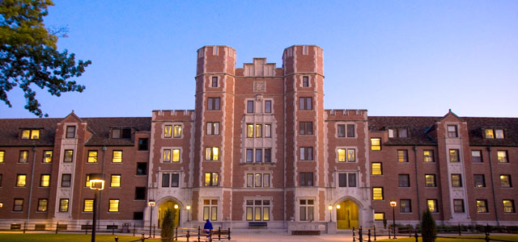
Wrap-Up – Day 2 Agenda / Expectations
8:30-9:45am: Breakfast, Social Time & Recognition/Awards
10:00-10:50am: Tools & Resources Update
11:00-11:50am: Story Telling Your Club’s Impact by The Purdue Brand Studio
  Presenters: Teresa Walker and Kolby Lybarger
11:50am–12:15pm: Lunch Buffet, Networking and Seating
12:15pm-1:30pm: Social Media & Crowdfunding
  12:15pm-1pm: Let's Talk Social - Strategies That Work – Darien Thompson
  1pm-1:30pm: Crowdfunding - Presenters: Alyssa Collevechio Crawford
1:30-2:30pm: Optional Networking and Q&A
Meetings requested during ACES registration have been arranged • Friendly reminder to meet with your assigned Alumni Club Team member on Thursday afternoon.

Slide 41
Other Reminders
1:1 Meetings Requested during ACES registration - August 6 (PM): Please connect with your assigned Alumni Club Team member.
Engagement Funds Available for Eligible Travel Expenses
Conference-related expenses: hotel, meals, and transportation. Alcohol is not eligible
Up to $150 per in-state traveler/Up to $300 per out-of-state traveler
Post-ACES Action Items:
Itemized receipts should be uploaded through the bank statement portal
Survey
  Feedback on ACES programming and logistics
  Submit 2 board member to access:
    Canva Templates
    New Club Inbox @purdueforlife.org access – President and a Board Member managing comms
  Sign up for PEFCU banking and Club Leaders Dashboard access

Slide 42
Activities through December
AUGUST
ACES
SEPTEMBER
Best Practices & Football
OCTOBER
Scholarship & End of Year Planning
NOVEMBER Homecoming Scholarships
DECEMBER
Purdue Winter Recess
Student Events
Post ACES
Survey
Newsletter - Week 8/17
Aug. 18–22, 2026
Boiler Gold Rush
Task Force
Restart/Meetings
Recognition Program
August funds processing will begin
September 16 - 202 Brainshare Agenda
Event Showcase
Engagement Ideas
September 19 PFLF Tailgate Purdue vs. UCLA
West Coast and Arizona Clubs
Dauch Football Tailgates
September 26: Alumni Clubs Saturday
2 hours prior to game time
How to start an Endowment – October 28 Forum
Event Submission Reminder
Game Watches Submit Monday’s by Noon
New - Scholarship Committee Training
Recognition Program Check
Scholarships
Forum process, timelines and actions
Winter Recess reimbursements
Thanksgiving
Closed Nov. 26-27*
Scholarship Applications
Go-live: Dec. 1
PACT Newsletter (No Forum)
Week of December 7
PFLF Year End Closing
Dec. 24th to January 1st.*
Deadline to submit event, email requests by December 11*. 5PM
JANUARY 2027
Brain Share #2 Wed. January 20
* Tentative dates
Notes:
Denise will add dates in Outlook for Team
Reminder

Slide 43
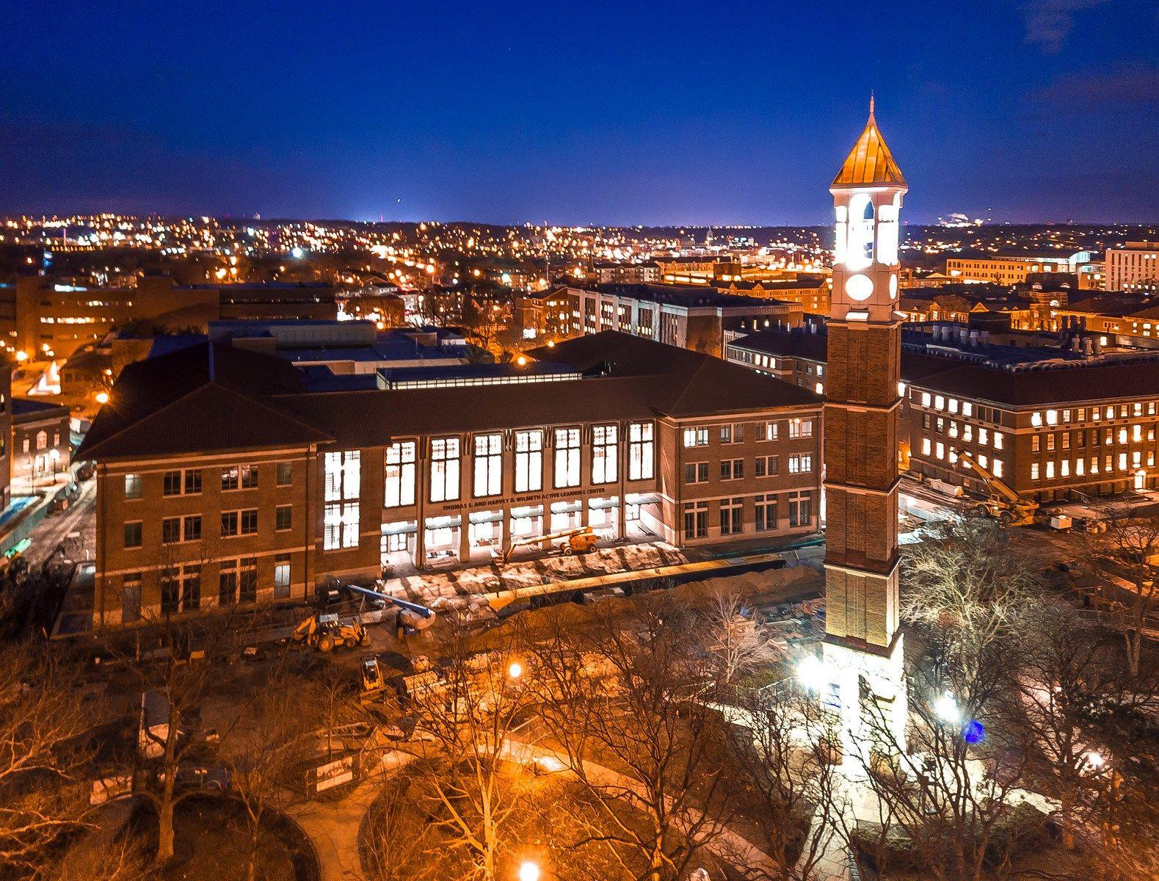
Up Next: Social Hour (5:30–6:30 PM)
Group Photo
Special Guests:
Trevor Peters - Director, Issues and Reputation Management; University Spokesperson, Purdue University
John Norberg - Journalist - Historian , 2025 Distinguished Boilermaker Award
Carrie Gurnell - Director of Volleyball Operations, Purdue Athletics
Nicholas Terruso - Director Of Technology, Purdue Athletics
Dave Shondell - Purdue Volleyball Head Coach, Purdue Athletics
Purdue Pete
Thank You for Joining us Today!

