Slide 1
Welcome to Advancing Club Engagement and Strategy (ACES)
August 5, 2026

Slide 2
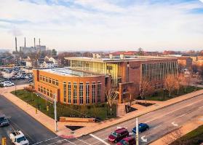
Good Afternoon
Welcome to the Dauch Alumni Center
Please grab snacks and settle in
Say hello and network with new and familiar faces

Slide 3
August 5 Agenda
    Noon – 1:00pm: Arrivals and Networking
    1:00-1:30pm: Welcome. Introductions and Agenda
    1:30-2:20pm: Goals and Events Discussion
    2:30-3:20pm: Engagement Best Practices. Focus: Young Alumni & GOLD
    3:30-4:20pm: High Performing Clubs: Opportunities & Problem-Solving Session
    4:30-4:45pm: Wrap-up; Day 2 agenda/expectations
    5:30–6:30pm: PM Social Hour (Dauch Patio)

Slide 4
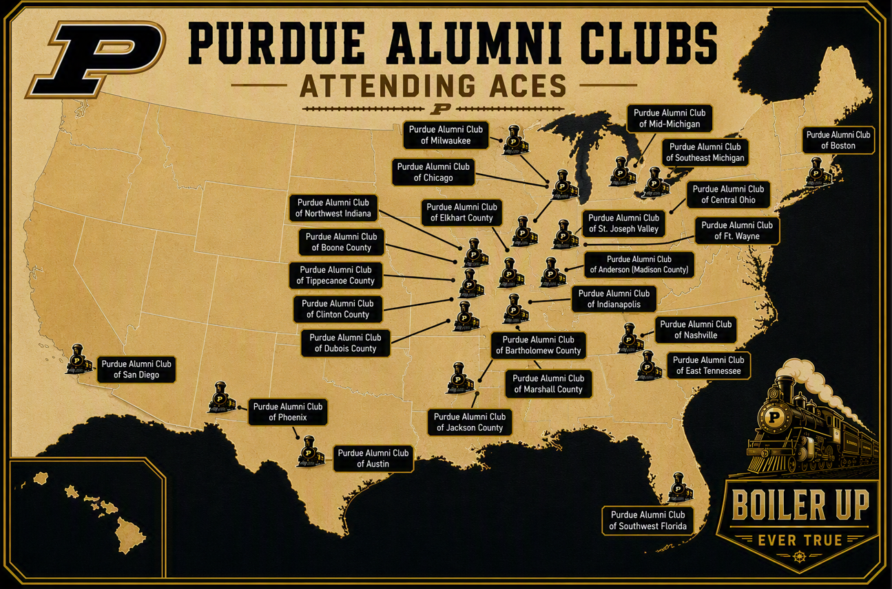
26 Clubs

Slide 5
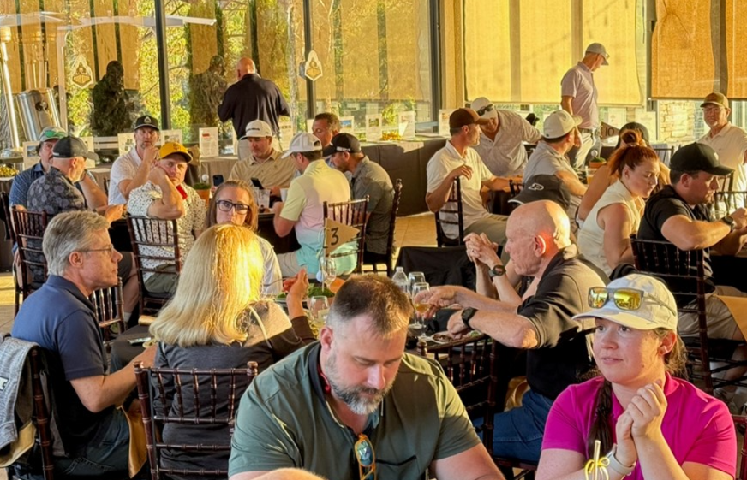
Getting to Know Your Fellow Club Leaders
Conversation Starters
If you had to pick one Purdue tradition to introduce to someone new to campus, what would it be?
What was your personal highlight from the club last year?
What inspired you to join the board?

Slide 6

Game Watches
    Tentative Email Send dates for fall are:
        August 26
        September 16
        October 14
        November 11
        December 16
    Website updates are due Monday prior to the email send date
      Use the email and event request form. Select Game Watch
        Submission Mondays by NOON ET on these dates:
          August 24
          September 14
          October 12
          November 15
          December 14

Slide 7

Big Ten Blood Drive– August 27 to Dec. 5th
More Info Coming Up – Details: https://bigten.org/abbott/donate/

Slide 8

Dauch Football Saturdays are Back!
Join us for games, refreshments, and giveaways before heading over to Ross-Ade Stadium
Sept. 12th (Wake Forest) – Time: Noon
Sept 26th (Notre Dame) – Time: TBD
  Alumni Clubs are hosting!
Oct. 10th (Minnesota) – Time: TBD
Nov. 21st (Wisconsin) – Time: TBD
Notes:
12:00-1:00 PM: Lunch, Recognition, Alumni Club Awards, Group Photo – Props
1:00-1:30 PM: Training
1:30-2:30 PM: Goals Discussion and Best Practice Sharing
2:30-3:00 PM: Debrief

Slide 9

Join Us for the Volunteer Appreciation Tailgate
Save the date for Friday, October 16,
ALUMNI APPRECIATION TAILGATE
2026 Dauch Alumni Center
Friday night game – 2 hours before game
More info to come!
Notes:
12:00-1:00 PM: Lunch, Recognition, Alumni Club Awards, Group Photo – Props
1:00-1:30 PM: Training
1:30-2:30 PM: Goals Discussion and Best Practice Sharing
2:30-3:00 PM: Debrief

Slide 10
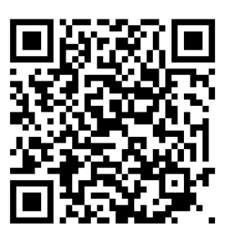
Lifelong Learning Reminders
Please visit the Lifelong learning page!
There are more than 500 online Ed2go courses to choose from.
There are hundreds of Purdue Online YouTube courses available at no cost
There are 100 online micro-credential and certificate courses available at no cost
https://www.purdueforlife.org/lifelong-learning/

Slide 11
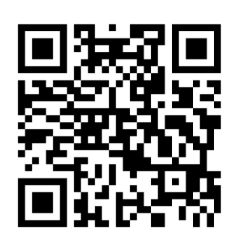



Homecoming information
NOVEMBER 5-7, 2026 – https://www.purdueforlife.org/homecoming/

Slide 12
Upcoming Purdue for Life Foundation Events
2026
2027
SEPTEMBER 13: PASE 5K COLOR RUN (WL)
OCTOBER 2: PURDUE GLOBAL GRADUATION
OCTOBER 30: FALL PURDUE DAY OF SERVICE
NOVEMBER 5-7: HOMECOMING
NOVEMBER 26-29: THANKSGIVING BREAK
DECEMBER 5: PASE FLASH MENTORING (Virtual)
DECEMBER: CAPS-OFF GRADUATES CELEBRATION
DECEMBER 24-JANUARY 3*: WINTER RECESS
FEBRUARY 10-13: NAPLES
FEBRUARY 27: BOILERMAKER BALL
MARCH: PASE ALUMNI DINNER
APRIL 28: PURDUE DAY OF SERVICE (PDOG)
MAY: CAPS OFF GRADUATES CELEBRATION
JULY 2026: GRANDPARENTS UNIVERSITY
AUGUST: BOILER GOLD RUSH
FALL: WOMEN'S CONFERENCE BAY AREA

Slide 13

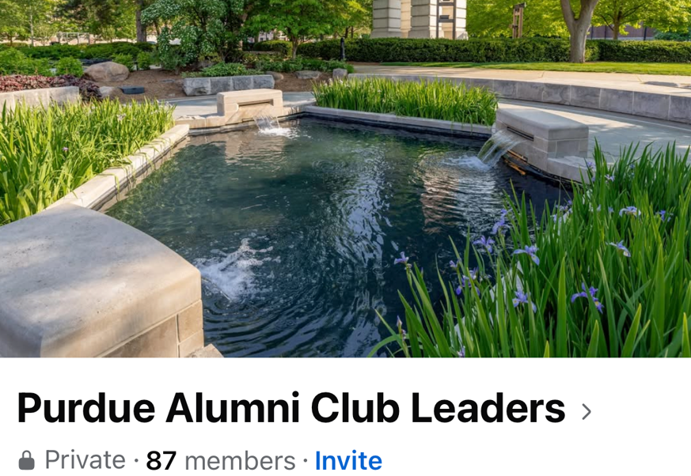
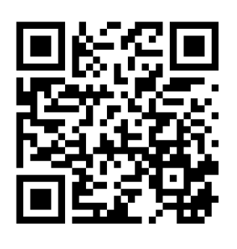
Join our Club Leaders Facebook Group
Don’t miss out: Join the Club Leaders Facebook page!
  Search for “Purdue Alumni Club Leaders”
  Click on “Join Group”
Notes:
12:00-1:00 PM: Lunch, Recognition, Alumni Club Awards, Group Photo – Props
1:00-1:30 PM: Training
1:30-2:30 PM: Goals Discussion and Best Practice Sharing
2:30-3:00 PM: Debrief

Slide 14


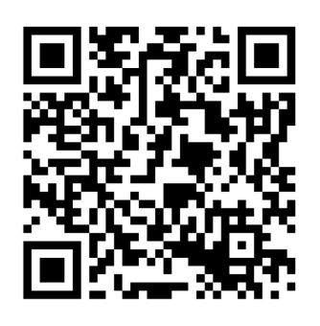
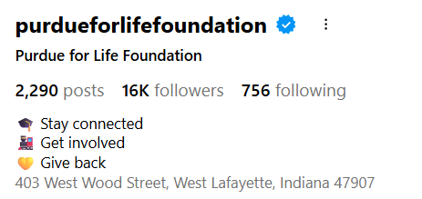
Follow Us on Instagram

Slide 15
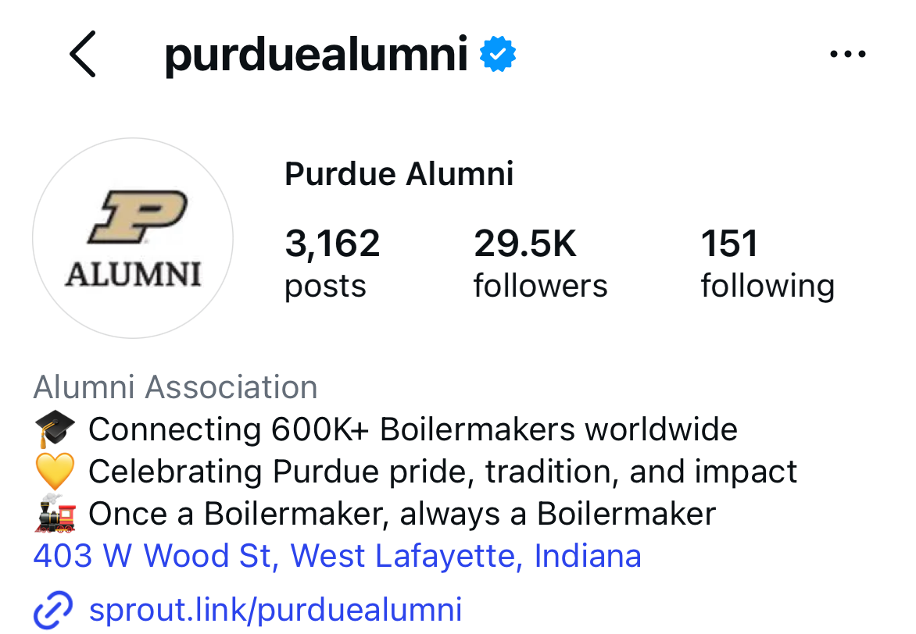
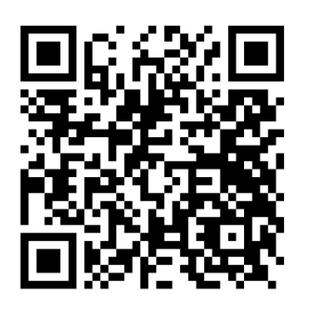
Follow Us on Instagram

Slide 16

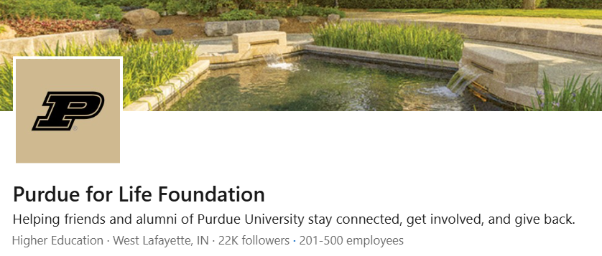
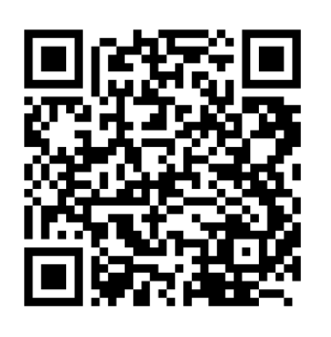
Follow Us on LinkedIn
Page link: Purdue for Life LinkedIn
Notes:
12:00-1:00 PM: Lunch, Recognition, Alumni Club Awards, Group Photo – Props
1:00-1:30 PM: Training
1:30-2:30 PM: Goals Discussion and Best Practice Sharing
2:30-3:00 PM: Debrief

Slide 17
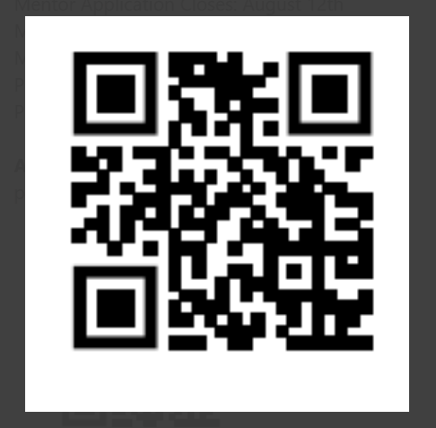
Sign Up to be a BoilerMentor
Be a Mentor / Sign Up to Be a Mentor
Our mentorship program connects current students with Purdue alumni who are passionate about supporting the next generation of Boilermakers. We’ve reimagined this experience to be more impactful, flexible, and rewarding for both you and your mentee by consolidating all programs into one. (Don't worry, we will match based on your interests/affiliations!) Your insights will help a student take their next giant leap with confidence.
Mentor Application Closes: August 12th
Mentee Application Closes: September 11th
Matching Period: September 11th - October 1st
Program Begins: October 5th
Program Ends: April 30th
Application link:
purdueforlife.org/mentorship-application.

Slide 18
Opportunities for Clubs to Support Students
Support Student Activities via PASE
PASE 5K Color Run - West Lafayette
Sunday, September 13, 10:00 am - 1:00 pm, Engineering Fountain
Seeking Alumni Volunteers to throw powder throughout the color run on campus.
PASE Flash Mentoring Session - Virtual
Saturday, December 5th
Mentor Purdue students through quick virtual sessions. Exact times still to be determined.
The PASE Board of Directors is currently working on several events to be held throughout the fall and spring semesters. More information to come via email in the coming months!
For questions, please email: PASE@purdueforlife.org

Slide 19

Join Us at the Travel Tailgate
Purdue vs. UCLA – September 19
Join fellow Boilermaker alumni, fans, and friends for an evening of great food, drinks, and Purdue spirit on the beautiful grounds of Brookside Golf Club at the Rose Bowl, located directly next to the stadium.
📅 Saturday, September 19 - 5:30–7:30 p.m. PT
🎉 Buffet dinner included, Bar service included
💲 Adults: $50/💲 Children (12 and under): $25
To register: https://lnkd.in/gY8TQ8SZ
🏟️ No game ticket required
⚠️ Space is limited, so reserve your spot today.
In collaboration with the Purdue Alumni Clubs of LA/OC, San Diego, San Francisco, Las Vegas, Oregon/SW Washington, Phoenix, Southern AZ and Puget Sound (Seattle area)

Slide 20

Purdue Travel Upcoming Opportunities
Visit: https://www.purdueforlife.org/travel/

Slide 21

Purdue Travel Upcoming Opportunities
Visit: https://www.purdueforlife.org/travel/

Slide 22

Purdue Travel Upcoming Opportunities
Visit: https://www.purdueforlife.org/travel/

Slide 23

Purdue Travel Upcoming Opportunities
Visit: https://www.purdueforlife.org/travel/

Slide 24
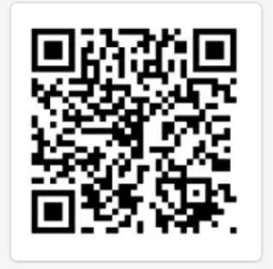
Interest in connecting with Fellow Leaders
Permission to Share Your Contact Info with Other Club Leaders
Scan the QR code if you agree to share this information with other Club Leaders for networking purposes and best practice sharing:
Name
Email
Phone Number

Slide 25
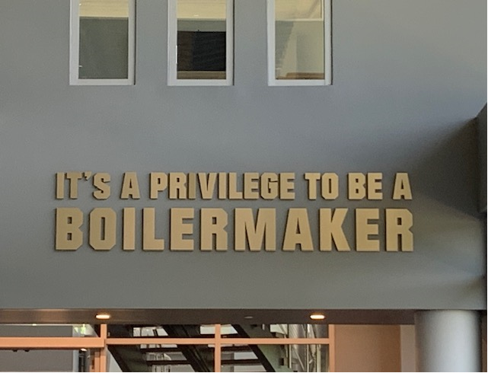

Thank you for joining us!

